Slide 1
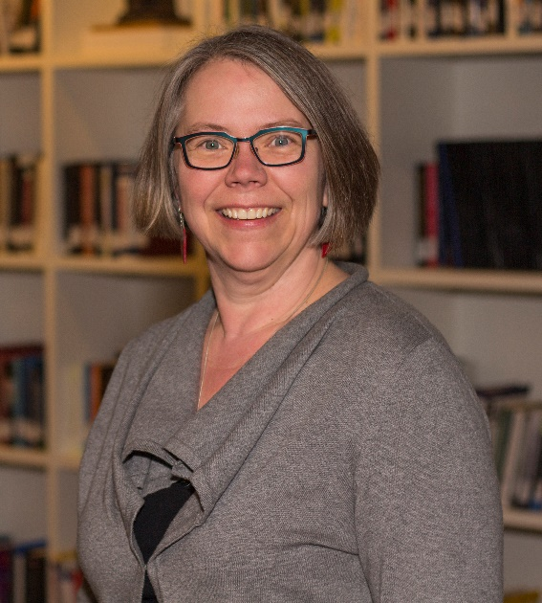
Supporting Student Learning with the Framework for Information Literacy
With Mary Mara, MLIS
Director of Library & Learning Resource Center
mmara@cityu.edu
Notes:
Welcome – my name is Mary Mara and I am the director of City University of Seattle’s Library & Learning Resource Center. I have a masters in library and information science from the University of Washington’s Information School, and I have worked within CityU’s library for nearly 15 years. My team has a strong history of collaborating with faculty to support student learning. Most recently we have been actively involved with CityU’s eLearning team and course managers on the development of exemplary online courses at CityU.

Slide 2

How can faculty increase students’ critical consumption of information?
Review CityU’s information literacy learning goal
Briefly compare ACRL IL standards versus framework
Share examples of ACRL framework integration in EAD 505: Adult Learning Theory
Notes:
The focus of today’s presentation is this: How can faculty help to increase students’ critical consumption of information?
As we move through today’s presentation, I will provide a brief overview of CityU’s approach to ensuring our graduates are information literate.
I will lead you through a comparison of the ACRL information literacy standards versus the updated information literacy framework. ACRL, by the way, is the Association of College and Research Libraries and is a division of the American Library Association.
And last, but not least, I will share a few examples of ways in which the ACRL framework is being used to support student learning and critical consumption of information in EAD 505 – CityU’s online course on adult learning theories and research in the MEd in Adult Education.

Slide 3
Questions
What types of information do students or graduates in your field need to know how to access, evaluate, and apply in order to solve problems and to be effective in the workplace?
How do students develop these skills?
Notes:
As we progress through this session, keep these questions in mind:
What types of information do students or graduates in your field need to know how to access, evaluate, and apply in order to solve problems, and to be effective in the workplace?
How do students develop these skills?
EAD 505 is designed with these questions in mind, with support for students woven throughout the course.

Slide 4
CityU Learning Goals (CULG3B): CityU graduates are able to find, access, evaluate and use information
Based in research on best practices for student learning – at point of need and in context
Collaborative endeavor between course managers, CityU librarians, and instructors
3 levels of integrated support and instruction at CityU
Commendations from NWCCU for CityU’s collaborative and integrated information literacy program
Fenster, L. (2005). Summary report on information literacy meetings for senior faculty. Seattle, WA: City University of Seattle. Retrieved from http://hdl.handle.net/20.500.11803/720
Notes:
Around 2004, CityU adopted an information literacy learning goal for all students that states our graduates will be able to find, access, evaluate, and use information to solve problems.
From the beginning, academic and library leaders collaborated to develop and implement the program.
The work involved a major paradigm shift from one-shot orientations and bibliographic sessions, thinly tied to required assignments, to an integrated program at students’ point-of-need.
Over time the program evolved into 3 levels of student support:
level 1 includes contact information for the program librarian in the Blackboard shell;
level 2 adds to the contact information through tutorials or how-to-guides that students may access on demand as they feel is needed;
and level 3 includes required instruction developed collaboratively with course managers that may be led by the program librarian or an instructor who feels confident with the activities designed and integrated into Blackboard.

Slide 5
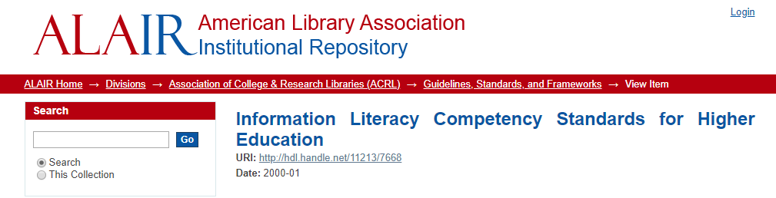
Find, Evaluate, Ethically Use Information
Example: The Information literate student constructs and implements effectively-designed search strategies.
Selects controlled vocabulary specific to a discipline or information retrieval system
Implements the search strategy in various systems, using different interfaces, with command languages, protocols and search parameters.
American Library Association (2000). Information literacy competency standards for higher education. Retrieved from http://www.ala.org/Template.cfm?Section=Home&template=%2FContentManagement%2FContentDisplay.cfm&ContentID=33553
Notes:
CityU’s program was grounded in ACRL’s 5 standards for information literacy. While the standards provided a good starting point for revising CityU’s approach, in many ways they continued to emphasize skill development over the application of concepts in what is an increasingly complex information environment.
On this slide, you can see one example of the skill-based focus of these standards.
We continued to notice that students believed they already had developed the skills necessary to locate and evaluate the information they needed, and that some faculty felt these skills should be acquired outside of course work.
At the same time, we heard that instructors were frustrated by the lack of quality information students used to support their work.
Five Standards:
Determine the nature and extent of their information need
Access the information effectively and efficiently,
Implement effective search strategies
Evaluate information and its sources critically, incorporating selected information into his or her knowledge base and value system
Understand the economic, legal, and social issues surrounding access to information, and using information ethically and legally

Slide 6
ACRL Information Literacy Framework
“Information literacy is the set of integrated abilities encompassing the reflective discovery of information, the understanding of how information is produced and valued, and the use of information in creating new knowledge and participating ethically in communities of learning.”
Association of College & Research Libraries (2016). Framework for information literacy for higher education. Retrieved from http://www.ala.org/acrl/sites/ala.org.acrl/files/content/issues/infolit/Framework_ILHE.pdf
Notes:
In 2016, ACRL moved away from the standards and adopted the Information Literacy Framework for Higher Education.
The framework is based on a cluster of interconnected core concepts, with flexible options for implementation, rather than on a set of standards or learning outcomes with a prescriptive list of skills to be developed.
This change is reflected in the updated definition for information literacy listed here that accompanies the framework.

Slide 7
ACRL Information Literacy Framework
Authority is constructed and contextual
Information creation as a process
Information has value
Research as inquiry
Scholarship as conversation
Searching as strategic exploration
Notes:
The framework is organized around 6 threshold concepts that you see listed here in alphabetical order.
Each concept includes an introductory paragraph, along with a list of knowledge practices, or demonstrations of ways in which learners can increase their understanding.
Each concept also includes a list of dispositions which describe the ways in which to address the affective, attitudinal, or valuing dimensions of learning.
The framework depends upon the idea that self-direction in a rapidly changing information environment is essential.
One aspect of the framework that I particularly like is that the framework is relevant for research novices as well as experts.
I have been working as a professional in the field of information science for 15 years, and there are still knowledge practices and dispositions which I personally feel I can continue to develop in.

Slide 8
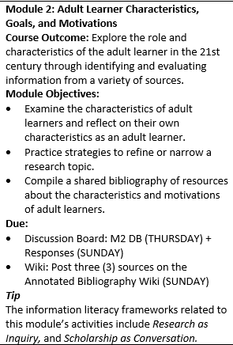
EAD 505 Adult Learning Theory
Framework integrated throughout course to explicitly highlight ways in which students are engaging with the framework through the “regular” activities of the course
Course Schedule
Announcements
Weekly activities
Notes:
EAD 505 is one of 5 courses designed to meet exemplary standards established by the School of Applied Leadership. It is a 6 credit graduate course in the Master of Education in Adult Education program. EAD 505 is designed to provide a foundation for students in adult learning theory and research skills and methods. It is one of the first classes students in this degree are expected to complete.
The revised course was first taught without explicit integration of the ACRL Framework in Spring of 2017. I noticed that the students really struggled with evaluating information sources. While they could repeat core concepts of what they should look for in a quality source, based on materials provided in the course, they were not effectively applying the concepts to the sources they selected for the weekly activities or for their written assignments.
What this suggested to me was that while the students believed they knew what to do, and were trying to apply the basic skills outlined in course tutorials, the online information environment they were searching in was more complex than they realized and they were not able to effectively transfer their learning.
So, when it came time to teach the course in Fall of 2017, one of the first changes made was to explicitly integrate the ACRL framework, its knowledge practices, and its dispositions, throughout the course. My intention was to help students recognize potential gaps in their learning by directly sharing all the details of the framework with them.
I use a variety of strategies for doing this. To begin with, I draw attention to which framework is addressed each week by including it in the Course Schedule as a tip for the week.
I also reference the relevant concept in weekly announcements introducing the week’s outcomes and activities, and in the wrap-up announcements reminding students of key takeaways from the week’s activities.

Slide 9

EAD 505 Adult Learning Theory
Week 1:
Discussion Board – Find and share 2 sources on a topic of interest to you. Explain why they interest you and how they might influence your work with adult learners
Discussion Board – Identify one knowledge practice and one disposition that you want to develop for your assigned threshold concept
Notes:
More directly, I include weekly activities that required students to reflect on and apply the framework. These activities provide me with rich feedback for each student so that I can more accurately gauge the type of coaching and support they need to be successful in the class and program. At the same time, the activities are designed to prepare the students for success as they complete required course project.
Week 1’s required resources introduce students to challenges college students face when locating information for projects, and to Kuhlthau’s Information Seeking Model which includes an affective dimension. The required resources also include skill-based tutorials on how to use the library’s tools and how to format APA in-text citations and references.
For the week’s discussion board, each student locates 2 articles on a topic of interest to them found through a CityU library database. This activity is designed to provide them with hands-on practice using library tools. It also helps me understand their area of interest in adult education more fully and provides their first practice using APA formatting.
Each student is also assigned one threshold concept from the ACRL framework and must select one knowledge practice and one disposition that they wish to improve upon during the quarter. They then reply to at least 2 of their classmates who were assigned 2 different concepts. This encourages the students to engage with 3 concepts in more depth.
[10 minute / half-way point]

Slide 10
ACRL Information Literacy Framework
Authority is constructed and contextual (4)
Information creation as a process
Information has value (3)
Research as inquiry (1)
Scholarship as conversation (2)
Searching as strategic exploration (4)
Notes:
Students responded with enthusiasm and engagement to the review of the framework, despite the fact that I forgot to assign them a specific concept to begin their discussion board activity.
This slide shows you the concepts students identified as ones that they wished to develop further throughout the course.
You can see that “Authority is constructed and contextual”, and “Searching as strategic exploration” were the most frequently selected concepts. Most concepts were selected by at least one student.

Slide 11
Searching as Strategic Exploration (KP)
Determine the initial scope of the task required to meet your information need (2)
Identify interested parties who might produce information, and how to access it (1)
Utilize divergent (brainstorming) and convergent (selecting best source) thinking when searching
Design and refine needs and search strategies as necessary, based on results (3)
Understand how information systems are organized in order to access relevant information (1)
Notes:
Now, using a Collaborate pool, it’s your turn to identify a knowledge practice and disposition from the framework that you would like to develop further. I’ve picked one of the concepts that the students identified as an area of interest to share with you today.
Take a moment or two to read through the knowledge practices on this slide for the concept Searching as Strategic Exploration. We will bring up the polling tool after you’ve had time to read through these knowledge practices and then you can select the one you’d like to learn more about.
[Summarize answers]
Faculty selected selections across 2 presentations are reflected on this slide.

Slide 12
Searching as Strategic Exploration (D)
Understand that first attempts at searching do not always produce adequate results
Realize that information sources vary greatly in content and format and have varying relevance and value depending on the needs and nature of the search (2)
Recognize the value of browsing and other serendipitous methods of information gathering
Seek guidance from experts, such as librarians, researchers, instructors, and professionals
Persist in the face of search challenges, and know when you have enough information to complete your task (1)
Notes:
Ok. We are going to repeat our poll for the concept Searching as Strategic Exploration, but this time you will select one of the dispositions for the concept that you wish to explore further.
[wait for poll to be completed; briefly summarize findings]
Thank you for participating in these polls. If you’d like to chat about ways that you or your students could develop these concepts further, feel free to reach out to me or to the librarian listed in your CityU Blackboard courses under Faculty Information. My contact information is listed at the end of this presentation.
[Summarize answers]
Faculty selected selections across 1 presentation is reflected on this slide.

Slide 13

EAD 505 Adult Learning Theory
Week 2:
Discussion Board – Draft a research topic on adult learning characteristics and motivations for the paper due in week 3
Wiki – Contribute 3 resources to the annotated bibliography on adult learner characteristics, goals, and motivations
Notes:
I have a few more examples of ways the framework is integrated into this course to share with you.
Week 2’s activities focus on the concepts of research as inquiry, and scholarship as conversation. They are designed to push the students a bit further in developing their skills identifying topics and locating relevant information, and to prepare them for the assignment due in Week 3. They receive detailed feedback from the instructor on the draft topic they select, including tips on where to locate relevant information through the library’s collection or online.
While this course is all about adult education, the settings in which students wish to apply their knowledge vary widely. I’ve had students in both sections tell me that there is no information on their topic, whether that be working with ELL adults, incarcerated adults, or coaching adults on college and career options. In these cases, I’ve been able to direct them to a body of research from within the TESOL, criminal justice, or Counseling disciplines where they’ve found a rich body of knowledge to inform their learning and their course work.
The Wiki activity for week 2 is designed to draw out patterns for the students – patterns of who the experts are that are writing about adult education – patterns of where those experts are publishing their work – and at the same time provide them with more practice writing a summary of a research article while formatting APA in-text citations and references.
The wiki is also a “take away” item from this course that students can return to for foundational readings about the characteristics, roles, and goals of adult learners.

Slide 14
EAD 505 Adult Learning Theory
Week 4:
Discussion Board –Identify 2 potential scholarly articles on your topic for the Lit Review due in week 6
Week 5:
Discussion Board 1 – Recall that scholarship is a conversation that takes place over time and results in varied perspectives and interpretations. With regard to andragogy there is disagreement as to whether it is a unique theory or whether it falls within pedagogy. Write a post defending your position on this debate.
Discussion Board 2 - Practice synthesizing research findings from 4 scholarly research articles using a matrix template. Share 1-2 themes encountered in the articles you’ve selected.
Notes:
Just as the activities from weeks 1 and 2 led to the assignment due in week 3, the activities for weeks 4 and 5 help students develop the skills they need to complete a literature review due in week 6. Framework concepts that are addressed include: Information creation as a process, research as inquiry, and scholarship as conversation.
Through week 4’s activity, I continue to assess whether or not the students are successfully locating the type of peer-reviewed articles that provide a rich source of information for their literature reviews. If they are continuing to struggle, they receive more coaching and feedback.
The first discussion board activity for week 5 introduces a concrete example of the concept of scholarship as conversation. The online debate format, where students take a position as to whether andragogy is a stand-alone theory or whether it falls within pedagogy, is intended to highlight that even as students they can be scholars engaged in the conversations taking place within their disciplines.
The second activity provides practice identifying themes across research articles that may help them organize their literature review. Students summarize 1-2 themes for their peers. They also turn in the research matrix and receive feedback and coaching on their work prior to completing the literature review due in week 6.

Slide 15
Questions?
The best learning is grounded in the best resources. Learning how to connect to information is fundamental, even critical, to good academic and professional work. Librarians help students connect to good information (more quickly than they might do on their own).
The best schools know what their students’ needs are and are focused on meeting those needs. In the library, we are focused on students’ information needs and finding ways to meet them in collaboration with faculty.
Notes:
I would like to leave you with these two thoughts.
Questions?

Slide 16
Contact / Framework
Contact: mmara@cityu.edu, 206-239-4550
Association of College & Research Libraries (2016). Framework for information literacy for higher education. Retrieved from http://www.ala.org/acrl/sites/ala.org.acrl/files/content/issues/infolit/Framework_ILHE.pdf

