Slide 1


Hallucination Check:
Verifying Sources in the Age of AI
Stephanie Johnson, MLIS, MPS
Reference & Instruction Librarian

Slide 2
What are “hallucinated” citations?
Citations created by generative A.I. programs (incl. ChatGPT, Gemini, etc.)
Sometimes “published” in reputable, peer-reviewed journals
Often “written” by authoritative authors in the field
Occasionally, with an authentic looking DOI

Slide 3
Real Numbers
1/1/2022-12/31/2022: 0
1/1/2023-12/31/2023: 9
1/1/2024-12/31/2024: 45
1/1/2025-12/31/2025: 107
1/1/2026-04/15/2026: 22

Slide 4
Real or Hallucinated?

Slide 5
Real or Hallucinated?
Crenshaw, K., Gotanda, N., Peller, G., & Thomas, K. (Eds.). (1995). Critical race theory: The key writings that formed the movement. The New Press.

Slide 6
Real
Crenshaw, K., Gotanda, N., Peller, G., & Thomas, K. (Eds.). (1995). Critical race theory: The key writings that formed the movement. The New Press.

Slide 7
Real or Hallucinated?
Crenshaw, K. (2022). Critical race theory in education and organizational studies: A comprehensive review. Educational Equity Journal, 18(3), 45-60.

Slide 8
Hallucinated
Crenshaw, K. (2022). Critical race theory in education and organizational studies: A comprehensive review. Educational Equity Journal, 18(3), 45-60.

Slide 9
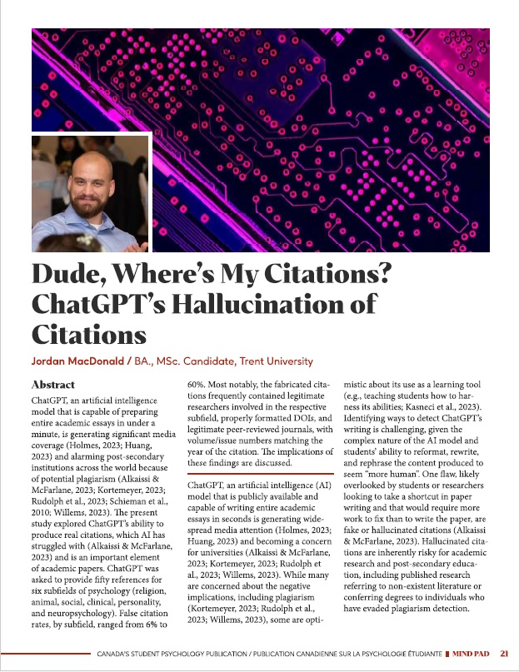
Study: Dude, Where’s my citations? (2023)
Tasked ChatGPT 3.5 with finding 50 citations for 6 psychology subfields
300 total citations
32.3% of citations provided were hallucinated
Real authors
Real peer-reviewed journals
Real DOIs

Slide 10
Patterns?
DOIs that lead no where or lead to completely different articles
  unique string of numbers and letters that identifies a document or article
  permanent, so they always refer to the same article, regardless of its location on the web
Most often hallucinated years were 2018, 2019, 2020
  CAUTION: study was conducted in 2023, so this may have changed
Repeated use of the same authors
Repeated use of the same journals

Slide 11
WHAT DOES THIS MEAN?!

Slide 12
Trust but Verify

Slide 13
Trust but Verify

Slide 14
Hallucinated
Crenshaw, K. (2022). Critical race theory in education and organizational studies: A comprehensive review. Educational Equity Journal, 18(3), 45-60.

Slide 15
Google Scholar scholar.google.com

Slide 16
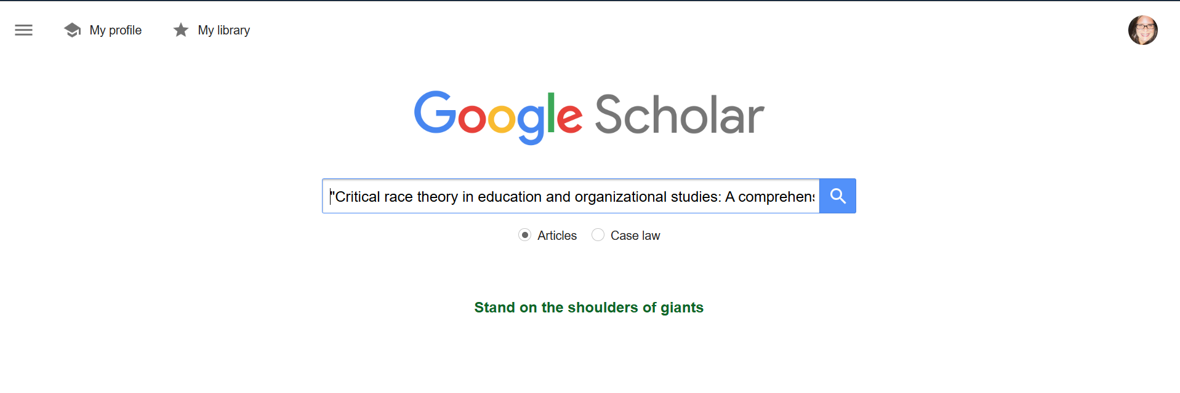
Google scholar

Slide 17
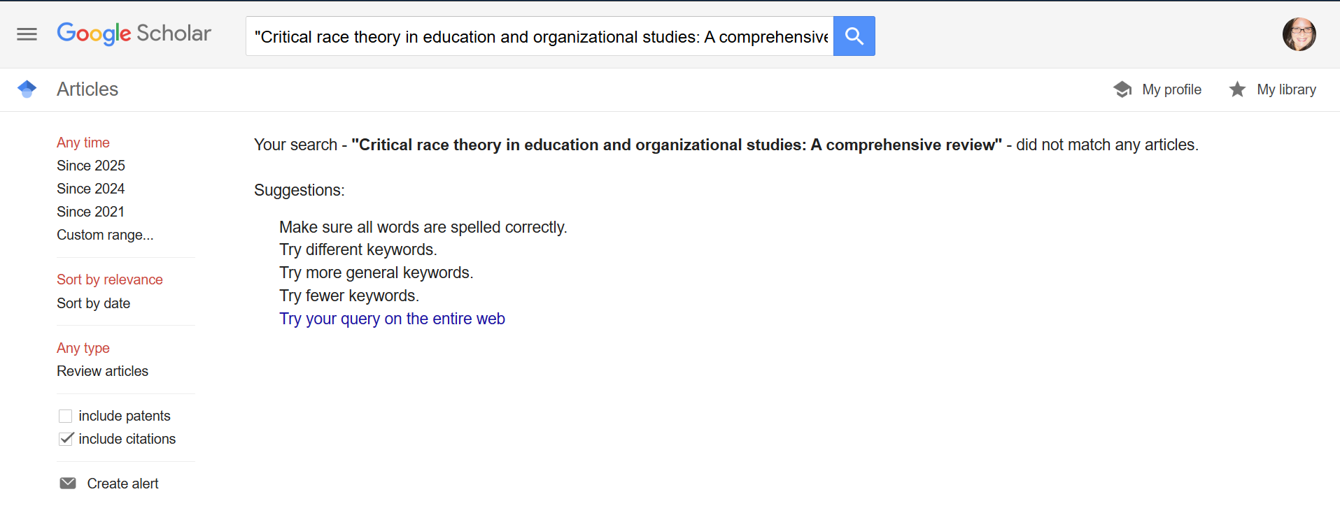
Google scholar 2

Slide 18
Library Catalog Search resources.nu.edu/library

Slide 19

Navigator search

Slide 20
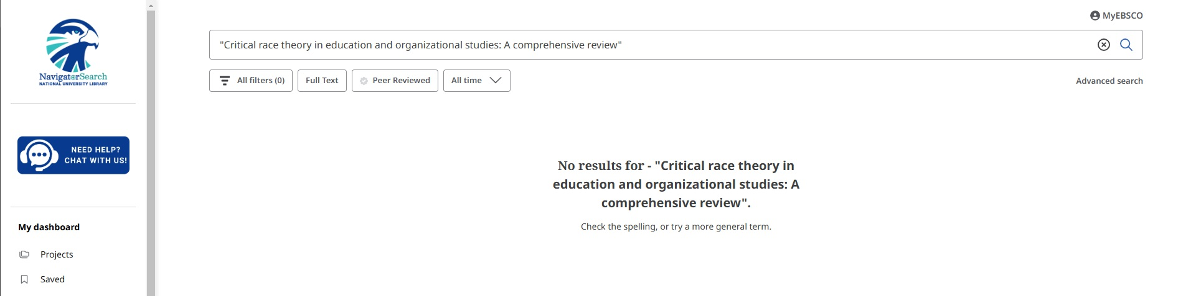
Navigator search failed search

Slide 21
Library Journal Search resources.nu.edu/library

Slide 22

Navigator search journal title search

Slide 23
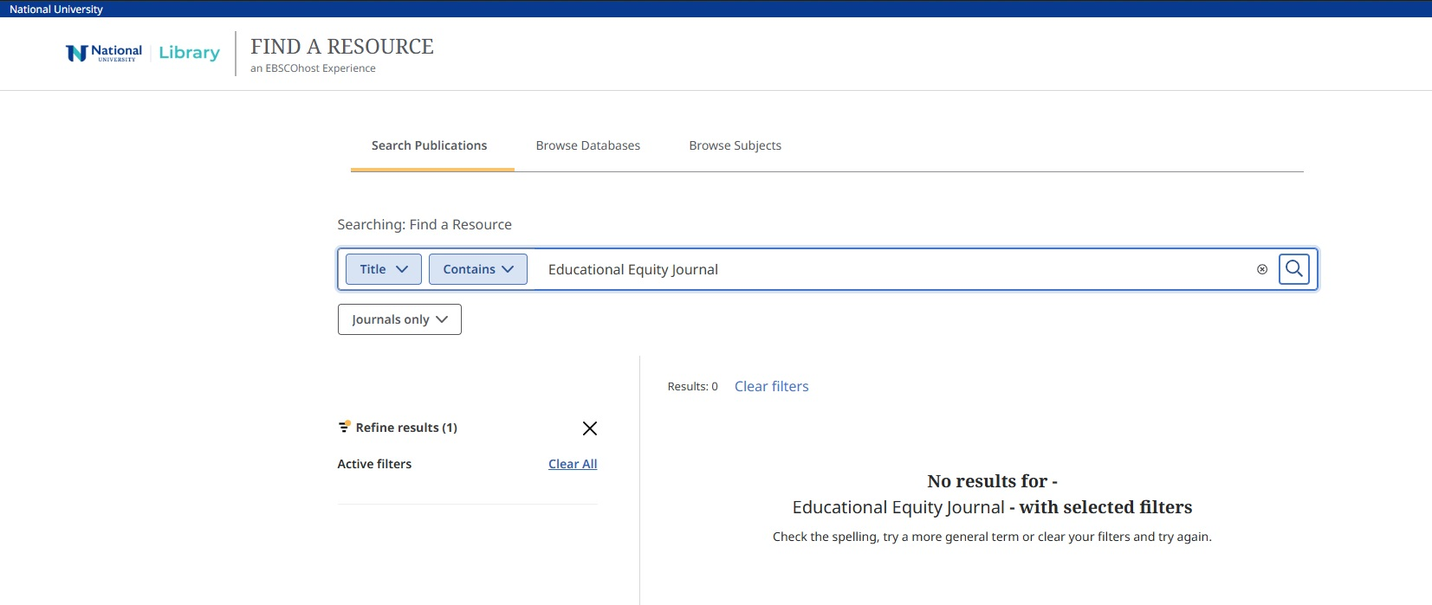
Navigator search failed journal title search

Slide 24
Basic Google Search google.com

Slide 25
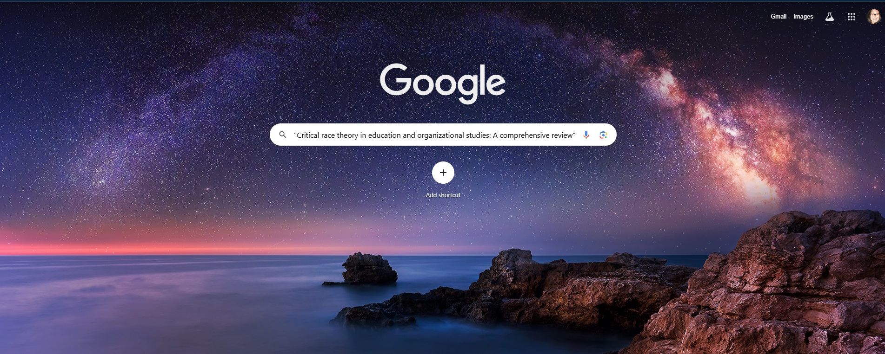
Google search

Slide 26
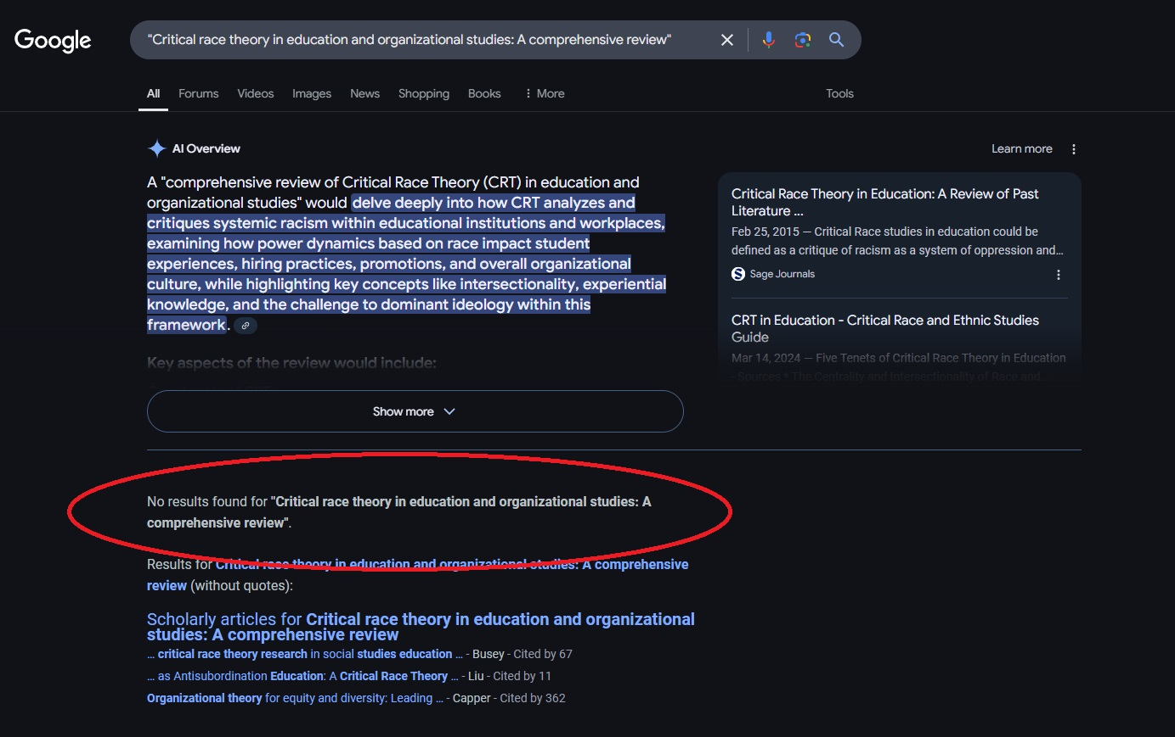
Failed Google search

Slide 27
DOI Checker doi.org

Slide 28

Failed doi search

Slide 29
Crossref crossref.org

Slide 30
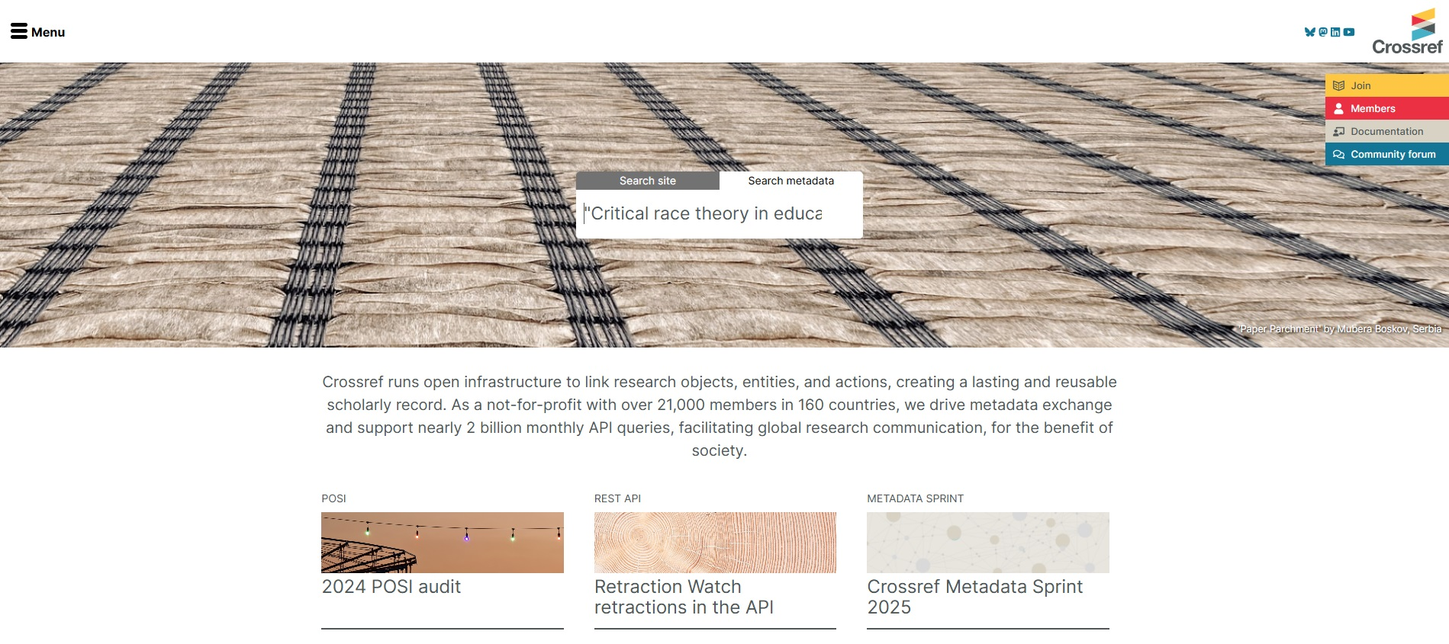
failed crossref search

Slide 31
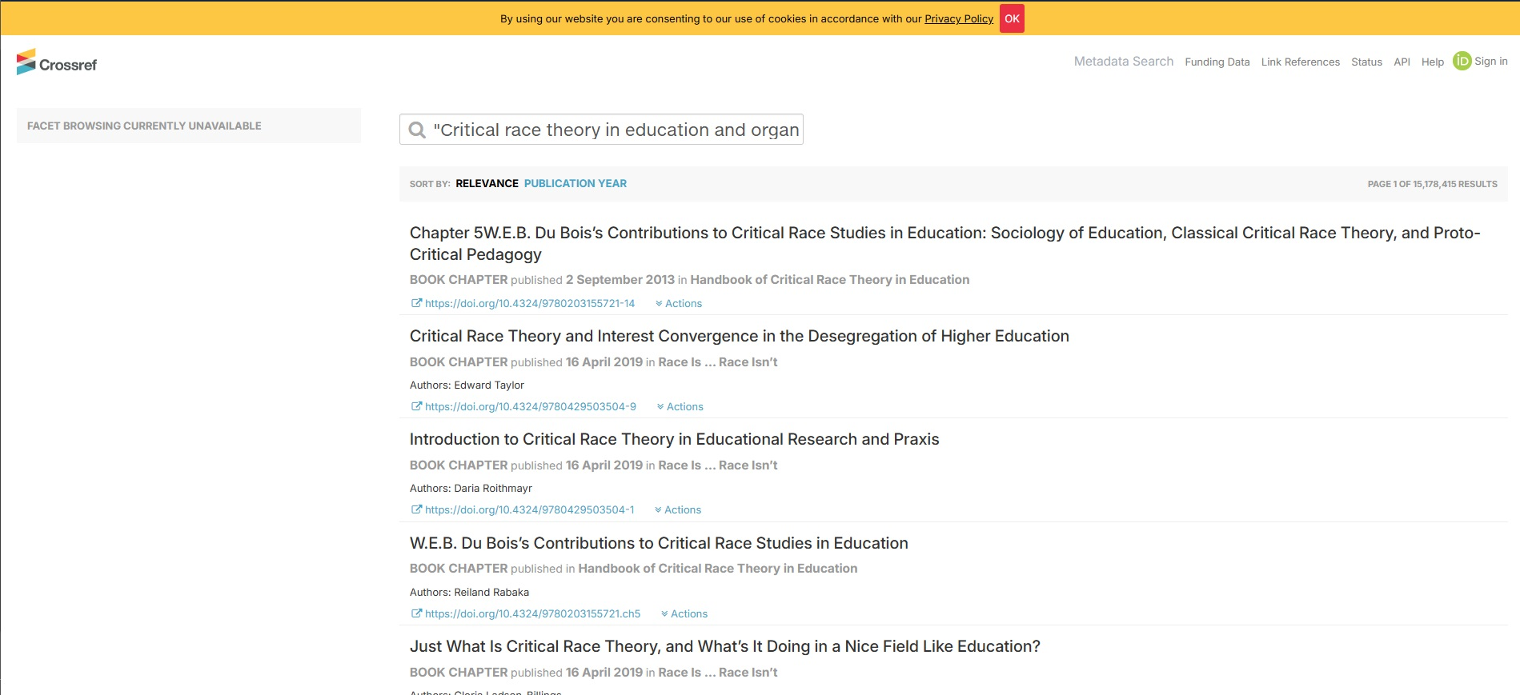
Failed Crossref search 2

Slide 32
Faculty &/or Student Hallucinations
Liu, X., Zhang, Y., & Wang, P. (2023). Barriers to digital transformation in SMEs: A focus on skill gaps and resource limitations. Journal of Small Business and Technology Management, 30(2), 112-130. https://doi.org/10.1016/j.jsbtm.2023.112130
Nwaiwu, F., Belgrave, L. S., & Kamoun, F. (2020). Understanding digital transformation in small and medium enterprises: A systematic review. Journal of Small Business Management, 58(1), 1-29.
Spencer, M. B. (2021). The psychological costs of racism: Microaggressions, isolation, and the impact on Black men in STEM leadership. Psychology in Leadership, 10(4), 771-783. https://doi.org/10.1037/amp0000789
Teh, W., Chong, S., & Ismail, S. (2023). Digital transformation readiness: A study of SMEs in the ASEAN region. Journal of Innovation and Knowledge, 8(2), 45-57. https://doi.org/10.1016/j.jik.2022.12.005

Slide 33


Real or Hallucinations?
Allen, J. G., Croteau, K., & Lord, D. (2023). The effects of induction and mentoring programs on early-career teacher outcomes: A meta-analysis. Teaching and Teacher Education, 127, 104031. https://doi.org/10.1016/j.tate.2023.104031
Amemasor, S. K., Oppong, S. O., Benuwa, B.-B., & Essel, D. D. (2025). A systematic review on the impact of teacher professional development on digital instructional integration and teaching practices. Frontiers in Education, 10. https://doi.org/10.3389/feduc.2025.1541031
Bristol, T. J., & Shirrell, M. (2019). Who leaves and who stays? Understanding teacher mobility using administrative and survey data. American Educational Research Journal, 56(1), 146–177. https://doi.org/10.3102/0002831218790544
El-Hamamsy, L., Monnier, E.-C., Avry, S., Chessel Lazzarotto, F., Liégeois, G., Bruno, B., Dehler Zufferey, J., & Mondada, F. (2023). An adapted cascade model to scale primary school digital education curricular reforms and teacher professional development programs. arXiv. https://doi.org/10.48550/arXiv.2306.02751
Talafian, H., Lundsgaard, M., Mahmood, M., Shafer, D., Stelzer, T., & Kuo, E. (2023). Responsive professional development: A facilitation approach for teachers’ development in a physics teaching community of practice. arXiv. https://doi.org/10.48550/arXiv.2310.11375
Wang, H., & Hall, K. (2023). Digital mentoring in teacher induction: Affordances and challenges. International Journal of Mentoring and Coaching in Education, 12(2), 156–172.
https://doi.org/10.1108/IJMCE-04-2022-0037

Slide 34
Real or Hallucinations?
Allen, J. G., Croteau, K., & Lord, D. (2023). The effects of induction and mentoring programs on early-career teacher outcomes: A meta-analysis. Teaching and Teacher Education, 127, 104031. https://doi.org/10.1016/j.tate.2023.104031
Amemasor, S. K., Oppong, S. O., Benuwa, B.-B., & Essel, D. D. (2025). A systematic review on the impact of teacher professional development on digital instructional integration and teaching practices. Frontiers in Education, 10. https://doi.org/10.3389/feduc.2025.1541031
Bristol, T. J., & Shirrell, M. (2019). Who leaves and who stays? Understanding teacher mobility using administrative and survey data. American Educational Research Journal, 56(1), 146–177. https://doi.org/10.3102/0002831218790544
El-Hamamsy, L., Monnier, E.-C., Avry, S., Chessel Lazzarotto, F., Liégeois, G., Bruno, B., Dehler Zufferey, J., & Mondada, F. (2023). An adapted cascade model to scale primary school digital education curricular reforms and teacher professional development programs. arXiv. https://doi.org/10.48550/arXiv.2306.02751
Talafian, H., Lundsgaard, M., Mahmood, M., Shafer, D., Stelzer, T., & Kuo, E. (2023). Responsive professional development: A facilitation approach for teachers’ development in a physics teaching community of practice. arXiv. https://doi.org/10.48550/arXiv.2310.11375
Wang, H., & Hall, K. (2023). Digital mentoring in teacher induction: Affordances and challenges. International Journal of Mentoring and Coaching in Education, 12(2), 156–172.
https://doi.org/10.1108/IJMCE-04-2022-0037

Slide 35
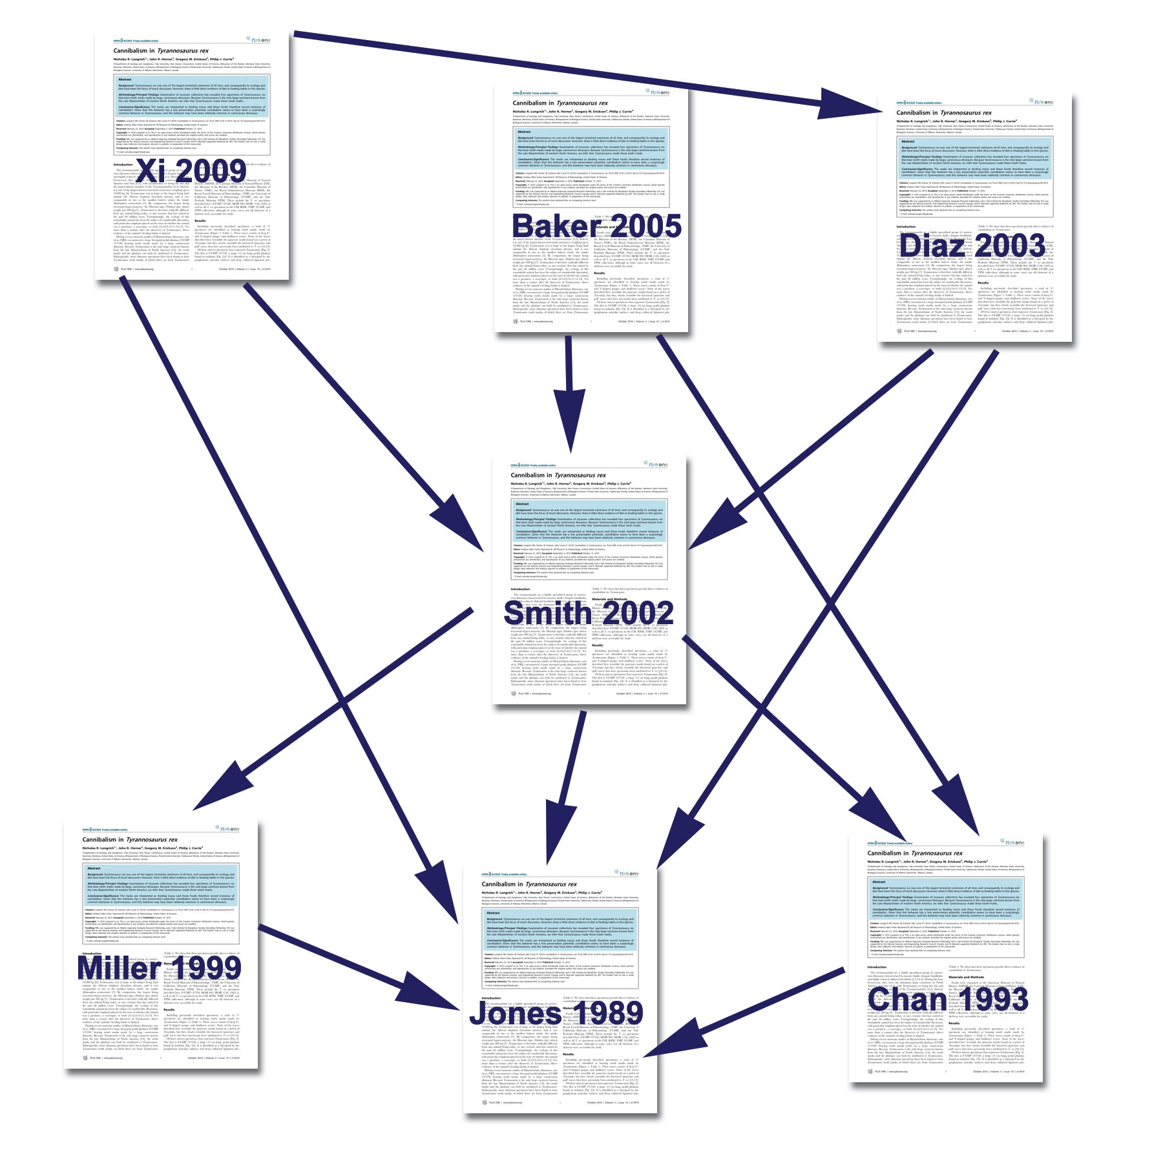
Ways to become an excellent researcher…
Citation Chaining
Look backwards and forwards with your own paper’s citations, as well as others’

Slide 36
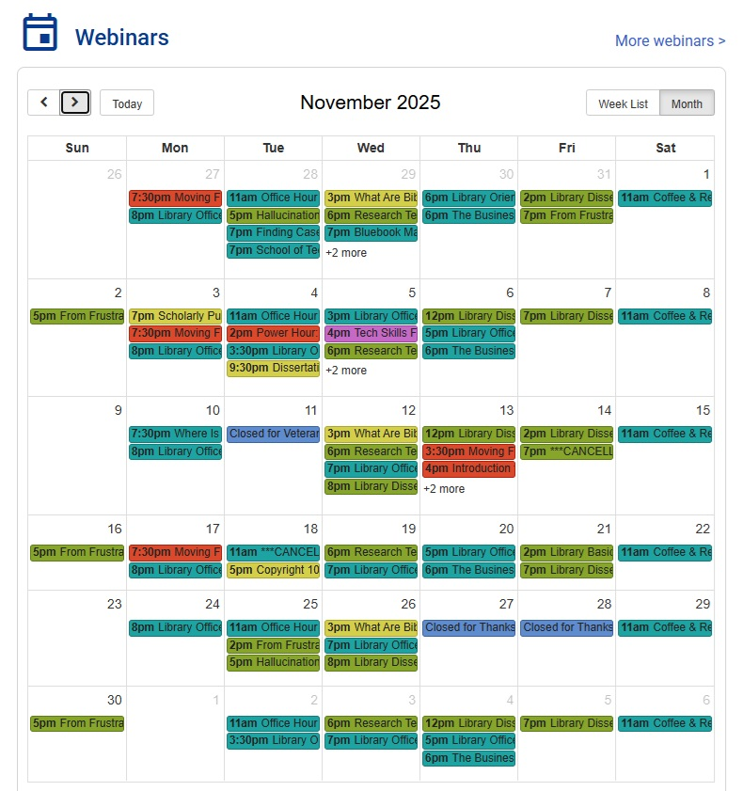
Ways to become an excellent researcher…
Library Webinars
resources.nu.edu/library

Slide 37
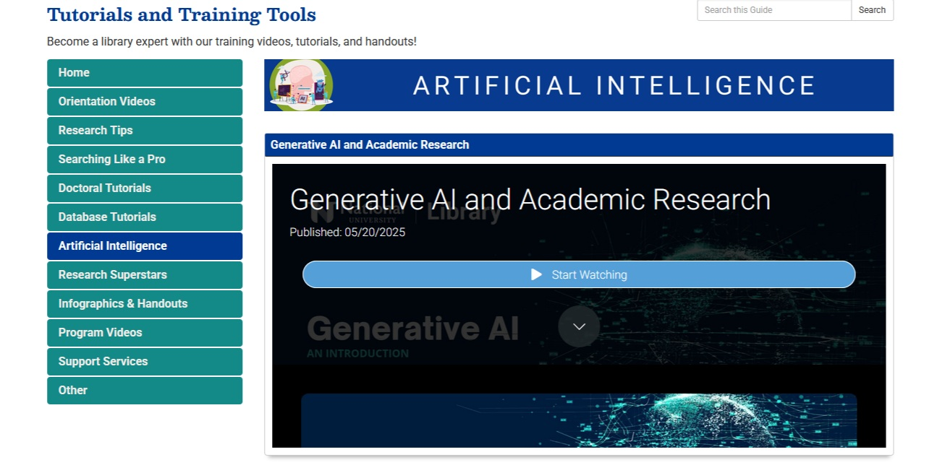
Ways to become an excellent researcher…
Library Tutorials
resources.nu.edu/tutorials

Slide 38
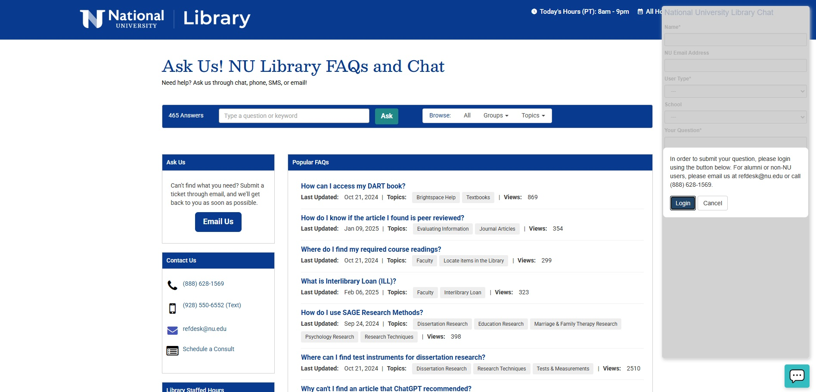
Ways to become an excellent researcher…
Ask for help
Chat 24/7 through the library’s homepage

Slide 39
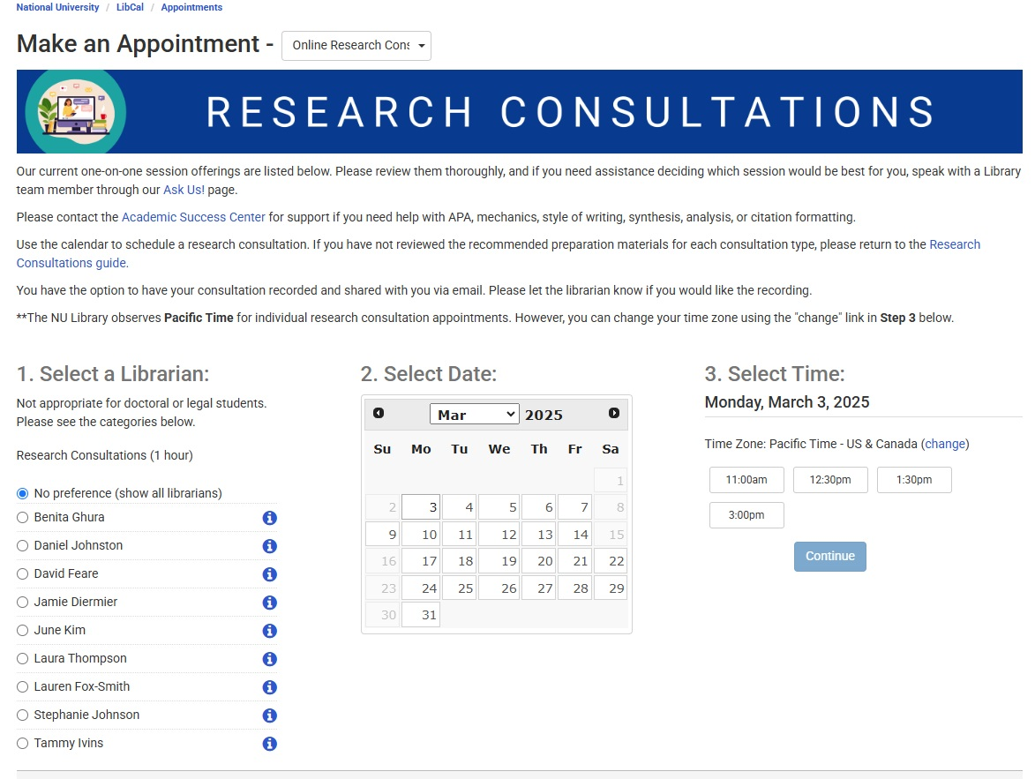
Ways to become an excellent researcher…
Schedule a research consultation
resources.nu.edu/researchconsultations

Slide 40

Ways to become an excellent researcher…PRACTICE

