Slide 1
Enhancing Employee Engagement in a Healthcare Organization: A Key Strategy to Reduce Turnover and Enhance Patient Care Quality
Fesseha Mulugeta
National University
Dissertation Chair: Dr. Meger Chappell
Subject Matter Expert: Dr. Lori Demeter
Academic reader: Dr. Jennifer Biddle
Notes:
Study Overview:
My research is a qualitative phenomenological study. I chose this approach specifically to capture the lived experiences of healthcare professionals—including nurses and administrators. My goal was to understand how their professional engagement is shaped by high turnover and how that ultimately affects the quality of patient care.
Let us visualize a modern hospital ward. We often focus on the technology and the medicine, but the true heartbeat of that ward is the collective energy of its staff. My research began with a troubling observation: when that heartbeat falters due to high turnover, it isn't just an administrative problem—it becomes a patient safety crisis. My study, titled 'Enhancing Employee Engagement in a Healthcare Organization,' seeks to move beyond the statistics of recruitment and explore the 'lived experience' of the professionals who stay behind when their colleagues leave.
Current Research Landscape (Citing Hom and Bae):
"While existing literature, such as the work by Hom (2017), has done an excellent job documenting the financial costs of turnover, there is a significant gap in the research. Most studies are quantitative. My research addresses this gap by focusing on the psychological impact and the internal experiences of the workers who remain—an area that Bae (2022) identifies as needing urgent exploration."

Slide 2
INTRODUCTION
…Turnover threatens workforce stability
Turnover remains a critical global issue, threatening workforce stability and organizational health across medical industries (Giallouros et al.2023; Zucco, 2023).
…Impacts patient safety and care quality
Maintaining workforce stability is the prerequisite for patient safety. Without a stable team, patient care is hindered, and clinical outcomes are undermined (Zucco, 2023).
…Limited qualitative insights on the remaining staff
There is a significant gap in understanding the psychological impact on the workers who stay behind (Bae, 2022).
Notes:
The Core Issue: High employee turnover in healthcare disrupts the continuity of care, increases costs, and lowers staff morale.
Turnover remains a critical global issue, threatening workforce stability and organizational health across medical industries (Giallouros et al., 2023; Zucco, 2023).
The need for this study (The Knowledge Gap)--Low engagement among remaining staff is a direct threat to patient safety and treatment effectiveness, productivity, yet qualitative data on these internal experiences is lacking (Alenezi et al., 2019; Poon et al., 2022), and there is a significant gap in understanding the psychological impact on the workers who stay behind (Bae, 2022).
Explore the lived experiences of healthcare workers regarding professional engagement and its direct impact on patient care quality.
The Larger Context: Modern Workforce Stability.
In the post-pandemic era, workforce stability has become a primary concern as organizations navigate unprecedented "quit rates" and shifting employee expectations (Cao & Chen, 2021).
Turnover is no longer just a localized issue; it is a threat to the global sustainability of healthcare systems (Giallouros et al., 2023).
Relevance & Justification: Maintaining workforce stability is the prerequisite for patient safety. Without a stable team, patient care is hindered, and clinical outcomes are undermined (Zucco, 2023).
The Research Gap. While we understand the statistics of turnover, we lack a deep understanding of how remaining employees navigate this instability to maintain professional standards.

Slide 3
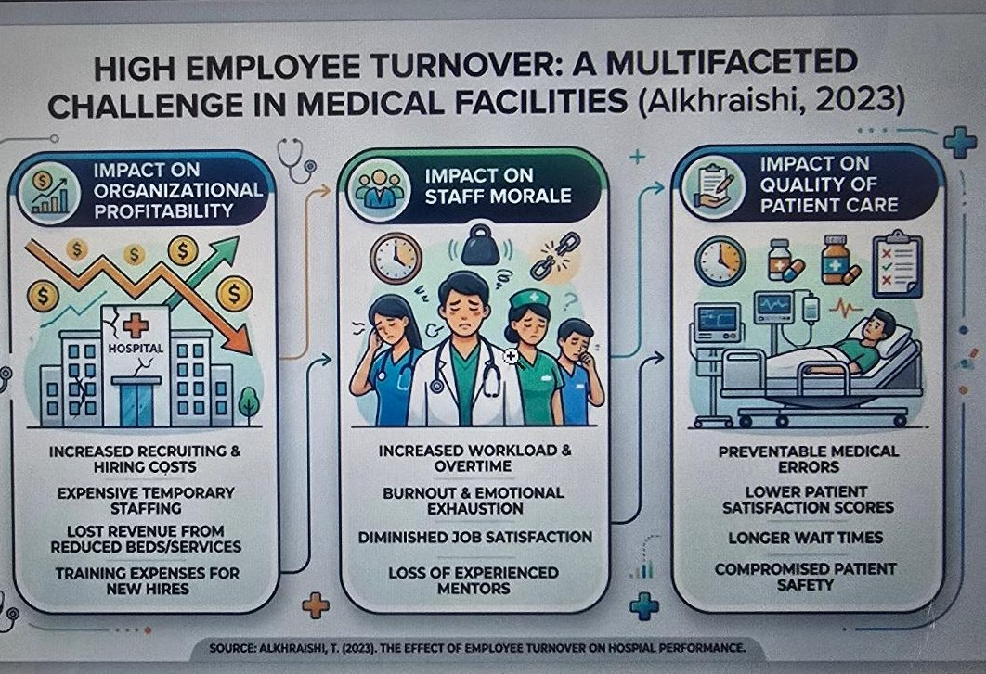
High employee turnover
Notes:
The problem exists within a modern healthcare environment characterized by extreme competitiveness and dynamic instability.
Systemic Instability: Turnover is a significant concern across industries, but in healthcare, it creates a unique "resource-loss spiral".
Workforce Challenges: As seasoned professionals leave, the remaining staff face increased workloads and emotional exhaustion, which often leads to a "decision to exit," further fueling the turnover cycle.
The Engagement Gap: A critical issue identified in your research is that low employee engagement is prevalent in high-turnover settings, directly threatening treatment effectiveness and patient outcomes.
Clinical Risk: High turnover rates are associated with medical errors, treatment delays, and reduced patient satisfaction (Giallouros et al., 2023).
Economic Impact: Beyond safety, turnover incurs massive costs related to hiring, training, and lost productivity (Jose et al., 2022).
Human Element: Understanding the human factors behind retention is essential for healthcare leaders to develop evidence-based strategies to optimize care standards (Eliyana & Fauzan, 2018).
Previous Research on the Topic
Extensive research has already established several key foundations regarding this topic:
Impact on Performance: Studies have repeatedly shown that turnover negatively affects corporate performance and service quality (Hom et al., 2017).
Safety Outcomes: Empirical data confirms that inadequate communication and lack of continuity resulting from turnover compromise patient safety (Alkhraishi et al., 2023; Poon et al., 2022).
The Motivation Factor: Research has defined engagement as the emotional dedication and involvement an employee has toward their business (Turner & Turner, 2020).
The Literature Gap: While quantitative impacts are well-documented, a gap remains in understanding the qualitative "lived experiences" of professionals in high-turnover situations, which your study aims to fill.

Slide 4
PROBLEM & PURPOSE STATEMENTS
The Problem: Maintaining professional engagement is difficult during high turnover, which directly threatens patient safety and treatment effectiveness.
Purpose: This qualitative phenomenological study explores the lived experiences of 21 healthcare professionals (nurses, doctors, administrators, etc.) regarding their engagement and the quality of care they provide amid high turnover.
Notes:
Statement of the Problem
The primary problem addressed in this study is maintaining employees' professional engagement amid high turnover rates in healthcare settings.
Disruption of Care: High turnover among nurses, doctors, and technicians disrupts continuity of patient care and care coordination.
The problem addressed in this study was employee professional engagement amid high employee turnover in contexts where quality patient care is crucial.
Healthcare organizations often face the practical challenge of retaining talented and dedicated staff to maintain high standards of patient care (Sabety et al., 2021).
The purpose of this qualitative phenomenological study was to explore the lived experiences of healthcare professionals and their perceptions of their professional engagement amid high employee turnover in healthcare organizations.
Engagement Gap: Research indicates that low employee engagement is prevalent during periods of high turnover, directly threatening patient safety and the effectiveness of medical treatments.
Impact on Staff: Turnover forces remaining employees to contend with increased stress, burnout, and reduced job satisfaction, creating a self-reinforcing cycle of disengagement.
Impact on Patients: Ultimately, patients receive unequal and subpar care, increasing the risk of medical errors and reducing satisfaction.
Purpose of the Study
The purpose of this qualitative phenomenological inquiry was to explore the lived experiences of healthcare professionals regarding their professional engagement during periods of high employee turnover.
Participants: The study focused on a diverse group of 21 healthcare professionals, including nurses, doctors, administrative staff, and allied health personnel.
Core Inquiry: You aimed to understand how turnover shapes their perceptions of engagement, which includes the quality of patient care, communication, and collaboration with colleagues.
Methodological Goal: By utilizing purposive criterion sampling and semi-structured questionnaires, the study sought to uncover the "essence" of these experiences to help healthcare leaders develop evidence-based strategies for retention and quality care.
“Because high turnover rates directly affect patient treatment quality and safety, the healthcare industry is particularly vulnerable. The loss of seasoned healthcare workers strains resources and jeopardizes the efficient provision of medical care, potentially leading to medical errors and decreased patient satisfaction”(Giallouros et al., 2023).

Slide 5
·
RESEARCH QUESTIONS
Research Question | Concept | Connection to my Bridge
RQ1: What are the lived experiences of engagement | Engagement | The "Internal Commitment" (Alenezi).
RQ2: How does turnover shape that engagement? | Turnover | The "Systemic Instability" (Giallouros).
RQ3: How does engagement contribute to care quality? | Quality | The "Clinical Risk" & "Moral Injury" (Bae/Hom).
Notes:
Questions:
RQ1: What are healthcare professionals' lived experiences of professional engagement amid employee turnover and the pursuit of quality patient care in healthcare organizations?
· RQ2: How do healthcare professionals make sense of how turnover shapes their professional engagement?
· RQ3: How do healthcare professionals make sense of how their professional engagement contributes to the quality of care they provide to patients?
• Impact of Turnover (RQ1): Participants reported a self-reinforcing cycle of resource depletion. High turnover led to increased workload, burnout, and decreased morale, which ultimately compromised patient care (e.g., delayed medications, missed clinical changes).
• Shaping Engagement (RQ2): Staff felt devalued and unappreciated when leadership failed to acknowledge the extra burden. They also noted stagnant growth as mentorship and training time were cut due to staffing shortages.
• Contribution to Quality (RQ3): Despite the chaos, professionals stayed engaged through teamwork, empathy, and a personal investment in patient outcomes—often citing their commitment to patients as the reason they stay.

Slide 6
THEORETICAL FRAMEWORK
Core Models:
job demands-resources (JD-R) Model: Shows how high demands (workload) without enough resources (support) lead to burnout. Primarily, the (JD-R) Theory was developed by Bakker and Demerouti (2017)
Social Exchange Theory (SET): The reciprocal bond between staff and the org.
Conservation of Resources (COR): Managing psychological energy.
Self-Determination Theory (SDT): Autonomy, competence, and relatedness.
Notes:
The theoretical framework for this study is an integrated, multi-theoretical lens that explores the psychological, relational, and structural dimensions of the healthcare professional's experience.
The study is primarily anchored in the Job Demands-Resources (JD-R) model, which is supplemented by three supporting theories:
Theoretical Framework
Primary Theory: Job Demands-Resources (JD-R) Theory
Developed by Bakker and Demerouti (2017) to explain the relationship between work environments and employee well-being.
The Dual Processes
Health Impairment Process: High demands (turnover/workload) lead to burnout and decreased care quality (Bae, 2022).
Motivational Process: Job resources (engagement/support) foster dedication and organizational commitment (Bakker & Demerouti, 2017).
Application to Research
Provides a lens to examine how medical workers maintain professional engagement as a protective resource against the "demands" of high turnover (Poon et al., 2022).
Significance
Explains the mechanism through which turnover undermines patient care quality by depleting the psychological resources of the remaining staff (Zucco, 2023).

Slide 7
The Integrated Conceptual Framework of Healthcare Engagement. The Central Conflict: The Loss vs. The Gain Spiral
Systemic Demands (The Loss Spiral) | Inherent Resources (The Gain Spiral)
High Employee Turnover: Acts as the primary stressor. | Teamwork & Collaboration: Peer support as a buffer.
Workload Overload: Leads to physical/mental fatigue. | Empathy & Compassion: The core "calling" of the provider.
Emotional Exhaustion: Depletes professional reserves. | Personal Investment: Commitment to patient outcomes.
Result: Burnout & Compromised Patient Safety | Result: Resilience & Sustained Engagement
Notes:
My study is grounded in four key theories that explain the "how" and "why" of turnover:
• job demands-resources (JD-R) Model: Shows how high demands (workload) without enough resources (support) lead to burnout.
• Social Exchange Theory (SET): Explains that employees stay when they feel the organization treats them fairly and invests in them.
• Conservation of Resources (COR): Theory: Describes a "loss spiral" where losing a colleague depletes the remaining team's psychological energy.
• Self-Determination Theory (SDT): Focuses on the need for autonomy, competence, and relatedness to stay motivated.

Slide 8
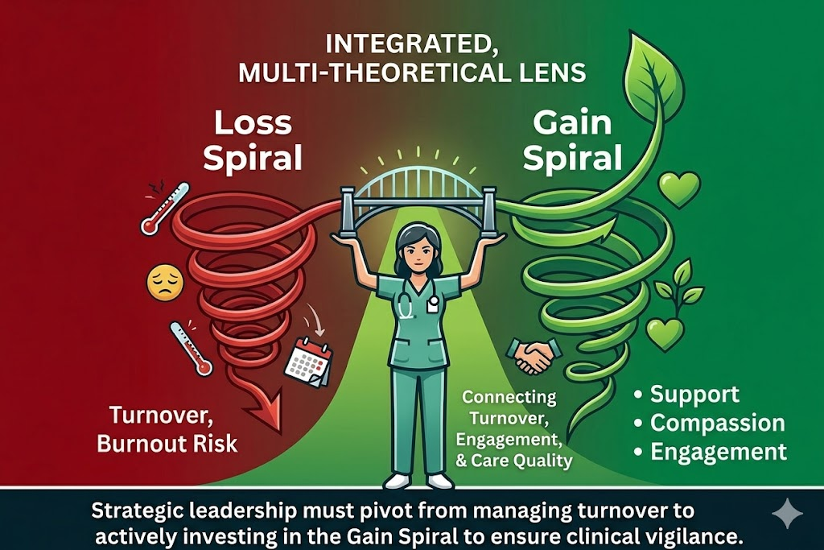
Integrated multi theoretical lens

Slide 9
REVIEW OF THE LITERATURE
Four major research paths were synthesized.
1. Hom (2017) established the severe economic impact of turnover. However, the stakes are higher than just finances
2. Bae (2022) demonstrated that turnover literally threatens patient lives by increasing clinical error rates.
3. Alenezi (2019), who found that 'professional engagement' is a key variable that can protect the quality of care.
4. Giallouros (2023) emphasizes that this is a modern global crisis of workforce stability.
My study bridges these ideas by asking: How do the workers themselves experience this tension on the ground
Notes:
The Cost of "The Revolving Door" (Hom et al., 2017)
Core Idea: Turnover is not just a human resources metric but a massive financial and operational burden.
Significance: Hom’s work establishes the "why" of the study—turnover creates a cycle of high replacement costs and productivity loss that destabilizes healthcare organizations.
The Impact on Clinical Outcomes (Bae, 2022)
Core Idea: There is a direct, negative correlation between high nurse turnover and patient safety.
Significance: Bae’s research provides the empirical evidence that staffing instability leads to increased medical errors and lower quality of care, framing your study’s focus on patient care consequences.
Engagement as a Buffer (Alenezi et al., 2019)
Core Idea: Professional engagement is the "internal engine" of the healthcare worker.
Significance: This study suggests that even in stressful environments, high levels of engagement can protect patient outcomes. This serves as the foundation for your inquiry into the lived experiences of those who stay.
Workforce Stability and Morale (Giallouros et al., 2023)
Core Idea: Turnover creates a "contagion effect" where the departure of one staff member lowers the morale and stability of the entire team.
Significance: This highlights the modern workforce stability issues you mentioned in your introduction, proving that the problem is systemic rather than individual.

Slide 10
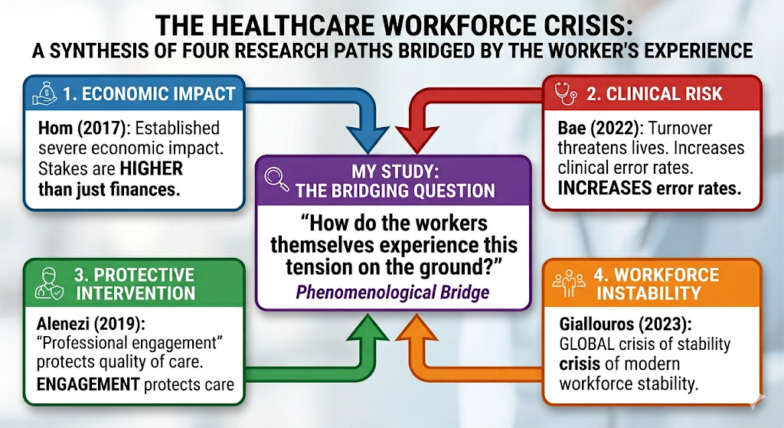
REVIEW OF THE LITERATURE
Four major research paths were synthesized.
Notes:
Using the "ground-level tension" as a bridge is a sophisticated way to move the research from identifying a problem to proposing a solution.
In academic terms, I am moving from description to prescription. By centering the solution on the worker's experience, I ensure that the intervention is not just a "top-down" corporate fix, but a "bottom-up" systemic one.
1. From "Operational Paradox" to "Structural Support."
The Tension: Workers feel engaged but are blocked by the system (The Paradox).
The Bridge: If the tension is caused by a lack of resources, the solution isn't "more training,” it’s Structural Empowerment.
The Solution: Designing workflows that automate administrative burdens, allowing workers to return to the "professional engagement" that Alenezi (2019) identified as a protective factor.
2. From "Moral Injury" to "Moral Resilience."
The Tension: The emotional weight of knowing what care is needed but being unable to provide it.
The Bridge: Use the "ground-level" stories of these tensions to argue for Shared Governance.
The Solution: Giving workers a seat at the financial/economic table (addressing Hom’s 2017 impact). When workers decide how resources are allocated, the "tension" of feeling powerless is reduced, which stabilizes the workforce.
3. From "Clinical Risk" to "Psychological Safety."
The Tension: The fear that clinical errors (Bae, 2022) are inevitable due to exhaustion.
The Bridge: The worker's experience proves that safety is a cultural issue, not just a checklist issue.
The Solution: Implementing "Just Culture" frameworks where the ground-level tension is treated as data for system improvement rather than a reason for individual punishment.

Slide 11
Summary Table: The Solution Bridge
Research Path | The Problem (Tension) | The Ground-Level Bridge | The Proposed Solution
Hom / Bae | Financial loss & Error rates | Anxiety & Frustration | Resource-based safety protocols
Alenezi / Giallouros | Lack of engagement & Instability | Disconnection & Burnout | Autonomy & Shared Governance
Four major research paths were synthesized.
Notes:
How do the workers themselves experience this tension on the ground? In a single sentence: Workers experience the tension as the exhausting struggle to maintain professional integrity and patient safety within a failing, resource-constrained system.
To break that down further for your study:
The Conflict: They feel a deep personal commitment to patient care (Alenezi's Engagement) but are constantly obstructed by systemic instability (Giallouros's Global Crisis).
The Weight: This manifests as Moral Injury, in which the worker knows what the patient needs but is financially or logistically prevented from providing it (Hom’s Economic Impact), leading to a high-stakes environment in which they fear their own exhaustion will cause harm (Bae’s Clinical Risk).

Slide 12
RESEARCH METHODOLOGY & DESIGN
Qualitative phenomenological design
21 healthcare professionals
Open-ended questionnaires
Two private healthcare facilities
Notes:
I utilized a qualitative phenomenological design. For data collection, I chose open-ended questionnaires. This method was specifically selected to allow healthcare professionals—who often have extremely demanding schedules—the time and private space to provide deep, reflective written accounts of their experiences with turnover and engagement."
Qualitative research methodology.
Justification: This approach was selected because it allows for the exploration of a phenomenon through the "nuanced lens" of participants' experiences, perceptions, and opinions. It provides a "thick, in-depth description" that quantitative metrics cannot capture.
Specific Design: A transcendental phenomenological design.
Justification: This design is specifically intended to investigate the "essence" of a phenomenon by examining how participants make sense of their lived experiences. It was uniquely suited to your study, as it went beyond turnover statistics to examine the internal psychological and professional states of healthcare workers.
Appropriateness of Choices
Subject Area & Problem: In the healthcare sector, turnover is a "systemic catalyst" that disrupts continuity of care. Your choice of phenomenology was appropriate because it captured the subjective understanding of how these disruptions affect professional reality.
Purpose & Research Questions: The study sought to describe the "essence" of engagement amid dual challenges. Phenomenology directly addressed the research questions (RQ1-RQ3) by focusing on the "what" and "how" of participants' lived experiences.
Data Analysis Method
Thematic analysis was employed to identify, analyze, and report patterns within the narratives of your 21 participants. Your specific process followed an eight-step approach:
1.Data Preparation: Transcribing questionnaire responses verbatim.
2. Initial Coding: Identifying recurring concepts and developing a codebook.
3. Focused Coding: Systematically applying codes (e.g., "Increased Workload") to text segments.
4. Category Formation: Organizing coded data into meaningful clusters.
5. Theme Development: Synthesizing categories into overarching themes.
6. Theme Validation: Cross-checking themes against raw data for validity.
7. Illustrative Examples: Selecting quotes to provide depth and context.
8. Comprehensive Reconstruction: Creating a coherent narrative of the participants' perspectives.
Role of the Researcher and Positionality
Role: The primary instrument: for data collection and analysis was used to manage questionnaire recruitment and the coding process.
Positionality & Neutrality:
Neutrality: A "neutral and independent" stance, refraining from letting personal experiences influence the data interpretation.
Reflexivity: A reflexive memo-writing and an audit trail (detailed process notes) to maintain transparency and acknowledge potential biases.
Trustworthiness: Member checking (allowing participants to review transcripts) and triangulation (comparing insights across different healthcare roles) to ensure the findings remained grounded in the participants' voices rather than your own preconceptions.

Slide 13

POPULATION & SAMPLE
200 healthcare professionals across two distinct medical facilities (Urban and Suburban)
Criteria: 18+ years old, 1+ year of tenure, and direct exposure to organizational turnover.
Notes:
Inclusion Criteria
To ensure the sample aligned with the research goals, participants had to meet the following criteria:
Be over 18 years of age.
Have at least one year of experience as a healthcare professional at a medical clinic or hospital.
Have personally experienced the impacts of turnover on their work engagement and the quality of patient care.
Be willing to participate in a recorded questionnaire (virtual or face-to-face).
Sampling Methodology
Strategy: You utilized purposive criterion sampling, a non-probability technique.
Methodological Alignment: This choice was consistent with your transcendental phenomenological design, which requires selecting "information-rich" participants who have firsthand experience with the phenomenon being studied.
Data Saturation:—the point where no new information or themes emerge—with your 21-participant sample. You justified this size by citing literature (Berndt, 2020) stating that saturation in qualitative studies is typically met with 15 to 30 participants.
Recruitment Efforts
Ethical Approval: Recruitment began only after obtaining approval from the Institutional Review Boards (IRBs) at both the participating medical facilities and National University.
Process: * A formal recruitment email was sent to HR administrators at the selected institutions.
HR then distributed this invitation to their healthcare staff.
Interested individuals contacted me directly via email or phone.
Once contact was made, I provided an informed consent form outlining the study's purpose, confidentiality measures, and the voluntary nature of participation before scheduling the questionnaires.

Slide 14
MATERIALS & INSTRUMENTATION
Recruitment Email and Flyer
Informed Consent Form
Transcription and Data Management Software: NVivo software
Notes:
Recruitment Email and Flyer: A formal email invitation and a recruitment flyer were developed to invite healthcare professionals to participate. These documents outlined the study's focus, participation requirements, and contact information.
Informed Consent Form: A detailed consent form was provided to all participants via email. This document outlined the study’s purpose, procedures, confidentiality measures, and the participants' right to voluntary participation.
Transcription and Data Management Software: All recorded responses were transcribed verbatim into a digital format. I utilized NVivo software to systematically manage, code, and analyze the thematic data.
and by maintaining a transparent audit trail of my data-analysis decisions.

Slide 15
STUDY PROCEDURES
Ethical Approval
Recruitment Strategy
Administrative Coordination
Informed Consent
Notes:
The data collection and management followed a specific sequence to maintain methodological rigor:
Ethical Approval: The process began by securing approval from the required Institutional Review Boards (IRBs), specifically those of National University and the participating medical facilities.
Recruitment Strategy: I utilized purposive criterion sampling to recruit at least 21 healthcare professionals who met specific experience and exposure requirements.
Administrative Coordination: I initiated contact by sending a formal recruitment email to the Human Resources (HR) administrators at the participating institutions, who then distributed the invitation to their staff.
Informed Consent: Interested individuals contacted you directly via email or phone. You then provided them with an informed consent form outlining the study's purpose, confidentiality protocols, and their right to participate voluntarily.
Data Collection Setting: Once consent was obtained, I scheduled individual questionnaires at the participants' convenience, and for a few, conducted either face-to-face or virtually.

Slide 16
DATA ANALYSIS
Thematic analysis
NVivo software
Coding and theme development
Notes:
For my Data Analysis, I employed a rigorous Thematic Analysis approach. Because I used qualitative questionnaires, the process began by transforming the written responses into a searchable digital format.
I moved through multiple cycles of coding. In the first cycle, I stayed very close to the participants' own language—what we call 'In Vivo' coding—to ensure their voices weren't lost. In the second cycle, I looked for patterns across the 12 participants to develop the themes I will present shortly.
To ensure the 'trustworthiness' of this analysis, I used NVivo 14 to keep a clear audit trail, allowing every theme to be traced directly back to the original questionnaire data."
Thematic analysis was used for this data collection and followed an eight-step approach
Data Preparation: Responses to open-ended questions from the questionnaires were transcribed verbatim into a digital format.
Initial Coding: I immersed myself in the data, reading transcripts multiple times to identify recurring concepts and phrases to develop an initial codebook.
Focused Coding: I systematically applied codes from the codebook to the text segments. For example, descriptions of being overwhelmed were assigned the code "Increased Workload".
Category Formation: Coded data were organized into broader categories based on shared meanings and relationships, such as grouping codes into "Meaningful Clusters".
Theme Development: I refined these categories into overarching themes that captured the central organizing concepts of the participants' perspectives.
Theme Validation: I revisited the original responses to seek disconfirming evidence or alternative interpretations, ensuring the themes truly represented the data.
Illustrative Examples: I selected specific quotes (e.g., from Nu-1 or Doc-3) to provide context, depth, and "thick description" for each theme.
Comprehensive Reconstruction: Finally, I integrated these themes into a coherent narrative that explained the phenomenon of engagement amid turnover
Trustworthiness and Credibility
I supported my analysis with several strategies to ensure Methodological Rigor:
Member Checking: Inviting participants to review their transcripts to confirm the accuracy of their recorded experiences.
Audit Trail: Maintaining detailed process notes of all coding and analytical decisions.
Reflexivity: Using memo-writing to acknowledge and mitigate potential researcher bias.

Slide 17
LIMITATIONS
Limited Generalizability: Only two healthcare institutions (one urban and one suburban)
Participant Bias
Methodological Constraints
Notes:
Limited Generalizability: Only two healthcare institutions (one urban and one suburban), which may not represent the diversity of all healthcare settings.
Participant Bias: Self-reported data from semi-structured questionnaires are susceptible to recall and social desirability biases, in which participants may modify their responses to align with expectations.
Methodological Constraints: As a qualitative study, the findings lack the statistical strength of quantitative research, meaning broad numerical conclusions cannot be drawn.

Slide 18
rq1
FINDINGS: RQ1 What are the lived experiences of engagement? (The Loss Spiral) Participants reported a self-reinforcing cycle of resource depletion
Theme 1: Increased Workload and Burnout
Quote: "I had to cover additional shifts or assume responsibilities beyond my day-to-day job description... I experienced burnout and was overwhelmed most of the time." — Nu-2
Theme 2: Emotional Toll and Decreased Morale
Quote: "Every time there is a turnover, it almost feels like a start over, and that can be draining." — Doc-2
Theme 3: Compromised Patient Care
Quote: "One example was delayed antibiotic administration due to staffing gaps." — Nu-3
Notes:
RQ1: Key Findings
1. Impact of Turnover on Staff
Them 1: Increased Workload & Burnout: 82% of participants reported that frequent turnover led to stress, exhaustion, and being "undervalued". Many had to cover additional shifts or take on duties outside their primary roles.
Team 2: Emotional Toll: 85% of participants reported a decline in morale, citing frustration and a loss of enthusiasm as veteran colleagues departed.
Them 3: Compromised Patient Care: 90.5% of the 21 participants in this theme, 17 emphasized the direct effect of turnover on patient outcomes

Slide 19
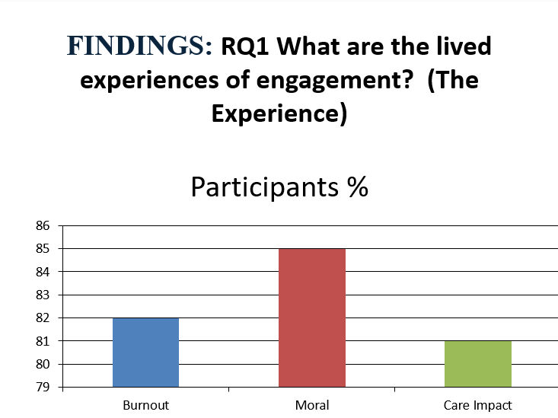
FINDINGS:
Notes:
RQ1: Findings
1. Impact of Turnover on Staff
Them 1: Increased Workload & Burnout: 82% of participants reported that frequent turnover led to stress, exhaustion, and being "undervalued". Many had to cover additional shifts or take on duties outside their primary roles.
Team 2: Emotional Toll: 85% of participants reported a decline in morale, citing frustration and a loss of enthusiasm as veteran colleagues departed.
Them 3: Compromised Patient Care: 80.95% of the 21 participants in this theme, 17 emphasized the direct effect of turnover on patient outcomes

Slide 20

rq2
FINDINGS: RQ2 How does turnover shape their engagement?
Staff felt devalued and unappreciated when leadership failed to acknowledge the extra burden they carried.
Theme 1: Lack of Organizational Support
Quote: "During turnover spikes, task allocation became more reactive... This situation underscored the importance of strong leadership." — Dr-1
Theme 2: Feeling Devalued and Unappreciated
Quote: "Frequent turnover makes me feel stressed and sometimes undervalued. It reduces my engagement because I spend more time covering for absent colleagues." — Nu-5
Theme 3: Reduced Opportunities for Growth
Quote: "Turnover influences... team dedication and morale. Motivation reduces as the workload increases." — Hea-1
Research Question 1
Notes:
Findings
Theme 1: Lack of Organizational Support: Within this theme, an overwhelming majority of participants—19 out of 21 (86%)—consistently expressed a profound perception that their organizations failed to provide adequate support amid ongoing high employee turnover.
Theme 2: Feeling Devalued and Unappreciated. In the theme Feeling Devalued and Unappreciated, a substantial majority of participants (19 out of 21; 90.5%) reported a profound sense of being undervalued and unacknowledged by their organizations amid persistent high employee turnover
Theme 3: Reduced Opportunities for Growth and Development. Over two-thirds of participants (15 of 21, 71.4%) expressed concerns about stagnation in their professional growth and limited access to developmental opportunities.

Slide 21
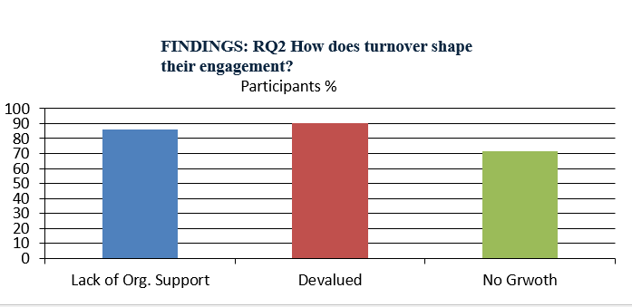
Research Question 1
Notes:
Findings
Theme 1: Lack of Organizational Support: Within this theme, an overwhelming majority of participants—19 out of 21 (86%)—consistently expressed a profound perception that their organizations failed to provide adequate support amid ongoing high employee turnover.
Theme 2: Feeling Devalued and Unappreciated. In the theme Feeling Devalued and Unappreciated, a substantial majority of participants (19 out of 21; 90.5%) reported a profound sense of being undervalued and unacknowledged by their organizations amid persistent high employee turnover
Theme 3: Reduced Opportunities for Growth and Development. Over two-thirds of participants (15 of 21, 71.4%) expressed concerns about stagnation in their professional growth and limited access to developmental opportunities.

Slide 22
rq3
FINDINGS: RQ3: How does engagement contribute to the quality of care?
(Despite low engagement with the organization, the staff remains engaged with the patient.)
Theme 1: Importance of Teamwork and Collaboration---(COR, SET)
Quote: "When someone leaves, and a new person joins, it takes time to reset, which can significantly affect decision-making." — PA-2
Theme 2: Role of Empathy and Compassion
Quote: "The consistent support I provided helped us maintain the quality of care despite understaffing." — Doc-3
Theme 3: Personal Investment in Patient Outcomes (Alenezi)
….Quote: "Knowing that patients rely on steady support keeps me focused and adaptable, ensuring their needs remain the top priority." — PA-2
Notes:
Findings
3. Sustaining Engagement (The "Buffers")
…..Teamwork: 77% of participants identified cohesive teamwork and peer support as the primary "shock absorbers" that allowed them to function amid instability.
……Nearly all participants (20 out of 21, 95%) unequivocally stated that their inherent empathy and compassion for patients were primary, unwavering drivers of their professional engagement, even amid high turnovers.
….Intrinsic Motivation: Despite organizational failures, 100% of participants remained committed to patient outcomes, driven by a "calling orientation" and a deep sense of personal responsibility.

Slide 23
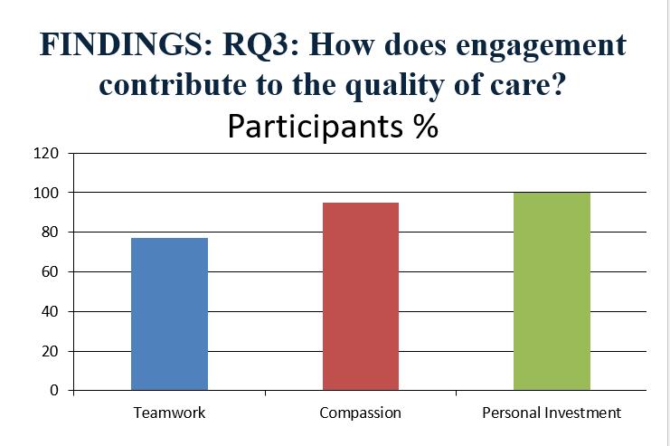
FINDINGS: RQ3: How does engagement contribute to the quality of care?
Notes:
3. Sustaining Engagement (The "Buffers")
…..Teamwork: 77% of participants identified cohesive teamwork and peer support as the primary "shock absorbers" that allowed them to function amid instability.
…Nearly all participants (20 out of 21, 95%) unequivocally stated that their inherent empathy and compassion for patients were primary, unwavering drivers of their professional engagement, even amid high turnovers.
…Intrinsic Motivation: Despite organizational failures, 100% of participants remained committed to patient outcomes, driven by a "calling orientation" and a deep sense of personal responsibility.

Slide 24
IMPLICATIONS
Engagement protects care quality (Dedicated staff ensures safety).
Turnover creates a loss spiral (High turnover erodes institutional knowledge).
Organizational support is critical (The bridge that stops the loss spiral). Healthcare organizations should view turnover as a "critical indicator of broader organizational health" rather than just a human resources metric. (By connecting my themes back to the JD-R and COR theories)
Notes:
My View
As turnover is 'contagious’, the leaders should focus on Buffer Resources. According to the JD-R model, stress becomes contagious when demand exceeds resources. My recommendation is that leadership must immediately 'inject' resources—such as temporary administrative support, mental health check-ins, or overtime incentives—to the remaining staff. We must stop the 'Loss Spiral' by creating a 'Gain Spiral' of support before the next person reaches their breaking point."

Slide 25
RECOMMENDATIONS (PRACTICAL APPLICATION)
Leadership Development: Moving toward Transformational Leadership to rebuild trust and recognize the extra effort of remaining staff.
Responsive Resource Allocation: Proactively providing support systems and mental health programs during "turnover spikes" to prevent staff from feeling abandoned.
Cultivating Collaboration: Strengthening interprofessional communication to act as a "shock absorber" against the stresses of understaffing.
Notes:
Recommendations for Practice
My findings suggest several actionable strategies for healthcare administrators to mitigate the negative cycle of turnover:
Implement Transformational Leadership: Organizations should train leaders to move beyond reactive management. Leaders must proactively recognize the "extra-role" efforts of remaining staff to rebuild the Social Exchange and prevent feelings of being undervalued.
Targeted Resource Allocation: During known "turnover spikes," management should deploy temporary support resources—such as mental health programs or administrative assistants—to buffer the increased Job Demands on frontline clinicians.
Formalize Mentorship Programs: To address the "Sense of Starting Over" (Theme 2), formalize peer mentoring to accelerate new-hire integration and reduce the emotional and professional burden on veteran staff.
Enhance Career Pathing: By providing clear professional development opportunities even during staffing shortages, organizations can satisfy the Self-Determination Theory need for "competence," which participants identified as a key driver of long-term engagement.

Slide 26
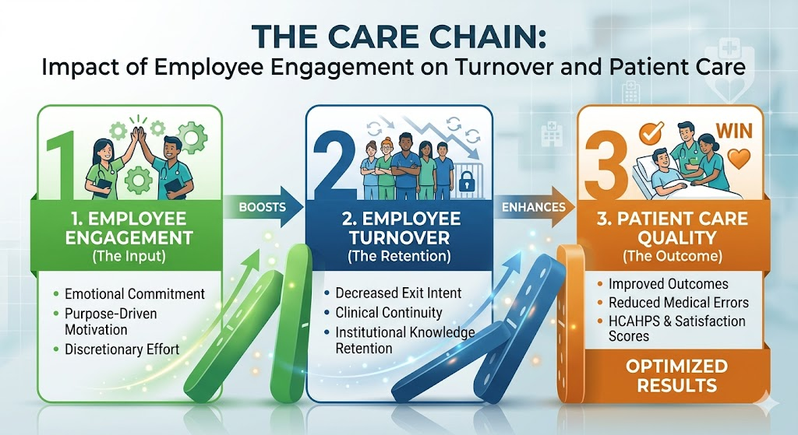
Care chain

Slide 27
CONCLUSIONS
The Core Issue: High employee turnover in healthcare disrupts the continuity of care, increases costs, lowers staff morale, and creates a "resource-loss spiral" for remaining staff.
Engagement sustains quality patient care. Engaged staff is the primary safeguard of patient quality
Systemic support is required (Clear policy, communication, admin…and so on).
---The gap: Statistics show who leaves, but not how staying impacts care
Notes:
The central focus of this research is the "lived experiences" of healthcare professionals, including nurses, physicians, and administrators, regarding their professional engagement during periods of high employee turnover
The study specifically explores how high turnover rates disrupt the "equilibrium" of an organization, impacting both staff morale and the clinical safety of patients.
The problem exists within a modern healthcare environment characterized by extreme competitiveness and dynamic instability.
Systemic Instability: Turnover is a significant concern across industries, but in healthcare, it creates a unique "resource-loss spiral".
Workforce Challenges: As seasoned professionals leave, the remaining staff face increased workloads and emotional exhaustion, which often leads to a "decision to exit," further fueling the turnover cycle.
The Engagement Gap: A critical issue identified in your research is that low employee engagement is prevalent in high-turnover settings, directly threatening treatment effectiveness and patient outcomes.
Clinical Risk: High turnover rates are associated with medical errors, treatment delays, and reduced patient satisfaction (Giallouros et al., 2023).
Economic Impact: Beyond safety, turnover incurs substantial costs for hiring, training, and lost productivity (Jose et al., 2022).
Human Element: Understanding the human factors behind retention is essential for healthcare leaders to develop evidence-based strategies to optimize care standards (Eliyana & Fauzan, 2018).

Slide 28
references
References
Alenezi, A., Maneze, D., & Everett, B. (2019). The association between health literacy and professional engagement among healthcare workers. Journal of Health Organization and Management. https://ijefm.co.in/v8i2/Doc/24.pdf
Bae, S.-H. (2022). Noneconomic consequences of nursing turnover and the quality of patient care: A systematic review. Journal of Nursing Management. https://ijefm.co.in/v8i2/Doc/24.pdf
Bakker, A. B., & Demerouti, E. (2017). Job demands–resources theory: Taking stock and looking forward. Journal of Occupational Health Psychology. https://ijefm.co.in/v8i2/Doc/24.pdf
Cao, J., & Chen, X. (2021). Navigating modern workforce stability: The impact of organizational turnover on industry growth. Journal of Business Research. https://ijefm.co.in/v8i2/Doc/24.pdf
Giallouros, G., et al. (2023). Global perspectives on workforce stability in healthcare: A modern analysis of staff retention. International Journal of Environmental Research and Public Health. https://ijefm.co.in/v8i2/Doc/24.pdf

Slide 29
references
References
Hom, P. W., Lee, T. W., Shaw, J. D., & Hausknecht, J. P. (2017). One hundred years of employee turnover theory and research. Journal of Applied Psychology. https://ijefm.co.in/v8i2/Doc/24.pd
f
Jose, J., et al. (2022). The economic burden of nursing turnover in private healthcare sectors. Healthcare Management Review. https://ijefm.co.in/v8i2/Doc/24.pdf
Poon, Y. S. R., et al. (2022). Impact of nursing turnover on patient care quality: A regional study. Journal of Clinical Nursing. https://ijefm.co.in/v8i2/Doc/24.pdf
Zucco, R. (2023). Professional engagement and patient safety: Exploring the link in high-turnover environments. Safety Science. https://ijefm.co.in/v8i2/Doc/24.pdf

Slide 30
THANK YOU
Thank you for your attention.
Are there any questions?

