Slide 1
The Data-driven Narrative

Slide 2



Presenters
      Mary Mara, MLIS
      Director, Library & Learning Resource Center
      Carolyne Begin, MLIS
      Associate Director, Instruction
      Albert Ybarra, MLIS
      Librarian

Slide 3
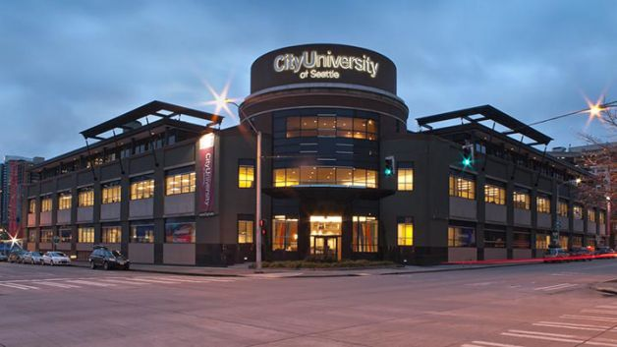
City University of Seattle
Notes:
Private non-profit started in 1973 to meet the needs of adult learners
Regionally accredited by Northwest Commission on Colleges and Universities since 1978
Today, offer online, mixed-mode, and in-person classes in US, Canada, Mexico, Europe and Asia
From the location in Seattle, WA, students located around the world are provided information services and resources by our library staff

Slide 4

Who needs libraries?
Notes:
What is a library director to do when management asks why library staff are needed when the resources students and faculty use are 98% digital? When management shares that they successfully completed their degree without using the services or resources provided by your library staff?
We face the same issues common to all academic libraries as budgets are constrained, information access expands online, and the traditional notions regarding the work of librarians persists with our users and stakeholders.
Over the course of the past 7 years we have questioned the traditional input/output data that we collected
Is the data actionable?
How many uses are sufficient to support renewal of databases?
Does the data help us with continuous improvement?
It’s nice to know that 88% of students agree that the library has the resources and services they need to be successful, but how do we improve for the remaining 12%?
If it does not, and generally it did not, what can we do to reduce the time staff spend gathering the input/output data?
And most importantly, what can we do to collect data that does a better job of providing actionable information that will help us improve service, or data that will expand understanding among key stakeholders of the depth and breadth of services and resources we provide in support of student success?

Slide 5

Assessment in Action (AiA)
Central Question:
What can the library learn about the impact of its instruction program on student learning by participating in the university’s Comprehensive Assessment Strategy?
Notes:
Joined 2nd AiA cohort to demonstrate positive impact of the library.
Other questions we asked, but which require more data in order to answer:
Do students with library instruction have higher grades, better retention, better engagement than students that don’t have any instruction? Or don’t use the library?
Too detailed:
Q1: Do students in courses with Level 3 instruction score higher on the university’s Information Literacy Rubric than students with Level 2 instruction?
Q2: Do students in courses with Level 2 instruction have higher scores on the CULG 3B Information Literacy Rubric than students with Level 1 library instruction?
Q3: Do students in courses with Level 3 instruction access library-created materials more times than students in courses with Level 2 instruction?

Slide 6
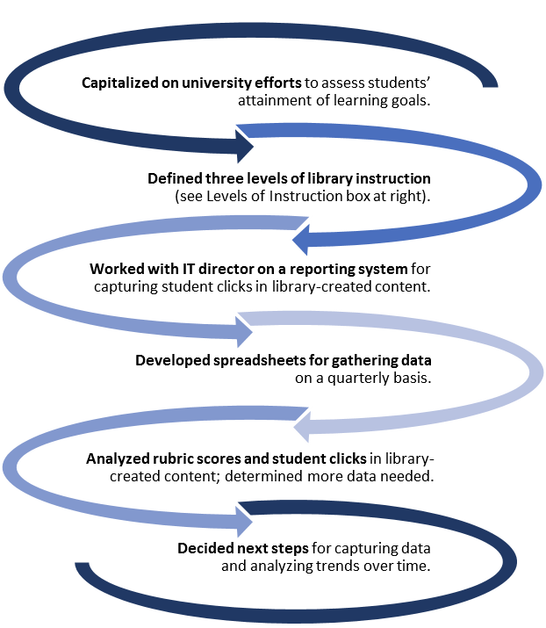
Early Steps

Slide 7
University Efforts
Capitalized on university efforts to assess students’ attainment of learning goals.
Notes:
Centralized curriculum. Designed at an institutional level by course managers and subject matter experts.
Librarians sit on curriculum council where these courses are approved, help course managers with designing assignments and picking course resources as needed, help design blackboard modules related to the library and supplement course material modules with library resources
Each course is mapped to the CityU learning goals and is mapped according to whether it is Introductory (I), Practice (P), Mastery (M). The assignments and outcomes of the course need to reflect the assignment to the CULG chosen.

Slide 8
CityU Learning Goals (CULGs)
City University of Seattle graduates exhibit professional competency and a sense of professional identity.
City University of Seattle graduates have strong communication and interpersonal skills.
City University of Seattle graduates demonstrate critical thinking and information literacy.
City University of Seattle graduates demonstrate a strong commitment to ethical practice and service in their professions and communities.
City University of Seattle graduates demonstrate diverse and global perspectives.
City University of Seattle graduates are lifelong learners.
Notes:
CityU has 6 learning goals but #3 is the one that the library has the biggest direct effect on. This is what we teach as an instruction team.
At a university level, secondary rubrics are being implemented in each course so that instructors can grade their students on these CityU goals. At this point, these “grades” are not available to students and are used to map progress of a program and not individual students.
A unique opportunity for the library to use these rubrics in order to see how instruction has an effect on CityU learning goal #3.

Slide 9
Instruction
Defined three levels of library instruction
Notes:
In order to make use of these rubrics we needed to determine levels of instruction. We need this to answer the question of whether more instruction or higher level instruction led to higher student success. We wanted to know the difference between a 5-10 minute library introduction, for example, and an embedded library activity where students interact with the librarian and are graded based on an upcoming assignment. These are very different things and need to be assessed as such.

Slide 10
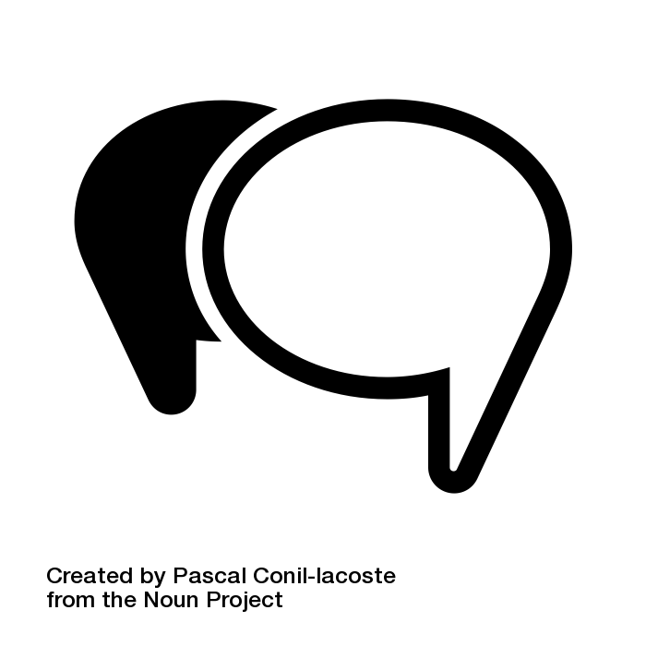


3 Levels of Instruction
Notes:
Level 1: access point for students. Librarian contact information added to the faculty information section in Blackboard and announcements added in classes welcoming students and introducing library services, and an Ask a Librarian link added to modules in courses. All of these areas of contact encourage students to reach out to librarians individually or through our online chat/emailing systems in Question Point
Level 2: Static interaction. Modules /folders incorporated in the classes, links to tutorials on the library homepage, handouts related to assignments and elements of the class. General or specific to concepts they will need in class.
Level 3: Library instruction in connection with an assignment. Designed in collaboration with the instructor or the course manager. Added at the course level but we’re working on adding more instruction at the design level so that it is built in to the classes. Direct relation to the assignment and topics of the class. In person, discussion boards, quizzes, activities
For AiA, we were trying to capture data about level 2 and level 3 instruction as accurately as possible. For AiA this meant how many students “clicked” on level 2 and level 3 instruction during the quarter.

Slide 11
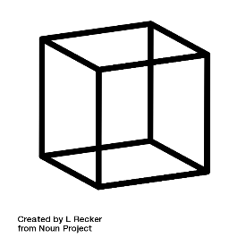

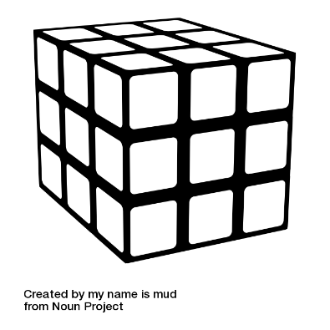
IT and “Data Cubes”
Worked with IT director on a reporting system for capturing student clicks in library-created content.
Developed spreadsheets for gathering data
on a quarterly basis.
Notes:
Collab. with Office of institutional effectiveness to get advice on collecting data. At the time this gave us information about who was clicking on resources and how often but nothing else.
Once we developed the 3 levels we were able to think about what we wanted to look at. Which level had the biggest impact on student success?

Slide 12
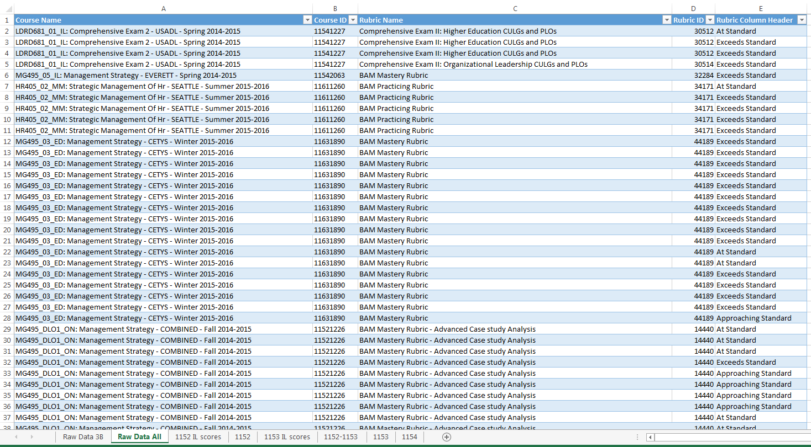
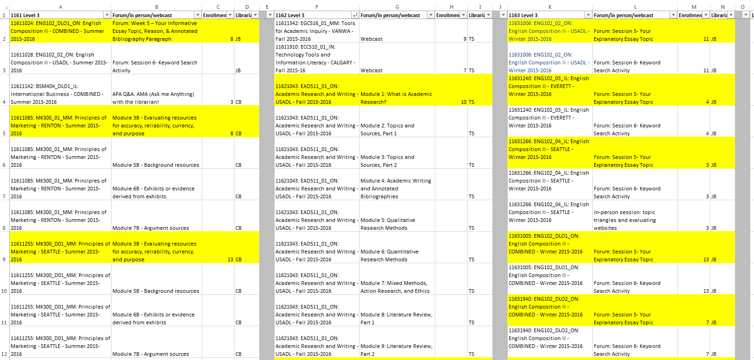
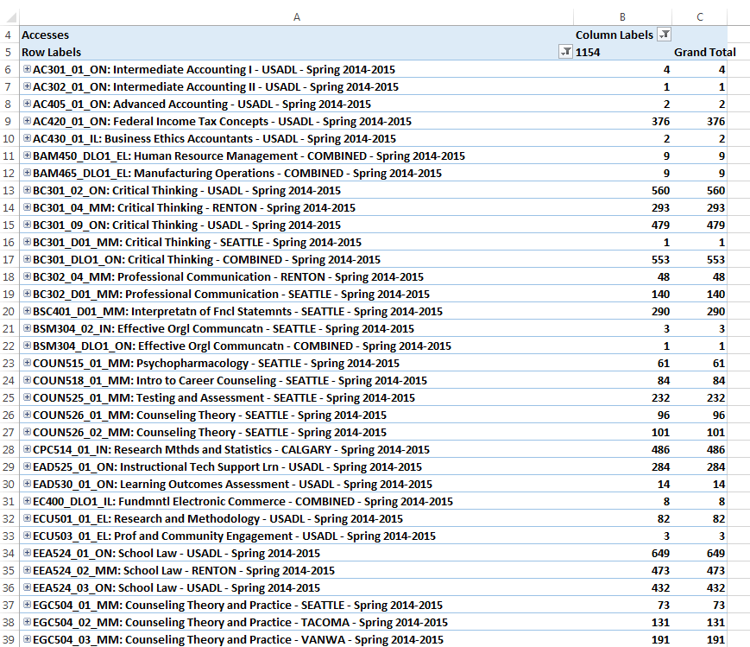
Data for AiA
Notes:
Instruction data from many different places telling us very different information. Participation in modules (level 2), level 3 instruction hand collected from librarians into this table. To combine these data points we had to copy and paste the relevant columns into one Excel spreadsheet.

Slide 13
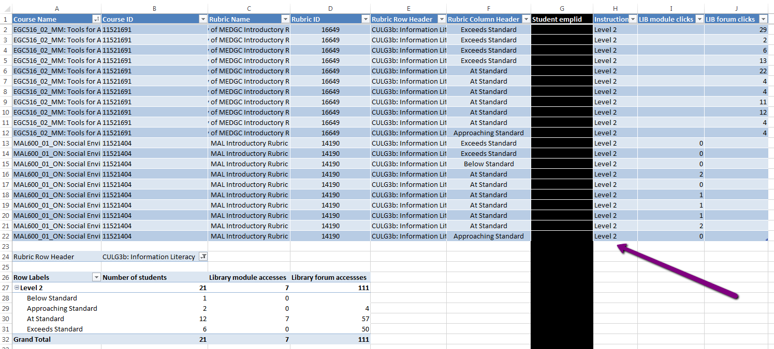
Final Product
Notes:
To start, some data pulled automatically from Blackboard by IT data cube and other data (mostly level 3) added by hand. All levels were added manually as all library instruction.

Slide 14
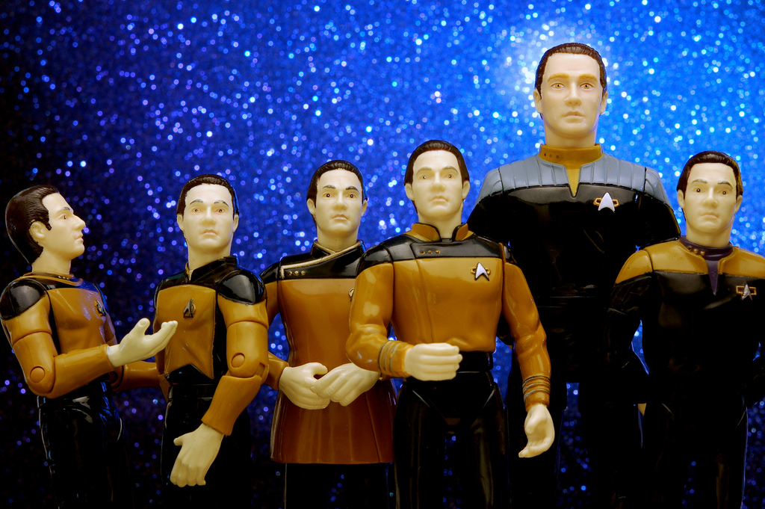
Lessons Learned
So much data!
What does it mean?
Notes:
This is the background and starting point to our assessment project and it has evolved since then.
We learned that we have so much data!
Al will be talking about what we have done to try to decide which data is important to us for the instruction program and what we have done to collect it.

Slide 15
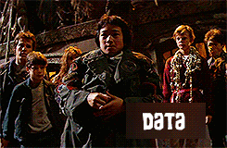
Notes:
So let’s talk about Data , no – not THAT Data although he is my favorite ….

Slide 16

©2012-2016 Roos-Skywalker
Notes:
We’re talking about student data…

Slide 17
REVIEW: 3 Levels of Instruction
©2012-2016 Roos-Skywalker
Notes:
As you’ll recall, moments ago Carolyne talked about the 3 levels of instruction we provide noting the differences between level’s 1, 2, and 3.
And as she mentioned, we’re focused on level’s 2 and 3: Static or passive interaction in modules vs. active interaction or instruction in connection with an assignment.

Slide 18

#DataDrivesDecisions
Notes:
Data drives decisions and -- In order to harvest the information we needed, we created a set of standardized naming conventions and applied these naming conventions to various items in the modules.
You’ll recall that our data stemmed from primarily two sources: data that was shared with us from our IT department and data that we hand coded into our data cube.
Working with our IT department, we began to capture live student data from various points of contact. However, when we began to harvest the data we quickly realized that in addition to capturing student clicks, we were capturing all users: Students, Faculty, Librarians, Course Managers, Program Directors, and more. At some point, it began to feel like data was coming at us from everywhere…

Slide 19
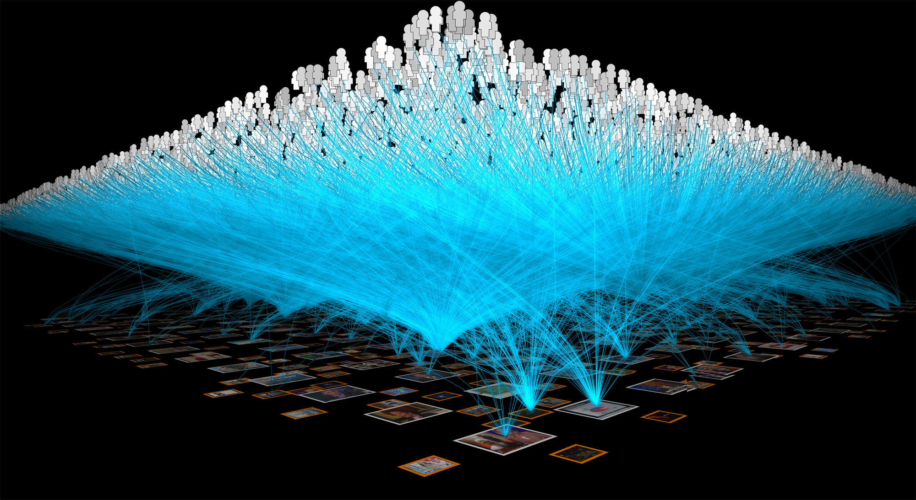
#Harvest
©2012-2016 Roos-Skywalker
Notes:
To parse the information we needed, we refined our data by identifying the role of the user. Once the user(s) were identified, we recalibrated to avoid “double-dipping” with regard to clicks. We also developed specific data views that are consistently used for key questions to inform stakeholders.
Today, we’re tracking student engagement in various ways: We’re measuring student activity in online learning modules, discussion boards, using the “Ask a Librarian” feature on our website, and even EZ Proxy.
We’re hoping to learn more about what works to support student success and where we can continue to grow and develop. As librarians/content creators in the learning environment, we use variety and relevance to create content that is helpful for students to stay motived throughout the course. If we’re noticing an uptick in usage for a particular research-starter module, or if an item previously created and is not getting very much engagement, this is the information we want to know.
Our goal, as it is with many of our fellow colleagues, is to create purposeful informational content that promotes interaction, participation, and communication with the library in the online environment.
And now I’ll turn it back over to Mary Mara as she tells us more about what’s in our future.

Slide 20
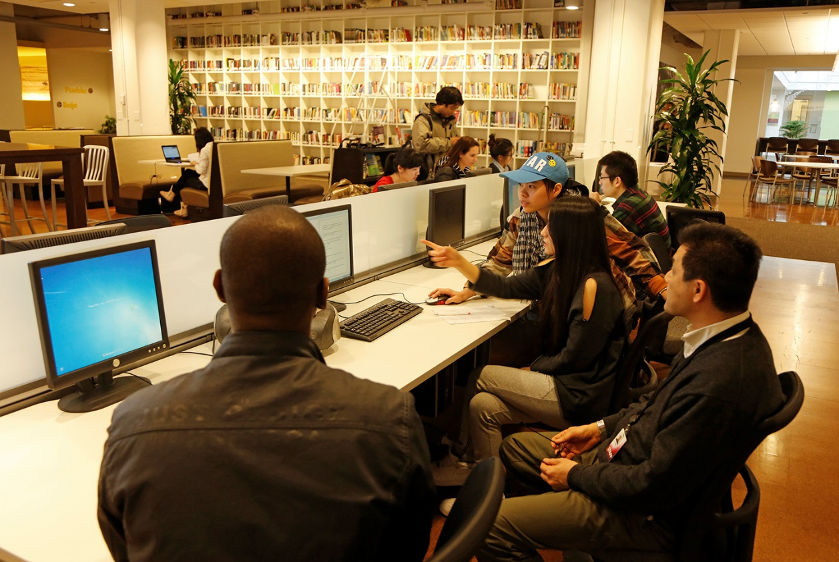
What’s next?
Notes:
Answer the question who is and who is not using the library? Is there a correlation between library use and student achievement? Student retention?
Data collection process for LMS use and Ask a Librarian is established
Add process for adding EZProxy data and demographics
Establish baseline usage, develop strategies to increase library use, and monitor trends over time
Gather AY16 data for the student retention framework that documents engagement with students through the library facilities, collection, instruction, and library staff
Further explore the emerging framework of low, middle, high-need students as we share our story with management and other key stakeholders

