Slide 1

Dissertation Construction: Building Better Scholars with Our Toolbox Series
Amanda Bezet
Benita Ghura
Tammy Ivins
Stephanie Johnson
Notes:
5 min - intro [Tammy]
our names

Slide 2
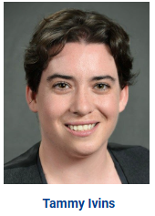
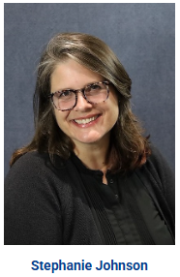
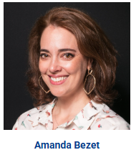
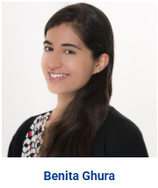

Introductions
Notes:
5 min - intro [Tammy]
What the Dissertation Toolbox is & why it is awesome (elevator pitch)

Slide 3
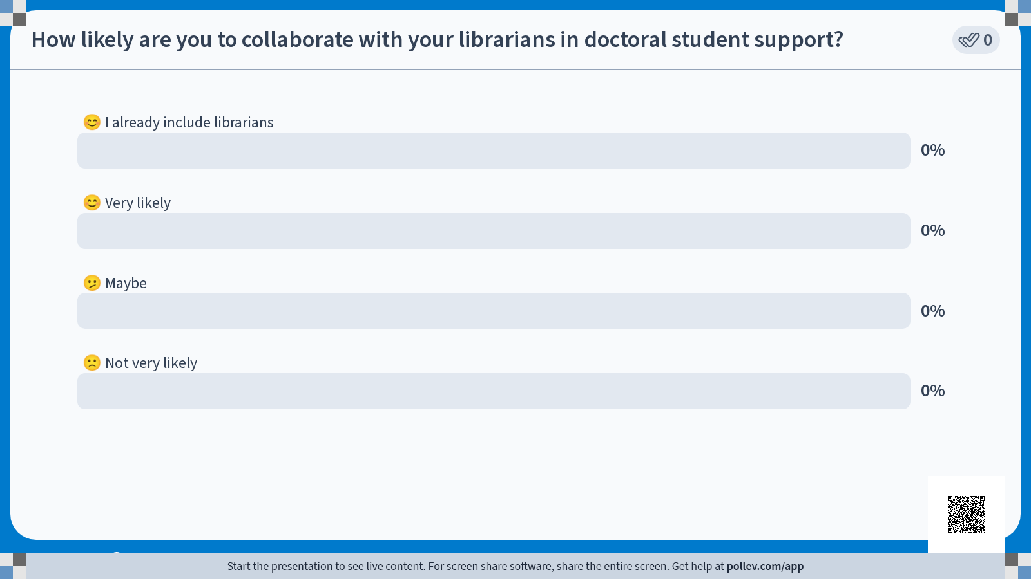
Poll
Notes:
5 min - intro [Tammy]
What the Dissertation Toolbox is & why it is awesome (elevator pitch)

Slide 4
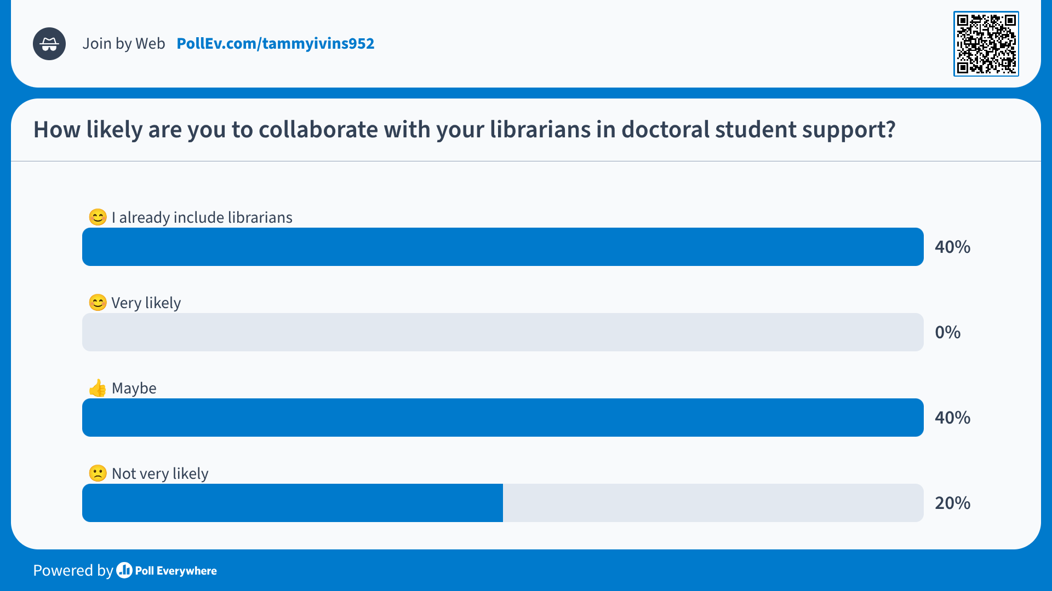
Poll

Slide 5

info
26 online doctorate degrees offered
5,000+ doctoral students currently enrolled

Slide 6

info
12 webinars designed specifically for doctoral students.
Covering how locate, evaluate, and use information relating to your dissertation research topic.
Standalone, do not require contiguous attendance.

Slide 7
How the Toolbox Was Built
Notes:
10-15 min - background [Amanda]
Describe NU context
history of the library’s Dissertation Toolbox series (NCU)
POLL: Hands up for similar, existing programs at other institutions

Slide 8
Building the Toolbox
March 2019
“An ongoing group series for doctoral students where they learn to locate, then evaluate, then use information relating to their topic effectively (i.e., they progress through the series). Your focus will be on modeling processes.”
Brainstormed session topics, learning objectives, frequency/schedule, polls, event description, follow up email/survey
Formal proposal with supervisor feedback and approval to go forward
Notes:
Began with a suggestion/directive from a former supervisor - first bullet.
Reference & Instruction librarian Amanda Bezet brainstormed - bullet 2

Slide 9
Building the Toolbox
April-May 2019
Drafted 12 individual session agendas
Fine tuned schedule
  Wednesday evenings at 6pm PT
  Sessions held every two weeks
  Each session would be held once every 6 months
Scheduled full series in LibCal, beginning June 2019
Advertised on Library website & Commons

Slide 10
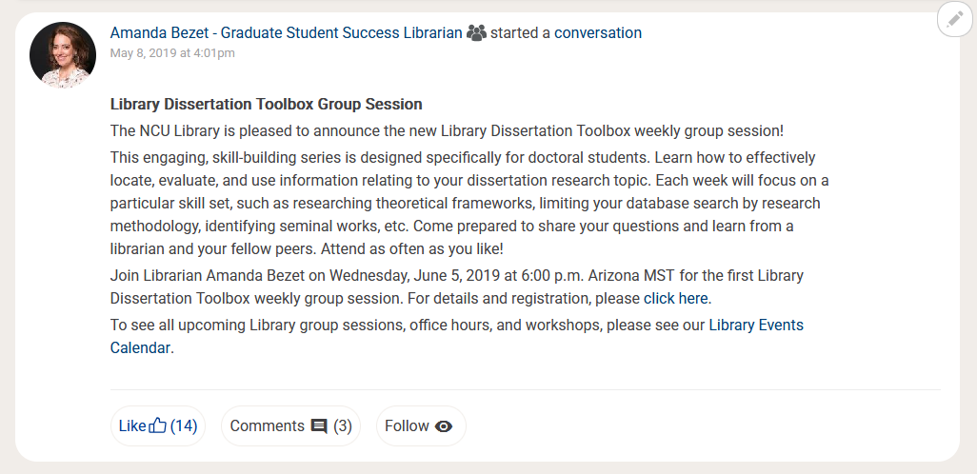
example
Notes:
Commons post - first announcement

Slide 11
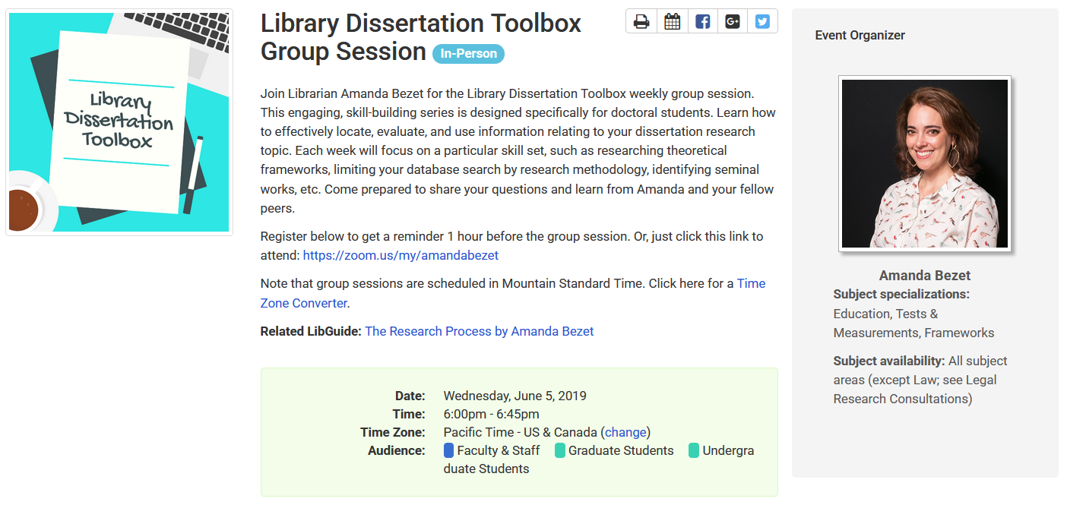
example
Notes:
First LibCal

Slide 12
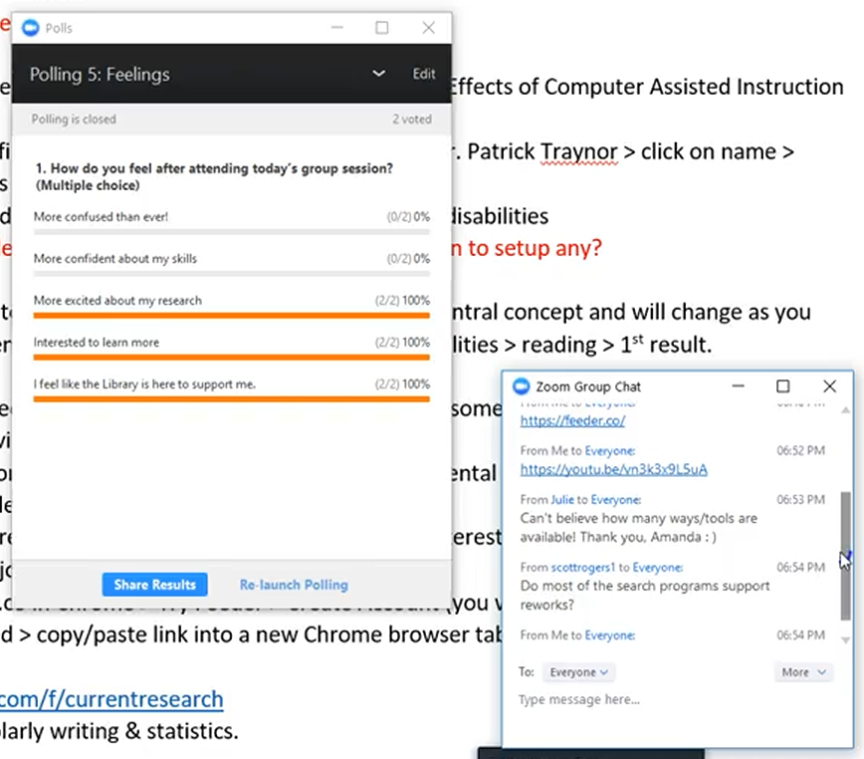
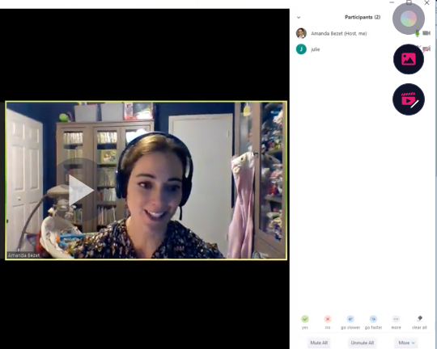
Examples
Notes:
First session was held on Wednesday, June 5, 2019 and the session was finding a research topic.
Only three participants but with positive feedback - “Can’t believe how many ways/tools are available!” Zoom polls also indicated that students felt more excited about their research, were interested to learn more, and felt like the library was there to support them.

Slide 13
Stumbling Blocks
Notes:
Amanda - So while I had some initial success with the Library Dissertation Toolbox series, there were certainly some stumbling blocks.

Slide 14
Changes
Early marketing efforts and event listings did not specify individual session content
Exhausting the Literature
  Not included in original series but recognized the need
  Added session in June 2022
Finding Systematic Reviews & Meta-Analyses
  Faculty directed students not to use in dissertation research
  Removed from series in April 2023
Dissertation Toolbox Office Hours
  11 sessions offered from January - May 2023 with 13 total participants
  Discontinued due to low attendance
Notes:
1st bullet “as evident by the previous images…” So Amanda had to pivot to post individual sessions rather than the generic listing.
3rd bullet - Amanda heard at dissertation boot camps that students were advised never to use systematic reviews or meta-analyses and that they were not valued as the highest level of research evidence.
4th bullet - 5 out of the 11 sessions had zero participants

Slide 15
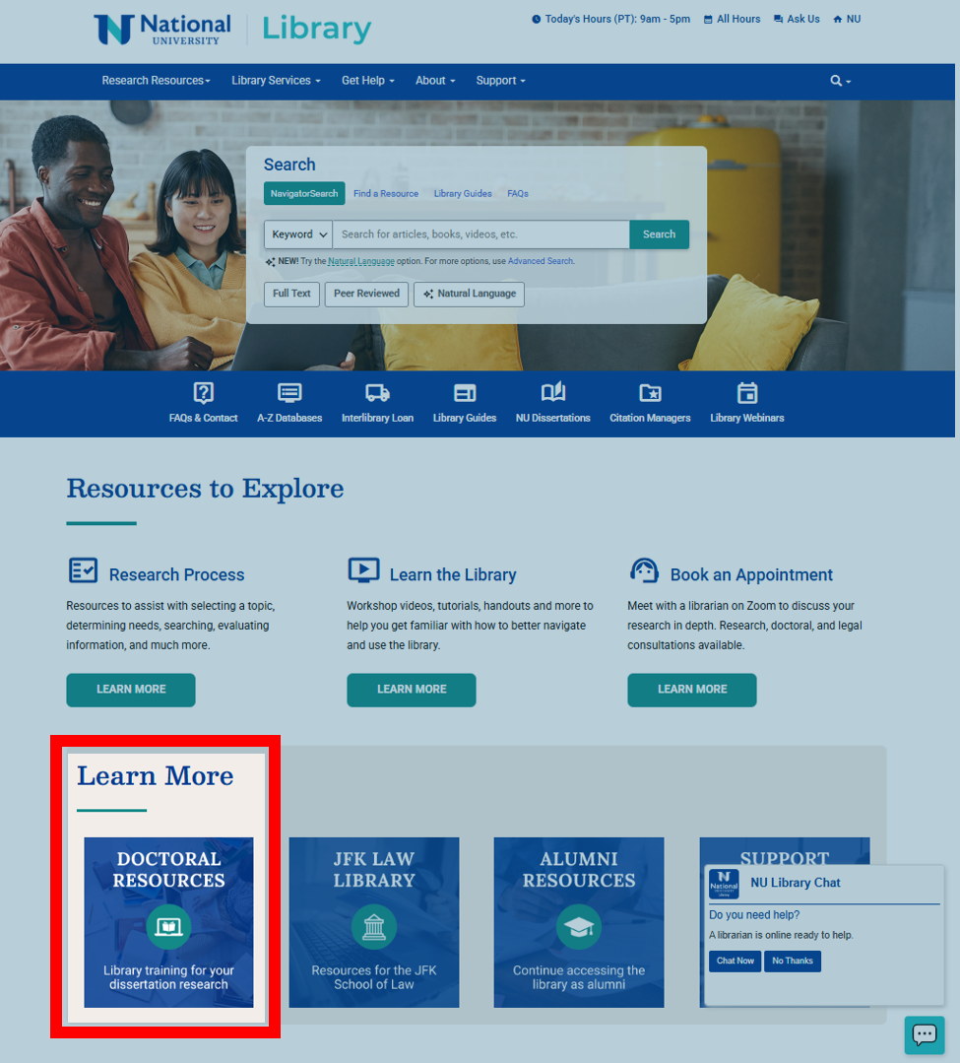
Expanded Marketing

Slide 16
Challenges Doctoral Students Face
Notes:
10 min - specific challenges [Stephanie]
POLL: Audience feedback on the most common research challenges faced by their doctoral students
Discussion of the specific topics covered by the Toolbox series (compare to poll results as appropriate)

Slide 17
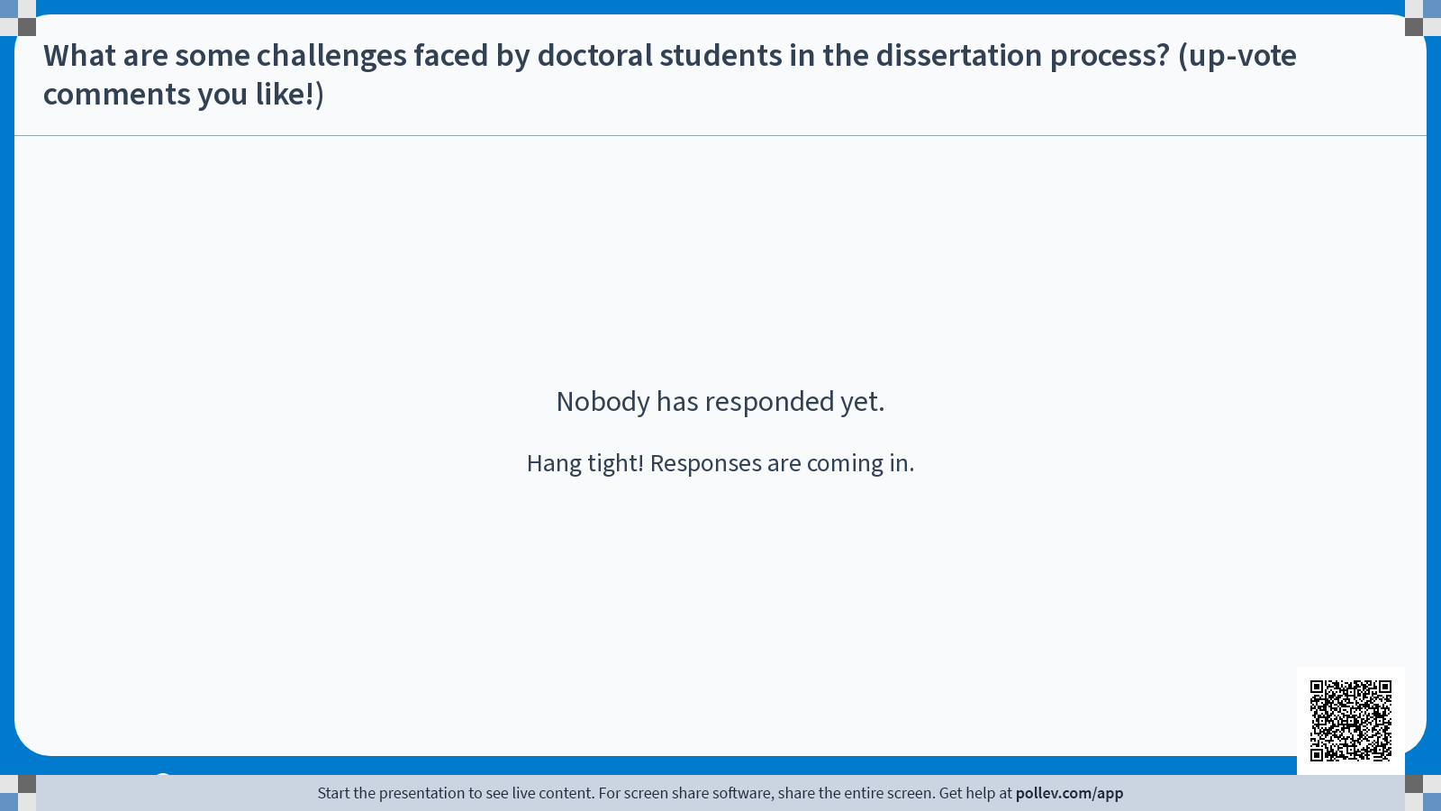
poll

Slide 18
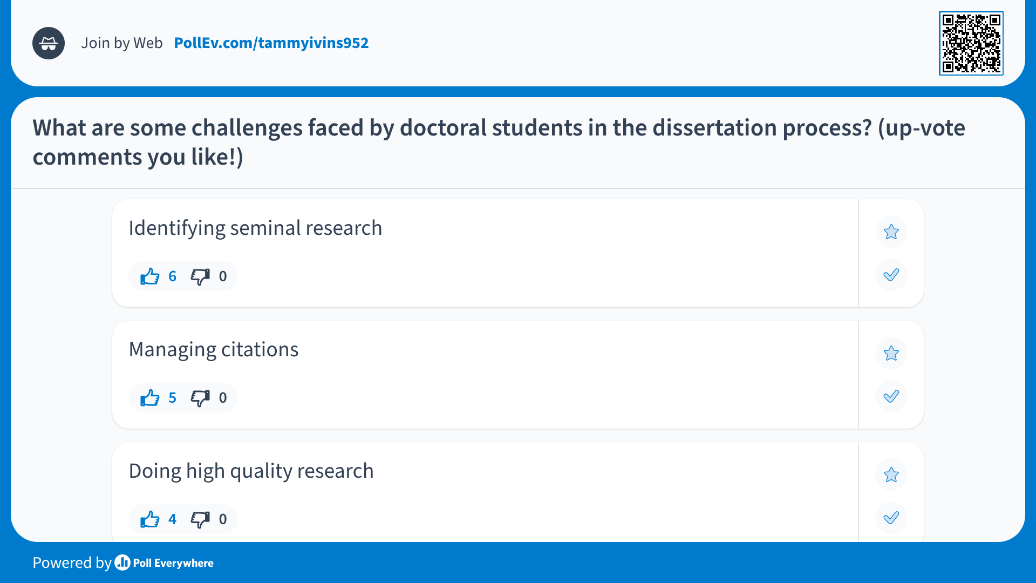
Poll

Slide 19
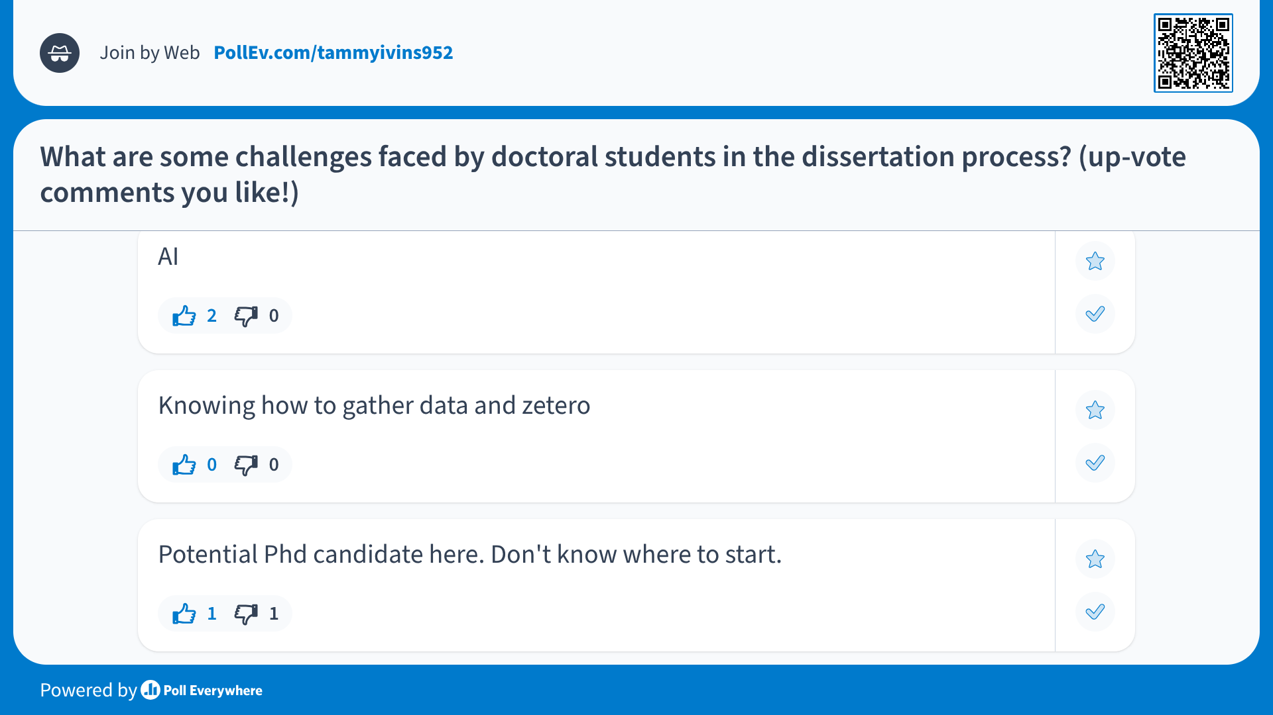
Poll

Slide 20
Dissertation Toolbox Topics
Finding and Staying Current on a Research Topic
Reading a Scholarly Article and Finding Definitions
Literature Gap and Future Research
Notes:
Learn about how to use the Library and online resources to find and stay current on a research topic
Learn effective techniques for reading and understanding a scholarly article, as well as locating definitions related to your research topic.
Learn effective techniques for reading and understanding a scholarly article, as well as locating definitions related to your research topic.
Keep in mind that the students who register, not necessarily ATTEND, but at least register, get a copy of the recording. If we have 25 registered, we often have between 8-15 attendees and 5-10 recording hits, which just about accounts for every registrant. These numbers have shown us that the topics are still valid and useful, even after 5+ years. We have worked in AI to each of these sessions, as well. Though we are not spending a ton of time showing the students how to use AI to complete these tasks, we certainly are not ignoring its existence. We do not get into the paid versions of the AI we talk about, instead we focus on the free versions and how they can be used in tandem with the students’ own research skills to create a more robust literature review and search.

Slide 21
Dissertation Toolbox Topics
Organizing Research
Citing Articles and Similar Resources
Evaluating and Using Information
Notes:
Learn about Library resources, including database accounts and citation management tools, to help organize your research.
Learn how to locate citing articles for a resource and use other techniques for finding similar research.
Learn how to effectively evaluate and use resources. This session does not review citing and APA Style. Please see the Academic Success Center for all writing help.

Slide 22
Dissertation Toolbox Topics
Finding Grey Literature
Finding Seminal Research
Researching Theoretical and Conceptual Frameworks
Notes:
Learn how to identify and locate grey literature in the Library and online.
Learn effective techniques for identifying and locating seminal research.
Learn how to effectively search for theoretical and conceptual frameworks both online and in the NU Library.

Slide 23
Dissertation Toolbox Topics
Finding Information on Research Methodology & Design
Locating Tests and Measurements
Exhausting the Literature
Notes:
Learn how to locate reliable information relating to research methodology.
Learn how to effectively locate test instruments within scholarly articles, dissertations, and specialized databases.
Learn advanced search techniques and practical tricks for revealing all of the relevant literature on your topic.

Slide 24
poll

Slide 25
poll

Slide 26
poll

Slide 27
Growing the Toolbox
Notes:
10 min - growth [Benita/Tammy]
Cross-training of other librarians
Expanding days & times
Incorporating AI
POLL: Hands up for feeling like this is possible for their institutions

Slide 28
Growing the Toolbox
Three new librarians have joined Amanda
Cross-training:
  Discussion and reflection on the series
  Review of outlines & instructional design
  Live shadowing and watching recordings
Notes:
Cross-training:
Dissertation tool box planning began in September 2024 with two meetings to discuss learning the content via webinar outlines and recordings of past sessions.
Each librarian incorporated their own learning style. For me, I would watch the recordings and make notes. For consistency the structure and presentation remained the same among the librarians. Differences in delivery style and examples differed slightly.

Slide 29
Growing the Toolbox
Increased frequency - each session, more often
Typically, 2 session per week on the same topic
New days and times
Notes:
Webinar offered Tuesday-Fridays, different times. Empowers students to select days/times that work with their schedule. Creating greater flexibility for the student.

Slide 30
Growing the Toolbox
Students are interested in AI, faculty are concerned
Mindful, intentional, and selective inclusion of AI tools into each Toolbox session
Pitfalls and issues are raised
Notes:
Faculty’s growing concern with AI ethics, plagiarism and detection. Currently, there is no reliable tool to detect plagiarism but indicators include writing style and tone of voice. Other faculty suggest having post-assignment discussions with students to learn their work process. Academic integrity is a key concern.

Slide 31
Success & Future of the Toolbox
Notes:
5 min - Tammy
Reflect on success (share feedback from students)
What is next: developing async video series (like the ”locating theoretical and conceptual frameworks” one)
POLL: openness to librarian collaboration

Slide 32


Success
Student Impact
“The dissertation toolbox series you have facilitated helped me to expedite the content gathering and writing. I sincerely appreciate your valuable contribution and assistance on my learning journey.”
“This was the best thing I could have done to prepare for my literature review. Very informative and helpful.”
“Months ago when I entered the beginning stages of the dissertation, I was a nervous wreck and I felt really dumb regarding my research skills. Since that time, attending meetings with the Librarians as well as today's meeting: "Exhausting The Literature", I always learn something new that can be immediately applied for searching and for research.”

Slide 33
Success
Attendance and Stats
2023-4 AY 24 sessions 200 attendees
2024-5 AY 60 sessions 406 attendees
July-Oct ‘25 35 sessions 338 attendees

Slide 34
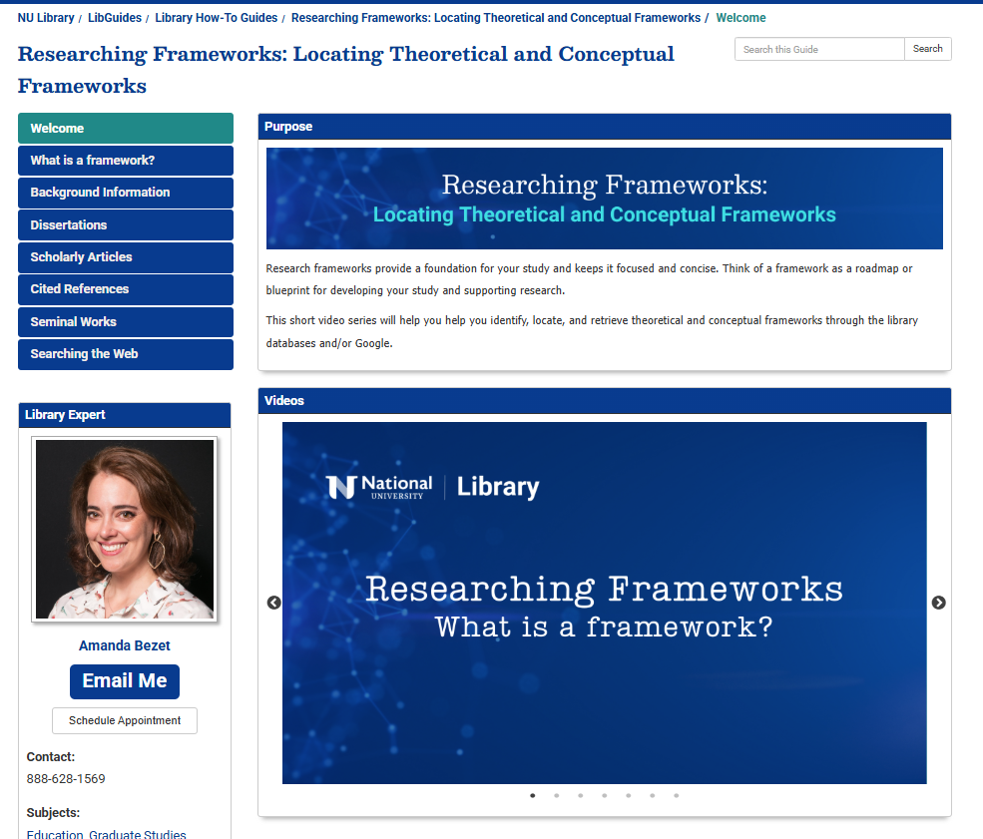
What is next?
The Asynchronous Revolution
Adapting each of the live Toolbox webinars into a series of short, modular videos.
This asynchronous model has been successful for “Locating Theoretical and Conceptual Frameworks.”

Slide 35
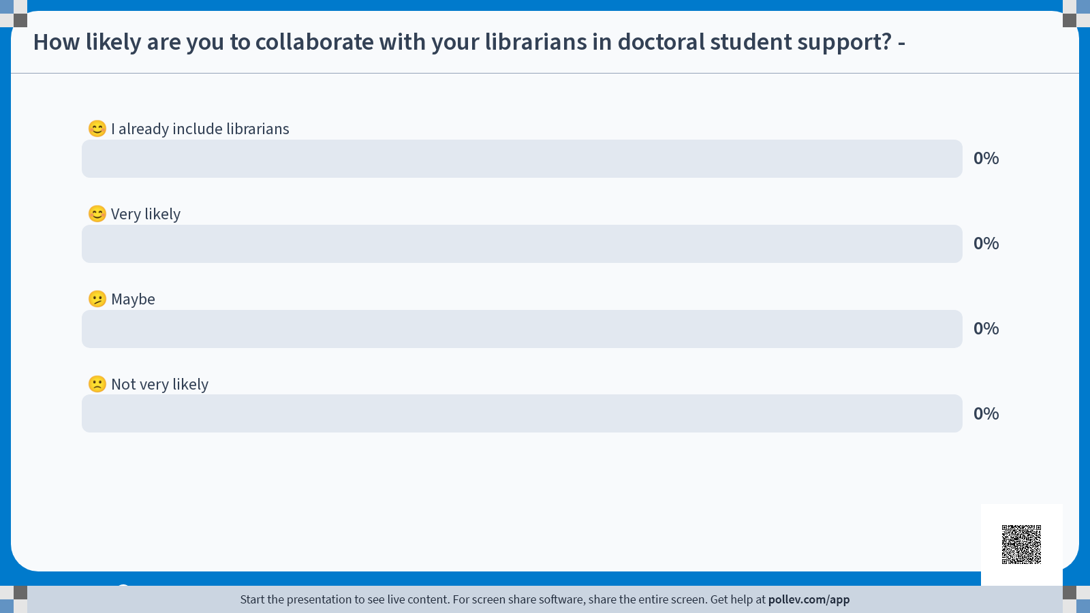
poll

Slide 36
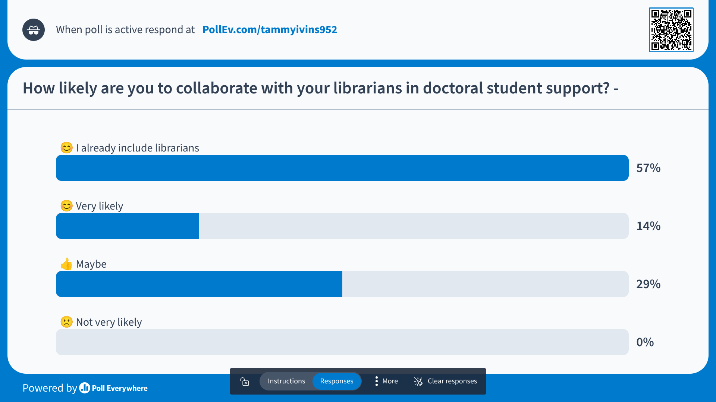
poll

Slide 37
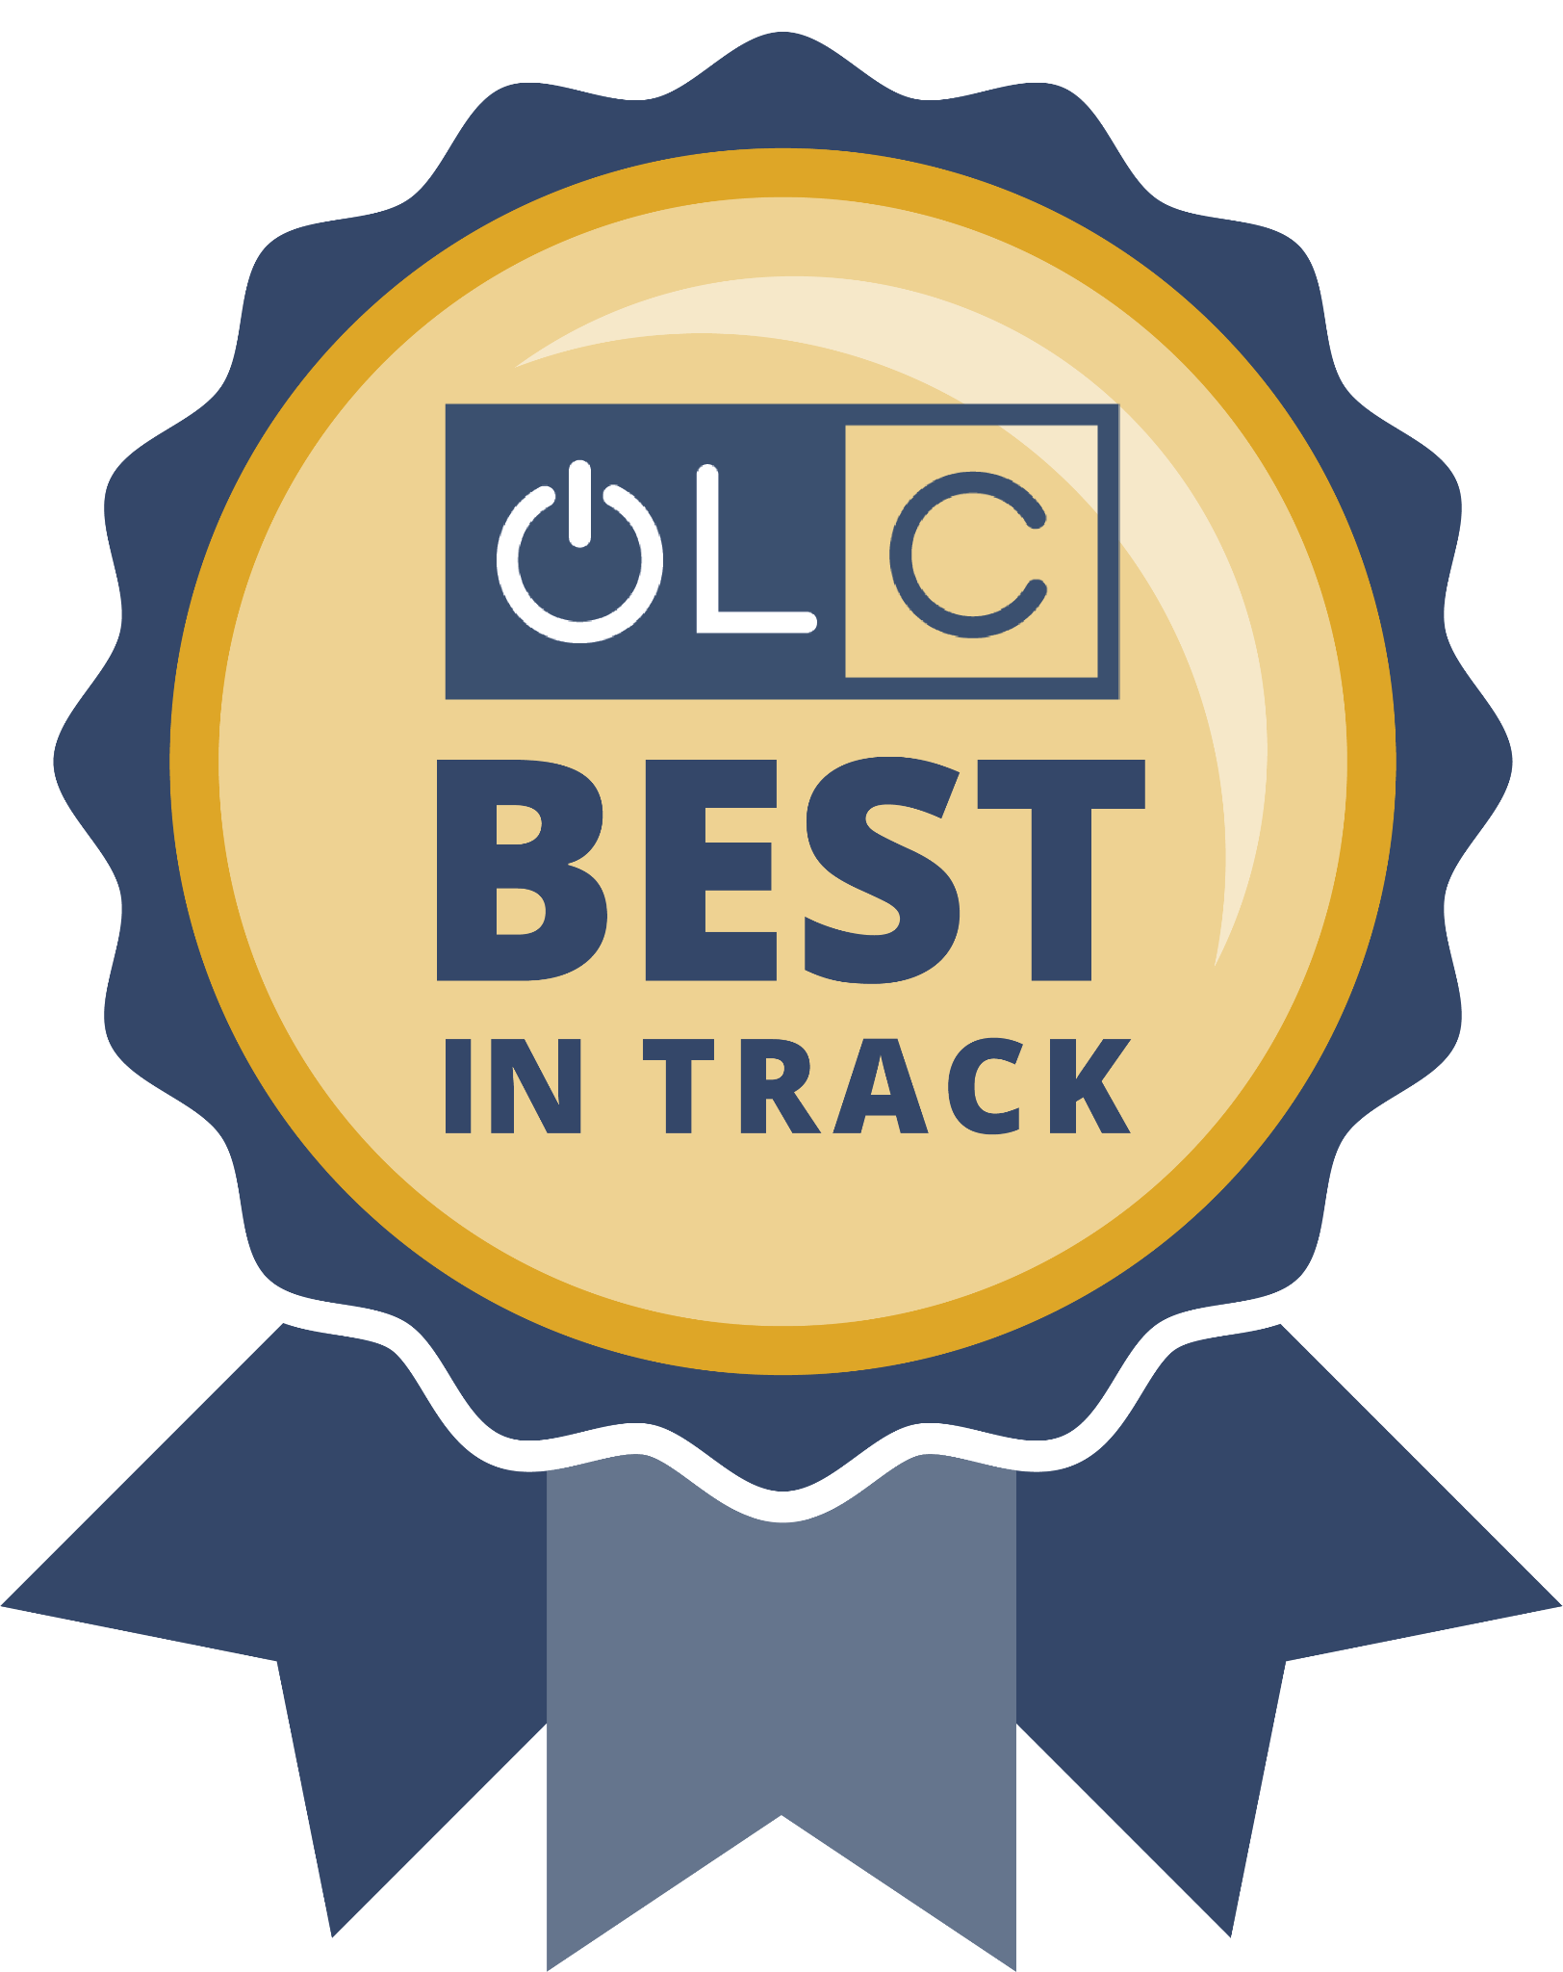
Help Determine Best In Track Awards
Your Voice Matters!
Evaluate sessions and win a gift card!
Navigate to the specific session via the session listing in the mobile app or through the conference platform.
Select “Evaluate Session” on session details screen.
Complete the session evaluation.*
*Each session evaluation completed (limited to one per session) = one contest entry. Five $25 gift cards will be awarded.

Slide 38
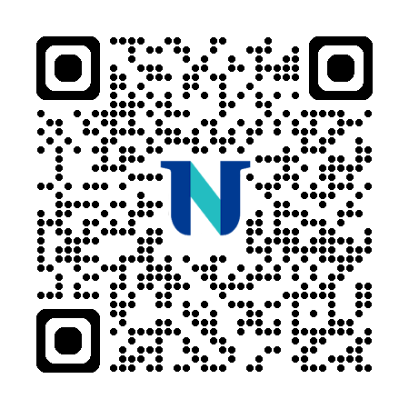

Questions?
Slide deck:
Contact:
Tammy Ivins, tivins@nu.edu
Stephanie Johnson, sjohnson10@nu.edu
Benita Ghura, bghura@nu.edu
Amanda Bezet, abezet@nu.edu

