Slide 1
Strategic Leadership in Resource-Constrained HBCUs: Uncovering the Levers Shaping STEM Success and National Talent Pipelines
Tracy B. Young
National University
Dissertation Chair: Dr. David Cross
Subject Matter Expert: Dr. Stephanie Menefee
Academic Reader: Dr. Jingyun Zhang
Notes:
Good Morning, Afternoon, or Evening. Thank you for joining us today. My name is Tracy B. Young, and I'm a doctoral candidate at National University in the College of Business, Engineering, and Technology.
Today, we will present research on the institutional and leadership characteristics that contribute to STEM (Science, Technology, Engineering, and Mathematics) success at small Historically Black Colleges and Universities (HBCUs).

Slide 2

Study Focus
National Imperative: A diverse STEM workforce.
Systemic Barrier: Funding inequities and resource limitations.
Knowledge Gap: Leadership and strategic practices drive STEM Success.
Notes:
This dissertation explores the critical relationship between institutional leadership and strategic practices and their contribution to successful STEM outcomes at small HBCUs. HBCUs are indispensable to the national talent pipeline, yet they operate within a larger context of systemic funding inequities (Jaeger, Mckayle, et al., 2023; Upton & Tanenbaum, 2014a). Research is warranted because small HBCUs possess a significant untapped talent pool in STEM, but their specific successful strategies are often overlooked (Boncana, Smith, et al., 2021). While research exists on HBCU impact (Clavier, Dancy, et al., 2021; Jaeger, Hill, et al., 2023), there is limited qualitative, case-specific evidence linking leadership behaviors to outcomes in this resource-constrained context. To address this, we define the Problem Statement.

Slide 3


PROBLEM and PURPOSE STATEMENTS
The problem addressed in this study was that small HBCUs possess a significant untapped talent pool in STEM fields but face systemic challenges in optimizing institutional and leadership strategies to fully support this potential.
The purpose of this qualitative case study was to explore and identify institutional and leadership characteristics that contribute to STEM success at small HBCUs.
Notes:
The central problem: Small HBCUs are essential drivers of the national Black STEM talent pipeline, but face significant, systemic challenges—primarily funding inequities, resource limitations, and structural barriers (Jaeger, McKayle, et al., 2023; Upton & Tanenbaum, 2014a). Consequently, they struggle to fully optimize their institutional and leadership strategies to support this critical talent pool.
The goal of this study was to address that gap: to explore and identify the specific institutional and leadership characteristics that contribute to STEM success at these small HBCUs. Key factors examined focused on actionable elements like leadership vision, faculty development, and external partnerships (Boncana et al., 2021c; Clavier, Dancy, et al., 2021; Jaeger, Hill, et al., 2023a). The desired outcomes allowed us to understand how these elements collectively influence positive STEM outcomes, including degree production and retention rates.

Slide 4

RESEARCH QUESTIONS
RQ1 - What institutional characteristics were perceived to support higher STEM degree attainment at small HBCUs?
RQ2 - How do leadership characteristics influence STEM student success at small HBCUs?
RQ3 - In what ways do institutional and leadership characteristics interact to shape outcomes in STEM degree production at small HBCUs?
  Framework: Transformational Leadership
  Goals: Explore institutional strategies and leadership influence in resource-constrained HBCUs.
  The Study: Addressed three interrelated questions
Notes:
Our analysis was structured by three critical, interrelated research questions: RQ1 (Structures) focused on tangible programmatic features institutions documented as keys to success; RQ2 (Behaviors) examined leadership styles and their relationship to student success; and RQ3 (Synergy) explored the alignment between strategic vision and operational effectiveness. These questions allowed us to move beyond correlation to a detailed examination of leadership actions (Jaeger, Taylor, et al., 2023).

Slide 5


FRAMEWORK: Transformational Leadership (TL)
Vision & Inspiration
Mobilizing stakeholders toward shared goals in STEM education.
Institutional Capacity Building
Creating cultures of accountability, innovation, and collaboration.
Data-Informed Decision Making
Aligning structures and policies with desired STEM outcomes.
Driving Transformation & Equity
Leveraging leadership to achieve institutional change and fairness.
Notes:
Our study is grounded in the Transformational Leadership (TL) Framework (Jaeger, Taylor, et al., 2023), the essential lens we used to analyze how small HBCUs drive STEM success for underrepresented students. This framework links visionary leadership to the institutional strategies necessary for major organizational change (Northouse, 2021). The framework guides the analysis of Institutional Capacity by detailing how leaders foster accountability and use Data-Informed Decision Making to align structures and overcome resource constraints (Chang & Menzies, 2022c), effectively linking leadership to operational success. Furthermore, these elements integrate to drive Transformation and Equity, the outcome of achieving both excellence and equity within the HBCU context (Jaeger, Hill, et al., 2023), advancing practical models for sustainable success.

Slide 6

REVIEW OF THE LITERATURE
Context & Framework
HBCUs as Vital STEM Contributors
Transformational Leadership Framework
TL's Four Dimensions
Critical Literature Gaps
Notes:
The literature review synthesized four major themes, confirming the critical role of HBCUs as Vital STEM contributors (NSF, 2021a; Clavier, Dancy, et al., 2021). Notably, despite chronic underfunding, these institutions produce nearly 30% of all Black science and engineering doctorates. It solidified the Transformational Leadership (TL) Framework as the conceptual lens, emphasizing that visionary leadership was critical for understanding innovation and change at minority-serving institutions (Northouse, 2021; Jaeger, Hill, et al., 2023). It also detailed TL's Four Dimensions (Idealized Influence, Inspirational Motivation, Intellectual Stimulation, and Individualized Consideration), which provided the concrete structure for the research questions (Bass, 1990; McGee, Bentley, et al., 2023). Finally, it identified Critical Literature Gaps, pointing out the limited focus on small HBCUs and the scarcity of qualitative research on leadership-strategy interaction (NCES, 2020; Clavier, Thompson, et al., 2021). This gap defined our mission: to provide the qualitative evidence needed to strengthen the strategy and policy solutions for these resource-constrained institutions.

Slide 7

RESEARCH METHODOLOGY & DESIGN
Case Constructions
Data Collection
Analysis & Validation
Notes:
We used an exploratory, inductive qualitative case study to understand the nuanced "how" and "why" of STEM success. The research was structured in three integrated phases: Phase 1 (Case Construction) established the foundation and selected the final 15 cases. Phase 2 (Data Collection) performed systematic document analysis, linking leadership intent with operational strategies. And Phase 3 (Analysis & Validation) utilized NVivo software for systematic coding, guided by a comprehensive Codebook, with findings validated through triangulation.

Slide 8

POPULATION & SAMPLE
Target Population
Small HBCUs with student enrollment between 800-2,500
Purposive Sampling
15 institutions selected for diversity in geographic location and institutional type
Selection Criteria
Established STEM programs, publicly available reports, and accessible leadership documents
Notes:
The target population was small HBCUs with enrollment of 800−2,500 students with active STEM programs. We began with 100 HBCUs, and 34 institutions met the criteria, and used Purposive Sampling and Statistical Package for the Social Sciences (SPSS) to select the final 15 cases to ensure maximum diversity in context. Cases required some established STEM disciplines and accessible public documents for analysis. This rigorous process ensured data saturation—as no new themes emerged after analyzing approximately 12 cases—providing confidence that our findings are robust, allowing us to advance actionable insights from the full scope of institutional and leadership characteristics.

Slide 9


MATERIALS & INSTRUMENTATION
Institutional Websites
IPEDS Datasets
Public Documents
Supplementary Research
Notes:
This study relied exclusively on document analysis (Yin, 2018). Data materials were drawn from four sources: Institutional Websites, IPEDS Datasets (NCES, 2020), Public Documents (strategic plans), and Supplementary Research. The core analytical instrument was the researcher-developed Code Book, designed based on the Transformational Leadership Framework (Bass, 1985) and existing literature. It contained over 50 defined items across six domains. The instrument’s clarity was confirmed through expert review for qualitative trustworthiness (Creswell & Creswell, 2018). Final coding was facilitated by NVivo software.

Slide 10


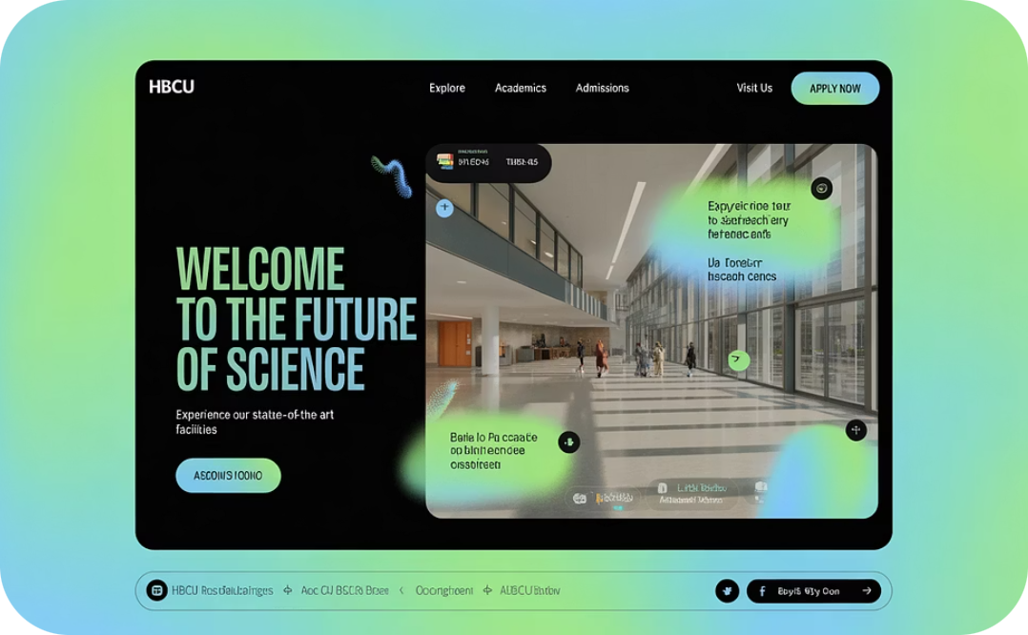
STUDY PROCEDURES
Document Analysis
Institutional Artifacts
Observational Sources
Notes:
Our systematic data collection was designed to inform a replicable qualitative case study (Yin, 2018) across the 15 institutions. This ensured robust triangulation for trustworthiness. We analyzed three categories: Document Analysis consisting of institutional websites, strategic plans, and other related reports (Creswell & Creswell, 2018), Institutional Artifacts such as promotional materials, partnership announcements, and student success dashboards (Jaeger, Hill, et al., 2023), and Observational Sources included publicly available virtual campus tours, leadership addresses, recorded town halls, and other institutional media content (Clavier, Dancy, et al., 2021). This rigorous process assured the fidelity of our evidence.

Slide 11

DATA ANALYSIS
Thematic Development
Identifying patterns across institutions
Case Summary Development
Structured around five analytical categories with qualitative ratings
Interpretation & Findings
Synthesizing themes into actionable insights
Notes:
The data analysis phase began with Thematic Development using NVivo software to systematically categorize patterns (Creswell & Poth, 2018; Lincoln & Guba, 1985). The inquiry was defined by the Coding Framework, which systematically applied six primary thematic groupings: Leadership Team (LT), Mission/Vision (MV), Institutional Environment (SIE), Student Supports (SSS), External Pathways (SP), and Business Partnerships ensuring alignment with our research questions. Interpretation and Findings involved synthesis rigorously established through triangulation, cross-referencing codes against quantitative frequency counts (Patton, 2015). This process produced robust and actionable insights (Nowell et al., 2017).

Slide 12


LIMITATIONS
Data Sources
Temporal Nature
Generalizability
Transferability
Notes:
Our study relied exclusively on publicly available data, posing a threat to credibility (Lincoln & Guba, 1985). We mitigated this using data triangulation (Yin, 2018) across multiple public sources. Data were also temporal and subjective, threatening dependability (Lincoln & Guba, 1985). We addressed this using qualitative analysis software for consistency and peer debriefing by two external scholars to strengthen confirmability (Miles et al., 2020). As a qualitative case study, our findings are not intended to be broadly generalizable. Instead, we focused on transferability (Lincoln & Guba, 1985). We provided rich, detailed accounts (thick descriptions) (Creswell & Poth, 2018) of each institution's context, allowing readers to assess the applicability of our findings to their own unique situations.

Slide 13
ETHICAL ASSURANCES
IRB Approval & Minimal Risk
Data Security & Confidentiality
Researcher Bias & Integrity
Notes:
We obtained full approval from the IRB before beginning. Because our study used only publicly available documents, there was no direct interaction with human subjects, meaning our research posed minimal risk to individuals (Creswell & Poth, 2018). All digital files were stored on a password-protected, encrypted server (Marshall & Rossman, 2016). We addressed potential researcher bias using reflexivity (research journal) (Denzin & Lincoln, 2018; Lincoln & Guba, 1985) and peer debriefing by two outside experts to validate interpretations (Creswell & Poth, 2018).

Slide 14





FINDINGS
Research Question # 1
    What institutional characteristics were perceived to support higher STEM degree attainment at small HBCUs?
Mission-Centric STEM Emphasis
Dedicated Infrastructure
Comprehensive Support Systems
Strategic External Partnerships
Notes:
Our first research question explored institutional characteristics. Institutions often mentioned STEM but lacked explicit emphasis in core mission statements ("'Science' only appears once in the strategic plan."), suggesting a gap between vision and formal identity (James, 2025). Investment was observed through federal grant acquisition documentation (IE-FF) ("The recent NSF grant... allowed for the complete modernization of the biology research lab."), confirming leaders secured resources despite constraints (Boncana et al., 2021b; NSF, 2020). Student-facing supports were prevalent, but the specific operational details were consistently under-articulated ("the mentorship program structure... is not detailed on the public site."). This suggested a documentation gap for support mechanisms crucial to persistence (National Student Clearinghouse Research Center, 2025; Tinto, 2017). And finally, partnerships (IE-P) were highly prevalent and often linked to experiential learning ("guarantees every engineering major at least one paid summer internship."), indicating their strategic value (Engerman et al., 2021b; Kuh, 2008).

Slide 15

FINDINGS
Research Question # 2
    How did leadership characteristics influence STEM student success at small HBCUs?
Visionary Leadership
Resource Optimization
Collaborative Governance.
External Relationship Building
Notes:
Research Question 2 explored how leadership characteristics influenced STEM student success. Visionary Leadership (LT-VL) was strongly prevalent, aligning with the core tenets of Transformational Leadership (Bass, 1985; Kouzes & Posner, 2017), establishing an aspirational tone. Resource Optimization demonstrated clear ability to secure funding (IE-FF) (NSF, 2020). However, strong operational effectiveness often existed despite low documented visionary articulation, challenging simplistic interpretations (Spillane, 2006). Collaborative Governance public documentation of specific decision-making processes (LT-DMP) and communication styles (LT-CS) was largely absent (Northouse, 2021), suggesting a narrative prioritizing the 'what' over the transparent 'how' (Kotler & Fox, 1995). Leaders showed a strong strategic approach to External Relationship Building, integrating partnerships with internal supports (Kuh, 2008), maximizing student persistence (Engerman et al., 2021b).

Slide 16

FINDINGS
Research Question # 3
    In what ways did institutional and leadership characteristics interact to shape outcomes in STEM degree production at small HBCUs?
Identity Integration
Sustainable Impact
Innovation Ecosystems
Culture of Excellence
Notes:
Research Question 3 focused on the interactions between institutional structure and leadership behavior. Identity Integration occurred where the operational focus on specialized STEM majors often developed as an emergent strategy that was not consistently articulated as a core, defining component of the institution's formal Mission or Vision statements, despite STEM being present in foundational documents (Mintzberg, 2007). Innovation Ecosystems demonstrated a synergistic relationship where the strong co-occurrence of external Business Partnerships and internal Internships validated integrated models of student success (Kuh, 2008). This alignment showed that optimal degree production resulted from strategically integrated internal and external supports (Engerman et al., 2021b). Sustainable Impact: The identification of distinct strategic archetypes—such as Comprehensive STEM Powerhouses, Partnership-Driven Innovators, Student-Centric Supporters, and Emerging or Niche Players—illustrated that different combinations of institutional and leadership strengths could lead to successful and sustainable STEM pipelines (Clewell et al., 2010b). Culture of Excellence: Articulated leadership vision co-occurred with operational effectiveness, confirming that vision, when reinforced through structures, creates shared expectations for achievement (Bass, 1985).

Slide 17

COMPARISON OF RESULTS TO THE LITERATURE
Research Question #1
  Robust Operational Focus
  Contradictory Gaps in Narrative & Strategy
    Mission Gap
    Operational Articulation Gap
  Implication for Transformational Leadership (TL)
Mechanisms and Gaps
Notes:
The findings confirmed a robust Operational Focus on Faculty Professional Development (IE-PD), Grants (IE-FF), and external Partnerships (IE-P), aligning with Intellectual Stimulation and corroborating foundational literature (NASEM, 2016). However, we identified Divergent Narratives and Gaps: a Mission Gap (low explicit strategic emphasis) (James, 2025) and an Operational Articulation Gap (low documentation for retention supports) (National Student Clearinghouse Research Center, 2025; Tinto, 2017). This missing data may signal a failure to consistently document Individualized Consideration - a core component for retaining underrepresented students (National Student Clearinghouse Research Center, 2025). Implication for TL, while the institutions may be practicing this supportive behavior internally, they are failing to document or communicate it publicly.

Slide 18

COMPARISON OF RESULTS TO THE LITERATURE
Research Question #2
    Visionary Dominance
    Operational Divergence
    Achievement Disconnect
    Direct Support Link
Notes:
Leaders successfully projected Visionary Leadership (LT-VL), aligning with Idealized Influence and Inspirational Motivation (Bass, 1985; Kouzes & Posner, 2017). However, we found an Operational Divergence— Documentation showed minimal explicit mention of internal organizational mechanisms (Decision-Making/Communication). This contrasts with literature emphasizing process transparency (Northouse, 2021) - a Process Gap in documenting decision-making (LT-DMP) (Northouse, 2021). A crucial contribution was the non-linear influence: strong articulated vision did not uniformly predict success; Resource Optimization (funding) often acted as a distinct driver, supporting a distributed leadership model (Spillane, 2012). High leadership code counts also coincided with robust internal support structures, reflecting Individualized Consideration.

Slide 19

COMPARISON OF RESULTS TO THE LITERATURE
Research Question #3
    Integrated Partnerships
    Emergent Strategy
    Archetypal Strengths
    Operational Driver
Notes:
The integrated approach of external collaborations and internal support structures was confirmed, validating integrated models of student success (Kuh, 2008), and supporting the Individualized Consideration dimension. A significant theme was Emergent Strategy (Mintzberg, 2007), where operational focus developed beyond the formal Mission/Vision. The identification of distinct strategic archetypes demonstrated that different combinations of strengths lead to success, reflecting the flexibility of the TL framework. This analysis reinforced that operational strength serves as a critical, tangible leadership output, confirming that successful leaders leverage diverse skills.

Slide 20

RECOMMENDATIONS (PRACTICAL APPLICATION)
Formalize Operational Transparency
Strategically Align Identity and Operations
Integrate External Engagement Holistically
Cultivate Diverse Leadership Skillsets
Notes:
Our findings offer actionable insights for leaders: Formalize Operational Transparency: Publicly document leadership decision-making (LT-DMP). The absence of the "how" creates a disconnect, while transparency enhances organizational efficiency (Northouse, 2021). Strategically Align Identity and Operations: Revise core mission statements to reflect proven operational strengths in STEM. Proactive alignment enhances organizational identity and attracts targeted funding (Kotler & Fox, 1995). Integrate External Engagement Holistically: Systematically link external partnerships with internal student support structures (Mentorship Programs). This synergistic approach maximizes student persistence (Kuh, 2008). Cultivate Diverse Leadership Skillsets: Empower leaders excelling in operational management and resource acquisition, moving beyond a singular focus on charisma. This aligns with distributed leadership models (Spillane, 2012).

Slide 21

RECOMMENDATIONS (FUTURE RESEARCH)
In-Depth Stakeholder Interviews
Targeted Process Tracing
Mixed-Methods Causal Analysis
Archetype Validation
Notes:
Future research should build upon our work by conducting in-depth stakeholder interviews to capture the nuances of a leader's lived experience and undocumented practices, addressing the primary limitation of our reliance on public documents. Do targeted process tracing to specifically investigate the operational 'how' of leadership (like decision-making processes) absent from public records, building upon the finding that vision alone didn't always correlate with operational strength. Use Mixed-Methods causal analysis to systematically correlate the identified characteristics with specific, measurable STEM outcomes (persistence, graduation rates), allowing for statistical generalizability and stronger evidence of correlation or causation. And finally, do archetype validation to systematically test the identified strategic archetypes across a larger sample of HBCUs, providing empirical evidence for the flexible application of Transformational Leadership principles.

Slide 22

CONCLUSIONS: Strengthening the STEM Talent Pipeline
Mission-aligned STEM initiatives
Resource optimization strategies
External partnerships
Honor HBCU cultural heritage
Notes:
This qualitative case study illuminated the complex interplay of institutional and leadership factors contributing to STEM success at small HBCUs. Success hinges on integrating aspirational leadership with operational strategy. Powerful environments are created where Mission-aligned STEM initiatives are supported by visionary leadership. To overcome structural funding inequities, robust resource optimization strategies are critical. Furthermore, external partnerships must be strategically developed to provide essential career pathways. Ultimately, the strongest outcomes are achieved by leadership approaches that honor HBCU cultural heritage while embracing innovation. By acting on these findings, stakeholders can effectively strengthen small HBCUs as vital contributors to the national STEM talent pipeline and advance workforce diversity, equity, and inclusion.

Slide 23
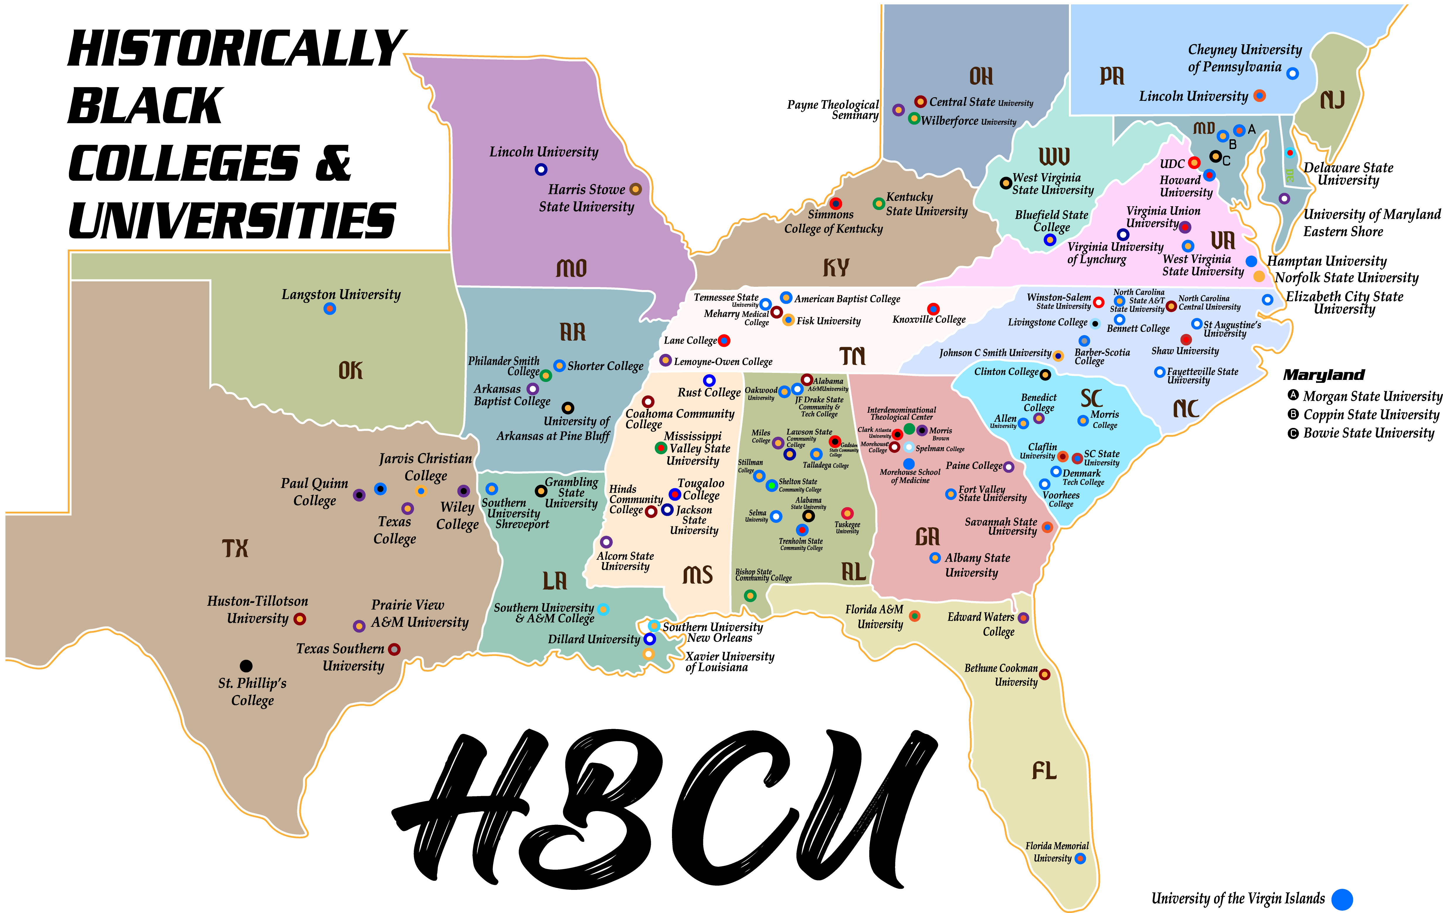
Notes:
Thank you. This concludes my presentation, and I welcome any questions.

Slide 24
REFERENCES
Bass, B. M. (1985). Leadership and performance beyond expectations. Free Press.
Bass, B. M. (1990). From transactional to transformational leadership: Learning to share the vision. Organizational Dynamics, 18(3), 19–31. https://doi.org/10.1016/0090-2616(90)90061-S
Boncana, M., Smith, R., & Johnson, L. (2021c). The impact of leadership-driven faculty mentoring programs on STEM graduation rates at HBCUs. Journal of Higher Education Leadership, 45(3), 245-267.
Chang, Y.-C., & Menzies, H. M. (2022c). Data-informed decision-making in higher education: Lessons from a teacher education program. Research & Practice in Assessment. https://www.rpajournal.com
Clavier, P. R., Johnson, M. S., & Lee, W. (2021). Transformational leadership and STEM retention: A study of HBCUs. Journal of STEM Education Research, 4(1), 67-83.
Notes:
SLIDE INSTRUCTIONS:
Put your references in alphabetical order on the slides. Will require more than one slide.
NOTE: Include only the references that apply to your slides. For a full list of references, readers should consult your Dissertation Manuscript.

Slide 25
REFERENCES
Clewell, B. C., de Cohen, C. C., & Tsui, L. (2010b). Enhancing the success of underrepresented minorities in STEM: Strategies for institutional transformation. American Institutes for Research.
Creswell, J. W., & Poth, C. N. (2018). Qualitative inquiry and research design: Choosing among five approaches (4th ed.). SAGE.
Denzin, N., & Lincoln, Y. S. (2018). The SAGE handbook of qualitative research (5th ed.). SAGE.
Engerman, K., Williams, M., & Saint-Preux, M. (2021). Corporate partnerships enhancing STEM education at HBCUs. Journal of STEM Outreach, 4(2), 22-35.
Jaeger, A. J., Hill, L. H., & Sutton, H. T. (2023). STEM outcomes and resource constraints at small HBCUs: Institutional resilience and innovation. Research in Higher Education, 64(2), 223–246.
Notes:
SLIDE INSTRUCTIONS:
Put your references in alphabetical order on the slides. Will require more than one slide.
NOTE: Include only the references that apply to your slides. For a full list of references, readers should consult your Dissertation Manuscript.

Slide 26
REFERENCES
Jaeger, E., McKayle, C. A., Engerman, K., Boncana, M., & Askew, K. (2023). Leadership vision and resource allocation at small HBCUs: Impacts on STEM education outcomes. STEM Equity Journal, 12(2), 89-104. https://par.nsf.gov/servlets/purl/10336505
Jaeger, A. J., Taylor, S. L., & Williams, S. M. (2023). Leadership vision and resource allocation in small HBCUs: A qualitative study. Journal of Higher Education Policy and Management, 45(2), 123-138.
James, S. (2025, February 25). Vision and mission of school statements: A practical guide with examples. Education Walkthrough. https://educationwalkthrough.com/vision-mission-of-school/
Kotler, P., & Fox, K. F. A. (1995). Strategic marketing for educational institutions (2nd ed.). Prentice Hall.
Kouzes, J. M., & Posner, B. Z. (2017). The leadership challenge: How to make extraordinary things happen in organizations (6th ed.). Jossey-Bass.
Notes:
SLIDE INSTRUCTIONS:
Put your references in alphabetical order on the slides. Will require more than one slide.
NOTE: Include only the references that apply to your slides. For a full list of references, readers should consult your Dissertation Manuscript.

Slide 27
REFERENCES
Kuh, G. D. (2008). High-impact educational practices: What they are, who has them, why they matter, and how to deepen their campus engagement. Association of American Colleges and Universities.
Lincoln, Y. S., & Guba, E. G. (1985). Naturalistic inquiry. SAGE.
Marshall, C., & Rossman, G. B. (2016). Designing qualitative research (6th ed.). SAGE.
McGee, E. O., Bentley, L., & Scott, J. A. (2023). Race-conscious leadership and STEM persistence at HBCUs. Journal of Race and Higher Education, 17(1), 75-95.
Miles, M. B., Huberman, A. M., & Saldaña, J. (2020). Qualitative data analysis: A methods sourcebook (4th ed.). SAGE.
Notes:
SLIDE INSTRUCTIONS:
Put your references in alphabetical order on the slides. Will require more than one slide.
NOTE: Include only the references that apply to your slides. For a full list of references, readers should consult your Dissertation Manuscript.

Slide 28
REFERENCES
Mintzberg, H. (2007). Tracking strategy: Toward a general theory of strategy formation. Oxford Handbook of Strategy: Volume 1, 44-59.
National Academies of Sciences, Engineering, and Medicine (NASEM). (2016). Barriers and opportunities for 2-year and 4-year STEM degrees: Systemic change to support students' diverse pathways. The National Academies Press.
National Center for Education Statistics (NCES). (2020). Data on STEM education and funding disparities at minority-serving institutions. U.S. Department of Education.
National Student Clearinghouse Research Center. (2025, June 26). Persistence & retention. https://nscresearchcenter.org/persistence-retention/
Northouse, P. G. (2021). Leadership: Theory and Practice (9th ed.). SAGE.
Nowell, L. S., Norris, J. M., White, D. E., & Moules, N. J. (2017). Thematic analysis: Striving to meet the trustworthiness criteria. International Journal of Qualitative Methods, 16(1), 1-13.
National Science Foundation (NSF). (2020). Science and Engineering Indicators 2020. National Science Board.
Notes:
SLIDE INSTRUCTIONS:
Put your references in alphabetical order on the slides. Will require more than one slide.
NOTE: Include only the references that apply to your slides. For a full list of references, readers should consult your Dissertation Manuscript.

Slide 29
REFERENCES
National Science Foundation (NSF). (2021a). Higher education in science and engineering. In Science and engineering indicators 2021 (NSB-2021-2). https://ncses.nsf.gov/pubs/nsb20212/
Patton, M. Q. (2015). Qualitative research & evaluation methods (4th ed.). SAGE.
Spillane, J. P. (2012). Distributed leadership in practice. Jossey-Bass.
Tinto, V. (2017). Through the eyes of students. Journal of College Student Retention: Research, Theory & Practice, 19(3), 254-269.
Upton, R., & Tanenbaum, C. (2014a). The role of Historically Black Colleges and Universities as pathway providers: Institutional pathways to the STEM PhD among Black students. American Institutes for Research.
Yin, R. K. (2018). Case study research and applications: Design and methods (6th ed.). SAGE.
Notes:
SLIDE INSTRUCTIONS:
Put your references in alphabetical order on the slides. Will require more than one slide.
NOTE: Include only the references that apply to your slides. For a full list of references, readers should consult your Dissertation Manuscript.

