Slide 1
Information Services and Student Success Mary Mara, MLIS, Carolyne Begin, MLIS & Tammy Salman, MLIS
Notes:
Our session focuses on the information services and resources provided by the library, and how they support students and student success.

Slide 2

Presenter
Information Services and Student Retention
Mary Mara, MLIS Director, Library & Learning Resource Center
Mary Mara is the Director of the Vi Tasler Library & Learning Resource Center at City University of Seattle with experience leading the design and implementation of an integrated information literacy instruction program, developing a digital library to serve students located worldwide, and modernizing data collection and analysis strategies within the library. She holds a BA degree from the University of Washington and a Master of Library & Information Science from the University of Washington’s iSchool.
Notes:
Introduction

Slide 3
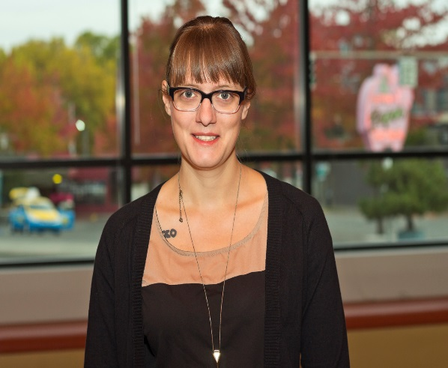
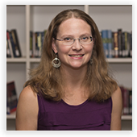
Presenters
Embedded Library Instruction: Improving Student Success on 21st Century Learning Outcomes
Carolyne Begin Associate Director, Instruction Carolyne holds a Bachelor of Arts in Sociology from the University of Victoria and a Master of Library Science from Emporia State University. She has experience developing and teaching information literacy to diverse groups of adult and ESL learners in higher education.
Tammy Salman Coordinator of Student Learning Assessment and Curriculum Development at Lane Community College in Eugene, Oregon Tammy has experience with information literacy instruction and teaching adult learners in graduate programs. She holds a Bachelor of Arts in Journalism from the University of Oregon and a Master of Library and Information Science from the University of Washington.
Notes:
Introduction

Slide 4

Retention in Real Life
Notes:
I am going to start by sharing a true story with you:
A 50-something-year-old employee at a local company that builds planes contacted the library as Winter quarter was starting. He was returning to school after more than 20 years to earn a masters degree, with the hope that a promotion, pay bump, or increased job security would follow.
Everything about the university experience has changed since he last attended school. There has been a shift from in-class and in-print to online.
Self-doubt was creeping into his thinking, as he wondered whether or not he could learn online, or could manage the combination of full-time work and part-time school along with family responsibilities.
One of the first steps needed, locating a required course resource, turned into a challenge. There was confusion over an online simulation and how to go about purchasing access – if it even needed to be purchased.
Four phone calls later, feeling overwhelmed, and without an answer that met his need, the student reached the program librarian. Five minutes of listening to the student’s needs and concerns solved the immediate issue and is the beginning of engagement with this particular student.
This call ended with the student sharing “I was getting ready to drop my class before I talked with you. Thank you so much for your help. I think I can do this!”
This is an example of student retention in action at City University of Seattle’s Library.

Slide 5
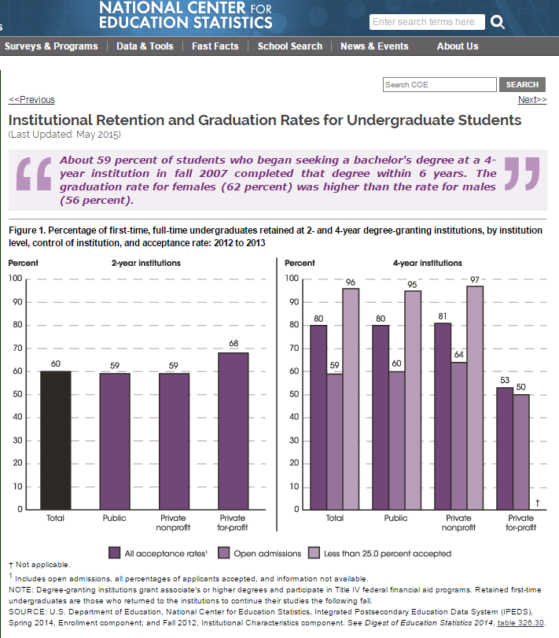
Retention Defined
Student Retention: A measure of the rate at which students persist in their educational program, typically expressed as the percentage of first-time degree or certificate-seeking students from the previous fall who re-enrolled or successfully completed their program by the current fall.
Source: National Center for Educational Statistics
Notes:
Simply stated - Retention is typically calculated as the percentage of degree seeking students from the previous fall who re-enrolled or successfully completed their program by the current fall.
My interest is in increasing understanding of how information services and resources support students and contribute to student retention.

Slide 6
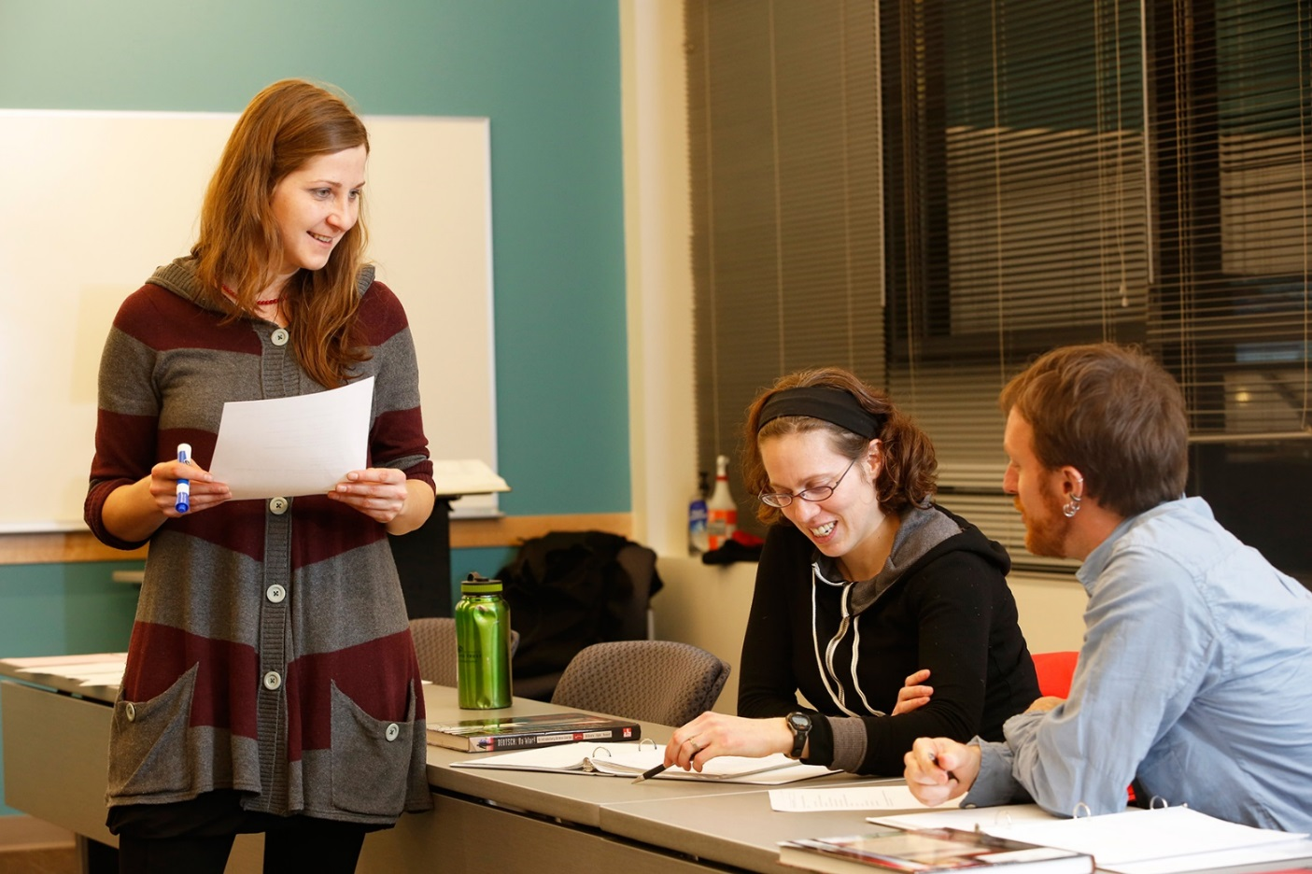
40 Years of Research
Notes:
Higher education has been researching student retention for over 40 years. Initial research focused on blaming the student for a lack of basic skills and motivation.
More recently, the emphasis of research has focused on the role of the university and the ways in which schools can foster interactions and engagement between students, faculty, and staff in order to increase retention rates.
The majority of retention studies, including research by leaders such as Vincent Tinto and George Kuh, address traditional university students in their freshman year of study.

Slide 7
AAC&U High Impact Practices
First Year Seminars and Experiences
Common Intellectual Experiences
Learning Communities
Writing Intensive Courses
Collaborative Assignments and Projects
Undergraduate Research
Diversity/Global Learning
Service Learning/Community-based Learning
Internships
Capstone Courses and Projects
Notes:
Kuh’s research has identified high impact practices that are likely to increase retention rates, practices such as first-year seminars, learning communities, and internships.
The American Association of Colleges & Universities recommends that schools adopt one or more of these high impact practices.

Slide 8
Non-traditional Students
Over the age of 25
Experienced gap between high school and college
Work full- or part-time
Serve multiple life roles
Notes:
While research has focused on traditional students, non-traditional students represent an increasing percentage of the university population in the US, and they are the majority of students served at City University of Seattle.
These students continue to experience lower retention rates than traditional students.
Of the limited research completed on non-traditional student retention, findings indicate that the factors impacting their retention rates differ from those that impact traditional students. High impact practices identified by Kuh may not be effective for non-traditional students.
Multiple studies agree that retention is a complex outcome to measure and to influence, with multiple cultural, social, and environmental factors influencing an individual’s decision on whether or not to persist towards their academic goal.
Family background, work status, finances, support services, course delivery methods, and university policies may all influence retention rates for non-traditional students.

Slide 9

Recent Library Research
Notes:
In the library profession, a new body of retention research is emerging from the Association of College & Research Library’s Assessment in Action program. 24 libraries have completed Assessment in Action research on student retention, typically focusing on one aspect of information service support provided by libraries including the instruction program, research service, or library use.
While these studies are an important first for the library profession, they represent early research stages with many studies reporting insufficient data, incomplete findings, or results that cannot be generalized.
The Association of College & Research Libraries recommends participation in Kuh’s high impact practices, increasing interactions and engagements with students, collaborating with support services such as advising, and aligning library work with university retention initiatives.
Other research from the library profession has found positive correlations between student retention data and increased expenditures for resources and staff, or use of the library’s resources and services (particularly during the first quarter of enrollment).

Slide 10
Framework for Retention Data
Framework | Qualitative Data Sources | Quantitative Data Sources
Library Facilities | In-person/online feedback | Front desk/online usage Study room usage Website usage
Library Collection | In-person/online feedback Open-ended survey responses | Survey responses Collection data Usage data
Library Instruction | In-person/online feedback End-of-course evaluations | Sessions offered Students taught Research consultations Tutorial usage Student achievement
Library People | In-person/online feedback Standards of care Collaboration with faculty Collaboration with support departments | Outreach data Orientations attended Students reached Users/non-users data
Notes:
The framework CityU is adopting to gain an overview of how all of its information services and resources support student retention includes these elements: Library Facilities, Library Collection, Library Instruction, and Library People.
For each element in this framework, there are qualitative and quantitative data sources that can be gathered to document engagement with students.
Based on recent research, data that shows increasing engagement with students may be used to infer positive correlations between information services and resources and student retention.

Slide 11
CityU Data
Front desk engagement increased from average of 5 to 247/week
Website usage increased from 97,000 to 159,000
Library collection is 97% digital with 1,300,000+ uses in AY16
48,000+ engagements with students via library instruction
20,395 questions answered
Individual student feedback
Notes:
Examples of the increased interactions and engagement for library facilities include in-person questions asked at our front desk, and usage of our website.
With the move to the Seattle campus, in-person questions have increased from 5 per week to an average of 247. The library is literally in the center of CityU’s classrooms, and serves as the primary gathering spot for students, providing many opportunities for library staff to interact with them.
We also completely redesigned the library’s online presence, the facility through which students outside of Seattle engage with us. We moved from a student portal that required multiple clicks to access basic information, to a website where most content can be accessed in 1 to 3 clicks. Visits have increased from around 97,000 in 2012 to over 159,000 in 2015 and we no longer receive complaints about the site on the student satisfaction survey.

Slide 12
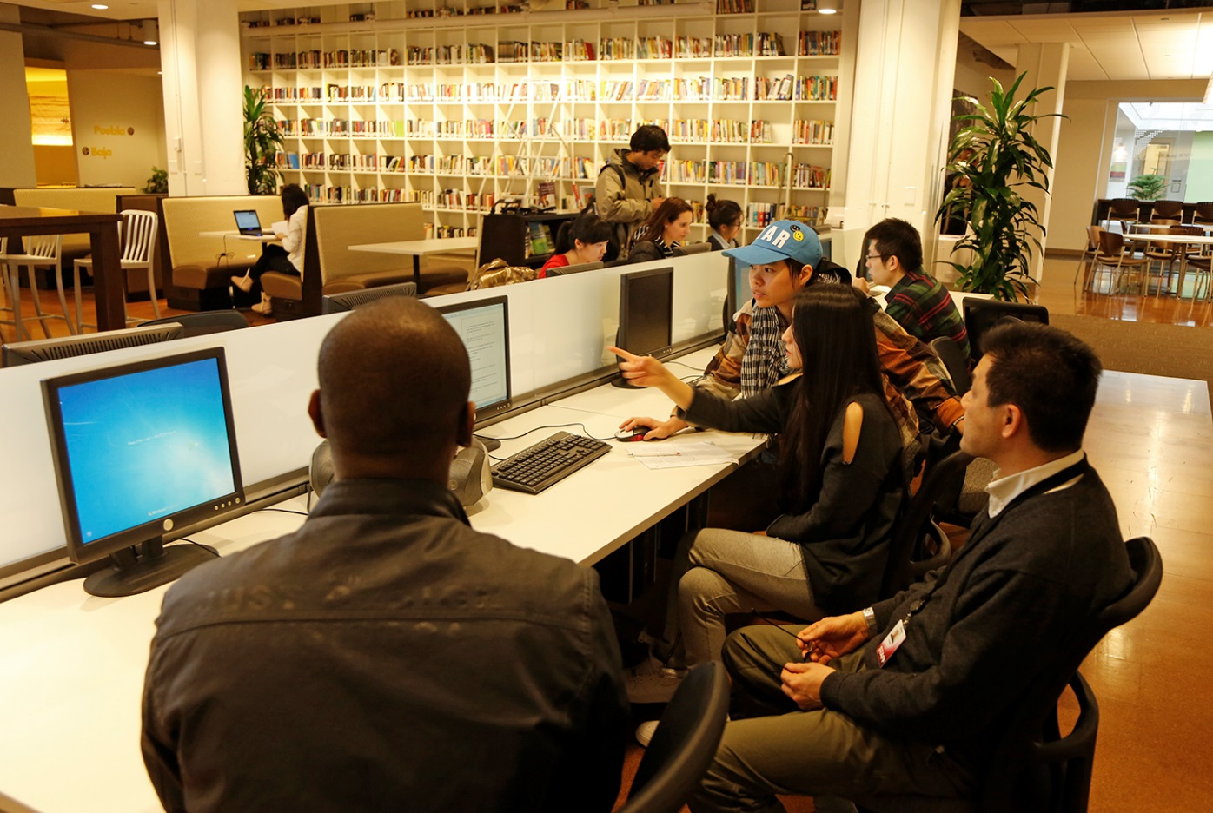
Library People
Notes:
Data related to Library People is really focused on the caring relationships library staff build with students and faculty to support the work of learning and teaching.
Feedback from students includes comments such as “I would never have finished my capstone research without your help and encouragement.”
Evidence of increased engagement in this category also comes through student responses to welcome emails sent by program librarians, responses asking for research assistance or help locating required textbooks.

Slide 13

Embedded Librarianship
Integration of the librarian within classes and departments.
Notes:
CityU has an integrated information literacy instruction program through which librarians participate in key courses across the program to engage with students and provide instruction.

Slide 14
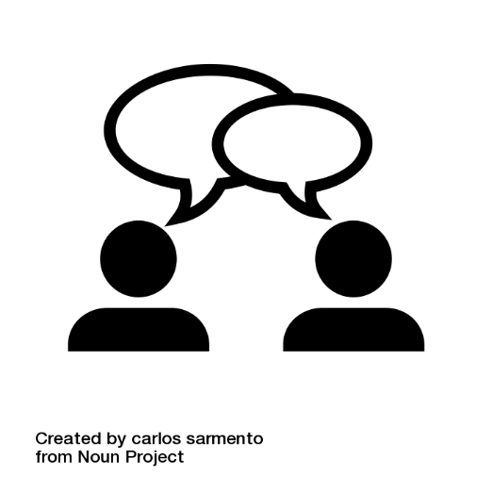

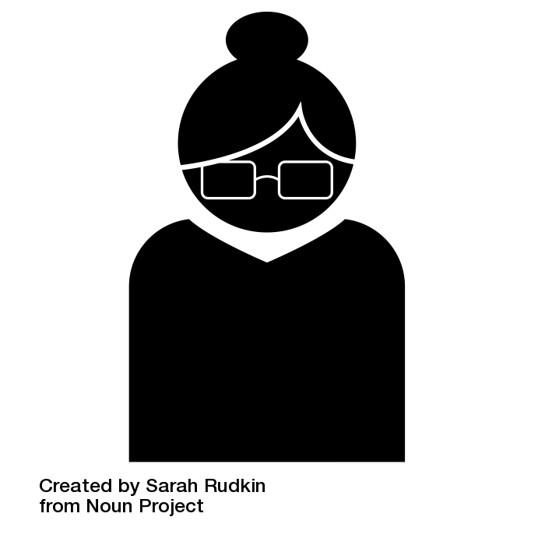
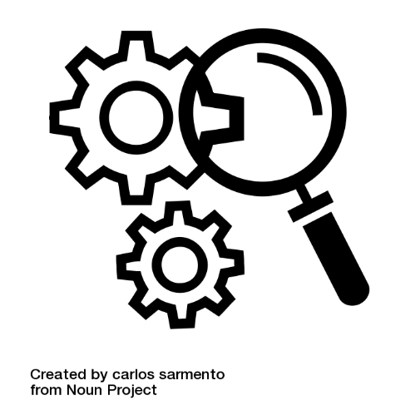

Faculty-librarian collaboration
Notes:
Librarians serve on course development teams through which they gain in-depth knowledge of the courses in the programs they support.
Librarians reach out each quarter to faculty teaching courses in which required information literacy instruction has been planned. They collaborate with the faculty to schedule, tailor, and deliver instruction.

Slide 15
Tiered instruction
Level 1: Access point for students to contact librarians.
Level 2: More involved static interaction. Ex.: modules, handouts, links.
Level 3: Scaffolded library instruction in connection with an assignment. Ex.: discussion boards, live sessions, etc.
Notes:
CityU’s instruction program includes three levels. Level 2 embeds resources in a course without direct instruction. Level 3 includes direct and required instruction and engagement with students.

Slide 16
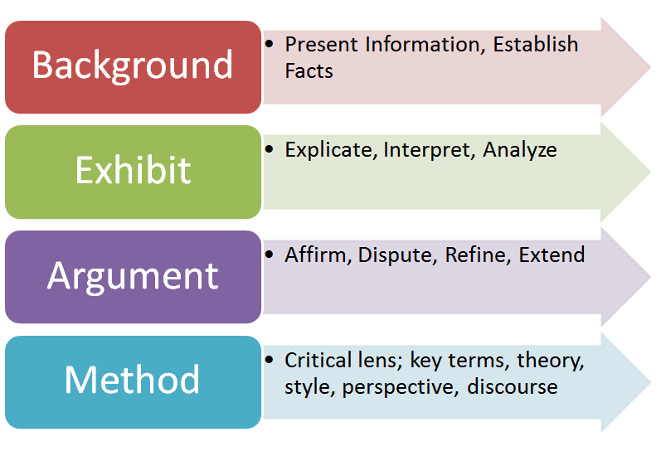
BEAM: J. Bizup (2008)
Goal: focus student attention on how to use resources and how to evaluate them for their assignment.
Critical thinking about resources

Slide 17
Topic triangles
Broad topic
Narrower
Narrower
Notes:
Librarians utilize a topic triangle activity to help students focus their research topic.

Slide 18
Lessons Learned
Student success activities are highly contextual
Increasing engagement with students increases retention
Aligning library instruction with assignments encourages student success
Data collection begins with what is at hand, and is iterative
Collaborative relationships may take 3+ years to mature

Slide 19
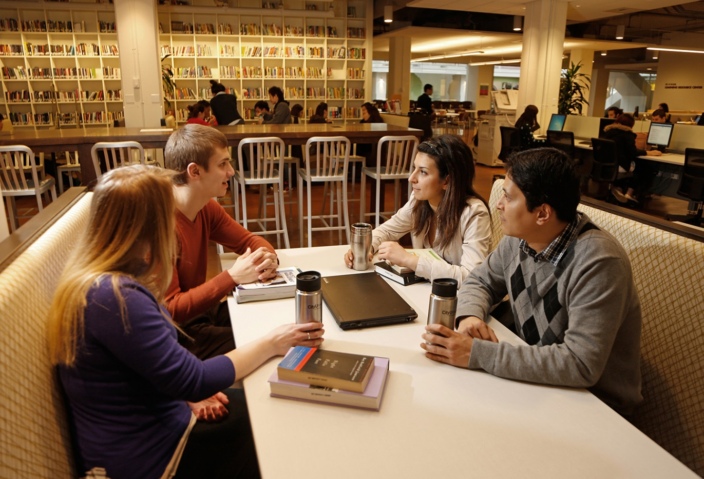
What’s Next?
Notes:
Continue to pilot the framework and gather data
Collaborate with the student success advisors, through which at-risk students might be referred to their program librarian for research support.
Collaborate with IT to improve our access to data. We may align data from the framework with specific program retention data in the future.
Utilize the data to learn more about who is and who is not using CityU’s information services and resources in order to be more effective in our outreach to non-users, and to learn more specifically whether use of our overall services and resources impacts student achievement and retention.

