Slide 1
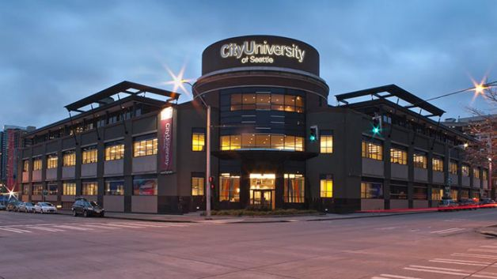
Expanded Access: The Library as Conduit for Collaboration
Matt Lechner, Mary Mara, and Tammy Salman
Notes:
Welcome to our session, Expanded Access: The Library as Conduit for Collaboration
Mary Mara, Director of Library & Learning Resource Center
Matt Lechner, Associate Director of E-Resources & Academic Technology
Tammy Salman, Associate Director of Instruction

Slide 2
Quick Facts
Private non-profit serving adults and international students
33 sites in 11 countries
Leadership, Business, Technology, Education, Counseling
Centralized curriculum development
Notes:
City University of Seattle is a private non-profit university that was founded in 1973 to serve the needs of working adults. We are accredited by NWCCU at the undergraduate, graduate, and doctoral levels.
Our students today are a mix of working adults and international students.
CityU is comprised of 3 schools and 2 divisions that offer online, mixed-mode, on-site, and performance-based programs at 33 sites in 11 countries. Our sites can be found in Asia, Europe, Canada, and Mexico, as well as the Washington state.
We offer programs in Leadership, Business, Technology, World Languages, Education & Counseling.
One unique aspect of CityU that contributes to our ability to collaborate effectively, is a centralized curriculum development model.
Curriculum Development is completed primarily at administrative center for CityU which is the site in Seattle and you’ll hear more about this from Tammy in a few minutes.
In January of 2013, CityU’s administrative center moved from Bellevue to Seattle, Washington. This marked a major point of change for the Library and Learning Resource Center in terms of access and collaboration.

Slide 3
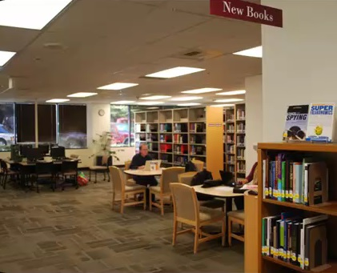
From this…
Notes:
Prior to 2013 our library looked like this:
A fairly traditional looking library with book stacks, computers, and small study tables.
Our library was located in a non-classroom building that was around the bend of a very busy road that was a bit dangerous to cross, and behind a dense bank of evergreen trees.
Few students visited us in person –

Slide 4
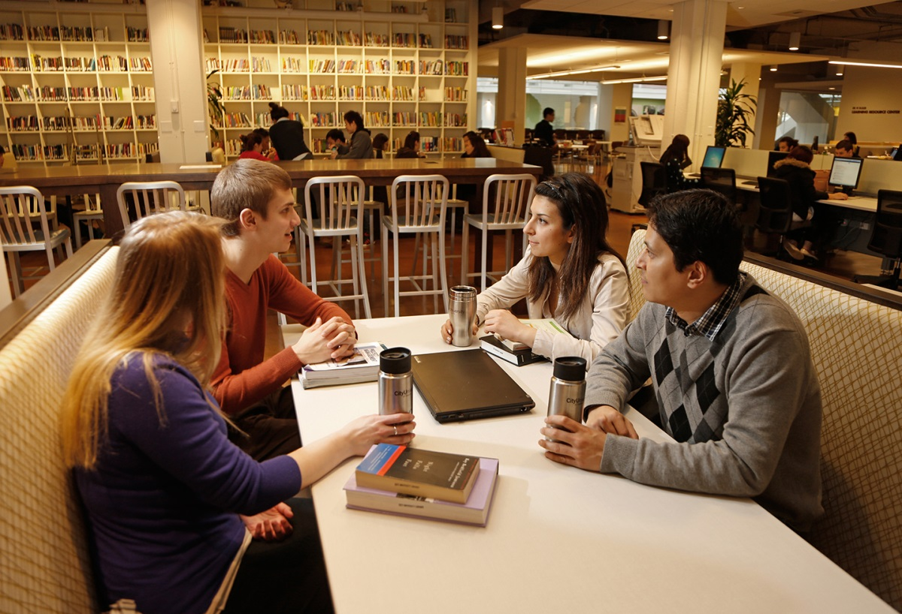
To this…
Notes:
In January 2013 we moved to Seattle, and this is a current picture of our library and learning resource center
We are now located in the middle of all Seattle classrooms , and where we used to see 5 students a week on a busy week, we are now working directly with over 260 students each week at our service desk.
This change came about through a collaborative design process that included faculty, staff, and students.
There are two things that helped ensure that library staff were included as a key stakeholder in the design process for CityU’s new location.
The first is that we had already started to take a slow but steady lead in developing an integrated information literacy instruction program. Collaborations with faculty developing and teaching our curriculum were not entirely routine yet, but were becoming more and more common. We were increasingly viewed as partners in their work and our presence as members of standing academic committees was a given.
The second thing that helped ensure we were collaborators in the design process is that I was serving as chair of the university’s academic technology committee. The technology committee reports directly to CityU’s provost, and a key component of the move to Seattle included a focus on expanding upon the use of technology to improve student learning, and to increase the availability of training and support for faculty and students on the use of academic technology.
Everyone on campus was interested in ways to design a learning commons that would better serve the needs of our students and the library staff were well situated to step into this role. The vision was for a 1-stop-shop for information and technology services for on-site students, and improved collaboration between our IT, Blackboard, and library staff for service to off-site students.
The concentration of our administrative faculty at the Seattle site, and the nature of the work that they do that you’ll hear more about from Tammy and Matt, also contributes to our ability to collaborate effectively on multiple levels across the university.

Slide 5
Front Desk Usage
Notes:
The usage of our front desk provides a simple visual of how significant the change in student and faculty interactions has been from our Bellevue location to the Seattle location.
You will also see that where the few student interactions in Bellevue were focused traditional library services, we now are the main information desk used by students and faculty to get what sometimes seems like any and all of their questions answered.

Slide 6
Expanded Access: Digital Shift
Move prompted collection changes
Weeded 75% of physical collection
Nearly 100% digital
Physical items are very targeted

Slide 7
Expanded Collaborations: Faculty
Proximity to faculty
More chance encounters
Stronger curriculum collaborations
E-learning
University assessment

Slide 8
Expanded Outreach: Student Support
Positioned to identify unique student needs
International Student Office
Acquisition of English Language Program
Changes to advisor leadership and staff

Slide 9
Expanded Role: Site Support
As the new central hub of our university, we assumed responsibility for:
Event support (with Marketing/PR)
Classroom technical issues
Computer lab support (with I.T.)

Slide 10
Expanded Mission: Academic Tech
Interacting more closely with students and faculty gave us the opportunity to promote and support use of technology to enhance learning:
Video recording & editing
How to incorporate multimedia into courses
Connecting students across geographical distance

Slide 11
Successes
Dramatic increase in use of both library space and staff expertise
Developing trust with other departments so that we can pass students off to others with confidence

Slide 12
Challenges
Co-location with e-Learning department was not enough for true collaboration
Blurry lines between departments can be confusing for students/faculty
Perception and staff funding

