Slide 1
Learn in a Week: On Demand, Scaffolded e-Learning
Tammy Ivins (she/her or they/them)
OLC Discovery Session
Wednesday 11/19/2025 | 9:45 AM - 10:30 AM

Slide 2

National University has multiple course schedules, including individual & weekly course starts.
On-Demand &
Asynchronous

Slide 3

Self running, minimal librarian lift
Automated

Slide 4

Avoiding the info dump.
Forced intentional pauses
Scaffolded
Notes:
Allowing meaningful reflection

Slide 5

Inspiration:
Email Series
A time-limited series of emails sent out to educate a group
✓ Scaffolded
✓ Automated
✓ Asynchronous
X not truly “on demand”

Slide 6

make.powerautomate.com
Notes:
Tool included in our Microsoft 365

Slide 7
1. Student submits Microsoft Form
2. Triggers Microsoft Power Automate “flow”
3. Daily email sent to student for the next week

Slide 8
1. Student submits Microsoft Form
forms.office.com

Slide 9
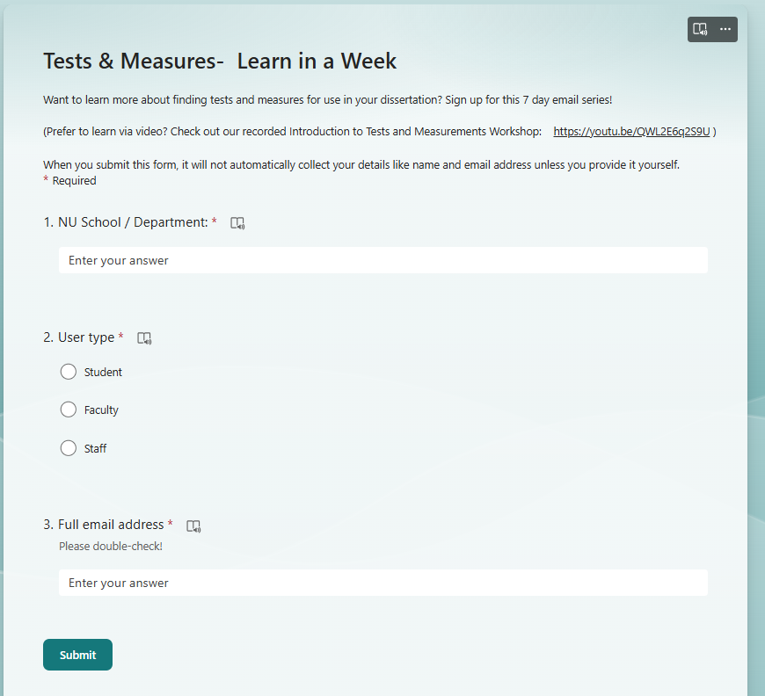

Slide 10
2. Triggers Microsoft Power Automate “flow”
make.powerautomate.com

Slide 11
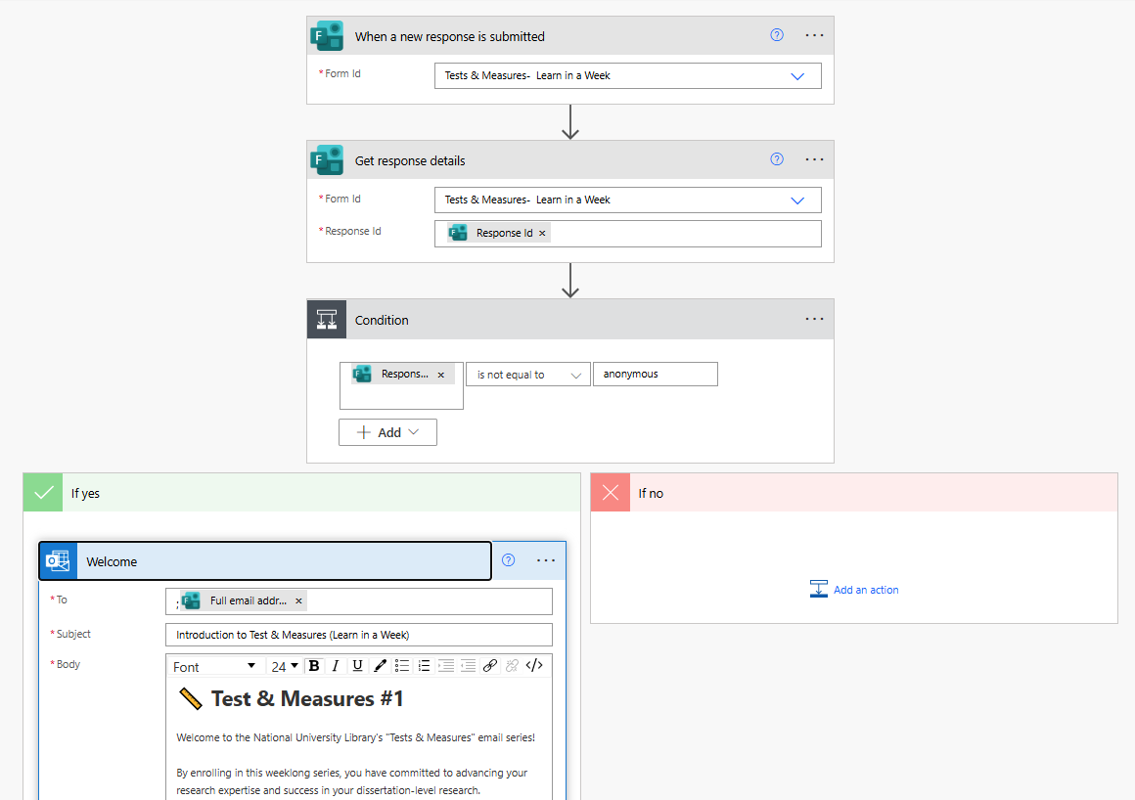

Slide 12
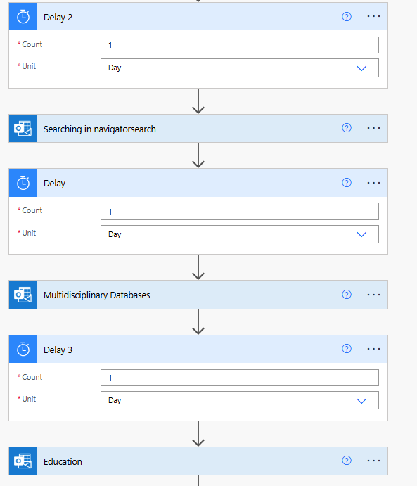
3. Daily email sent to student for the next week

Slide 13
1. Student submits Microsoft Form
2. Triggers Microsoft Power Automate “flow”
3. Daily email sent to student for the next week

Slide 14
Next Steps
Aspirations meet operational needs
Expand topics
HTML design
Assessment & applied learning / metacognition component
Explore further automation
But, operational needs have taken my time away from this project
┐(‘～`)┌
Notes:
Based on positive feedback and popularity, we will be expanding this program to more topics and implementing assessment protocols.
Was intended to be one of my goals for the coming year
Random timing thing. Makes sense to fall under me (I also manage our Institutional Repository), and it has far more operational significance for the university than continuing to experiment with this project.
So, the “learn in a week” power automate project is on hold indefinitely. But! I hope that maybe some of you can draw inspiration from this and take it further!

Slide 15
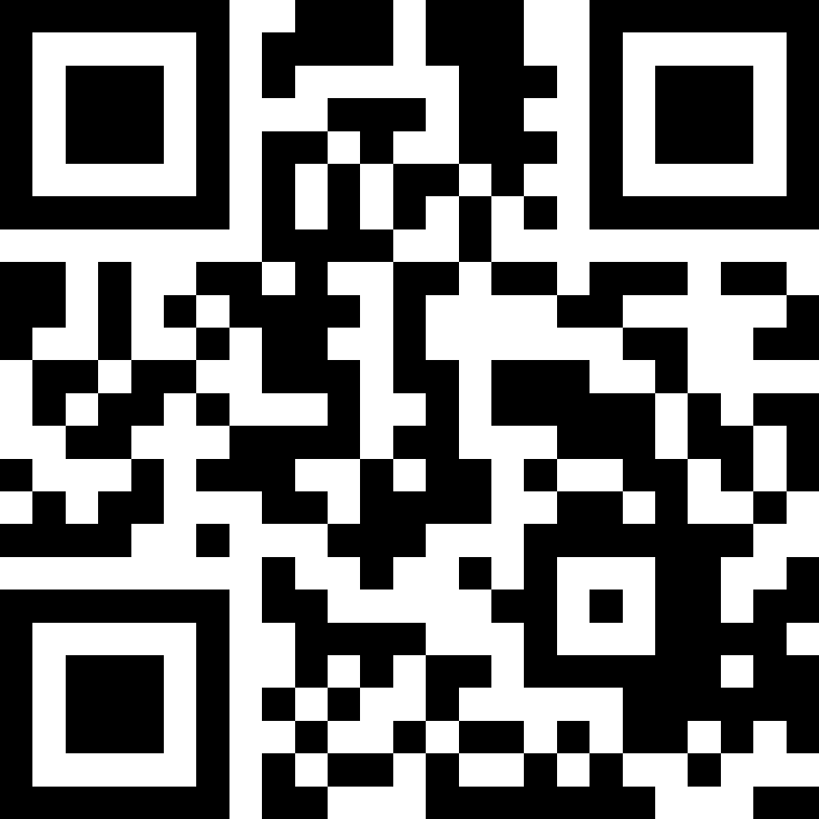
Slide deck & Flow .zip
tinyurl.com/olc25-tivins
Tammy Ivins
> Reference, Instruction, & Institutional Repository Librarian
> Dissertation Manuscript Publication Admin
MS Library Science, 2011
MA Conflict Resolution, 2020
Email me: tivins@nu.edu
Notes:
My flow to look at, you may find a better way to set it up! Or a better tool than power automate! Please drop me a line and tell me how it is going and what you build!!!

