Slide 1


Hallucination Check:
Verifying Sources in the Age of AI
Stephanie Johnson, MLIS, MPS
Reference & Instruction Librarian

Slide 2
What are “hallucinated” citations?
Citations created by generative A.I. programs (incl. ChatGPT, Gemini, etc.)
Sometimes “published” in reputable, peer-reviewed journals
Often “written” by authoritative authors in the field
Occasionally, with an authentic looking DOI

Slide 3
Real or Hallucinated?

Slide 4
Real or Hallucinated?
Crenshaw, K., Gotanda, N., Peller, G., & Thomas, K. (Eds.). (1995). Critical race theory: The key writings that formed the movement. The New Press.

Slide 5
Real
Crenshaw, K., Gotanda, N., Peller, G., & Thomas, K. (Eds.). (1995). Critical race theory: The key writings that formed the movement. The New Press.

Slide 6
Real or Hallucinated?
Crenshaw, K. (2022). Critical race theory in education and organizational studies: A comprehensive review. Educational Equity Journal, 18(3), 45-60.

Slide 7
Hallucinated
Crenshaw, K. (2022). Critical race theory in education and organizational studies: A comprehensive review. Educational Equity Journal, 18(3), 45-60.

Slide 8
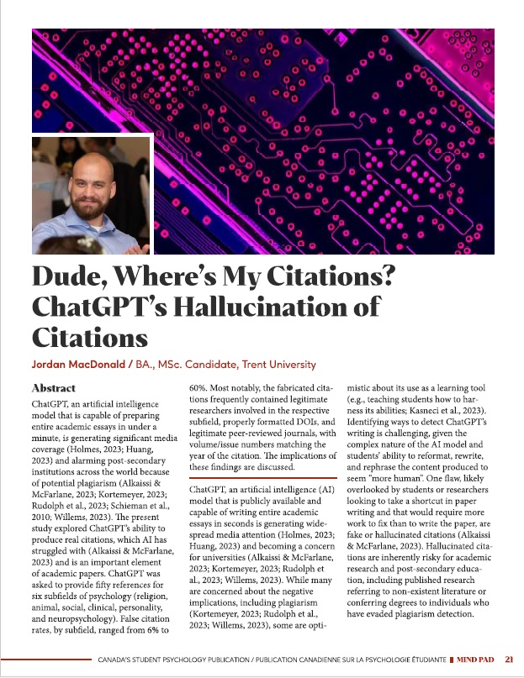
Study: Dude, Where’s my citations? (2023)
Tasked ChatGPT 3.5 with finding 50 citations for 6 psychology subfields
300 total citations
32.3% of citations provided were hallucinated
Real authors
Real peer-reviewed journals
Real DOIs

Slide 9
Patterns?
DOIs that lead no where or lead to completely different articles
  unique string of numbers and letters that identifies a document or article
  permanent, so they always refer to the same article, regardless of its location on the web
Most often hallucinated years were 2018, 2019, 2020
  CAUTION: study was conducted in 2023, so this may have changed
Repeated use of the same authors
Repeated use of the same journals

Slide 10
WHAT DOES THIS MEAN?!

Slide 11
Trust but Verify

Slide 12
Trust but Verify

Slide 13
Hallucinated
Crenshaw, K. (2022). Critical race theory in education and organizational studies: A comprehensive review. Educational Equity Journal, 18(3), 45-60.

Slide 14
Google Scholar scholar.google.com

Slide 15
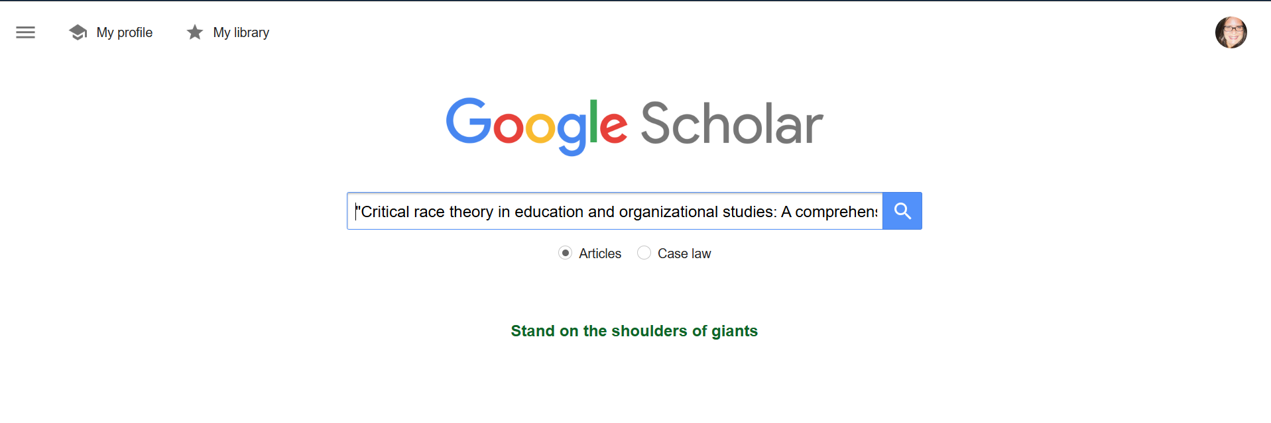

Slide 16
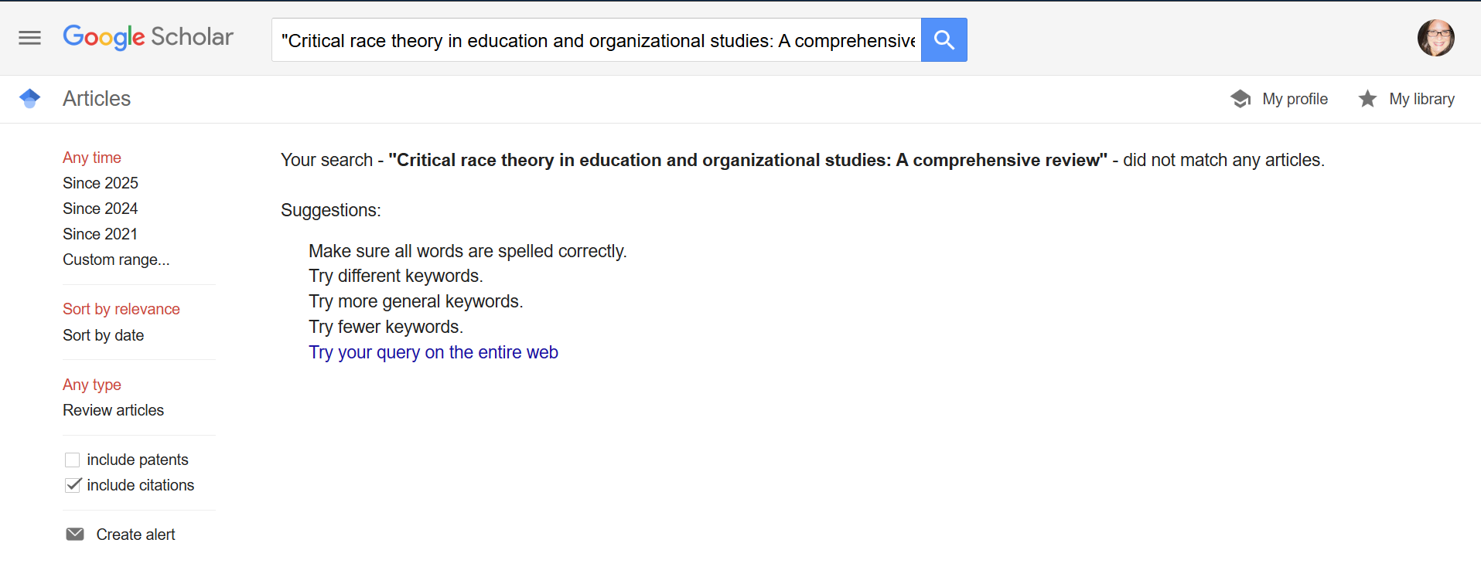

Slide 17
Library Catalog Search resources.nu.edu/library

Slide 18


Slide 19
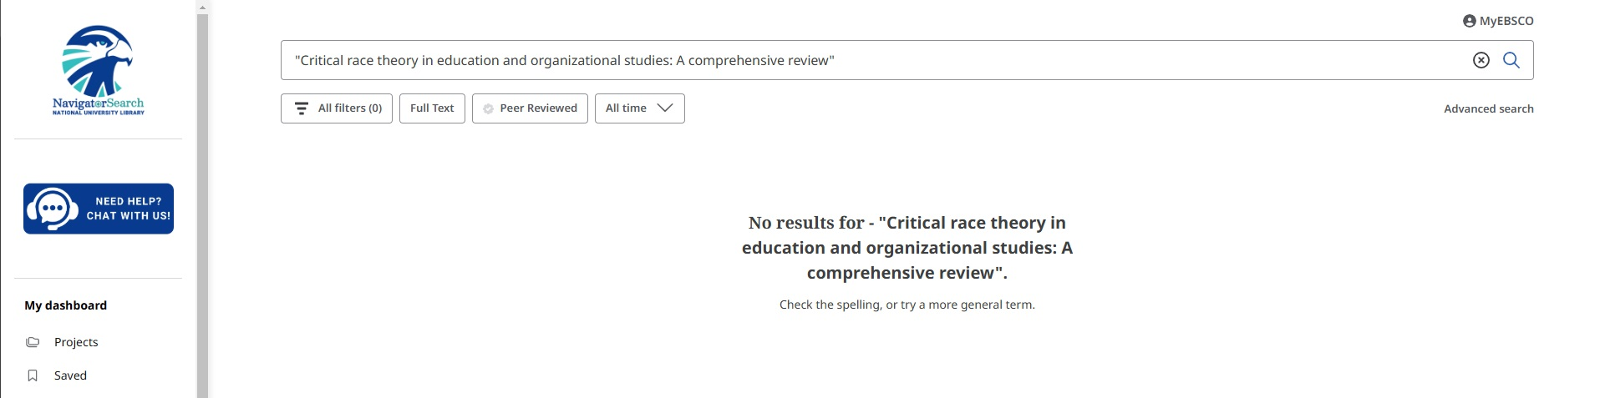

Slide 20
Library Journal Search resources.nu.edu/library

Slide 21


Slide 22
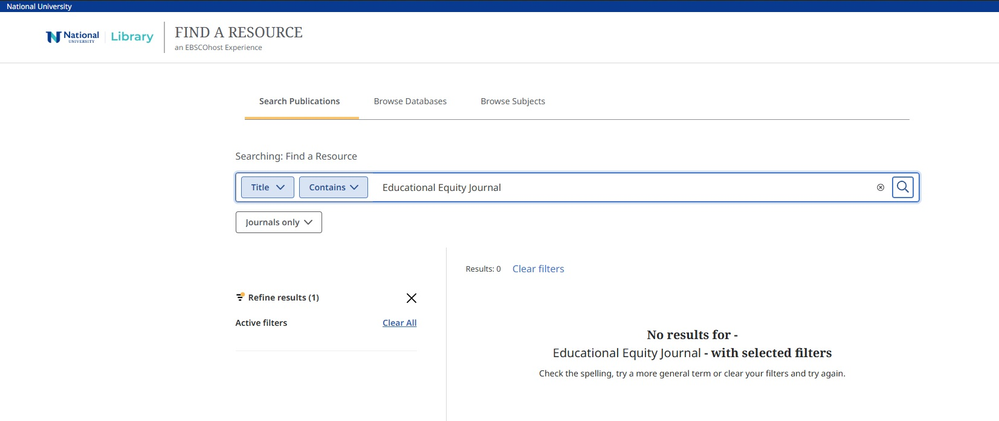

Slide 23
Basic Google Search google.com

Slide 24
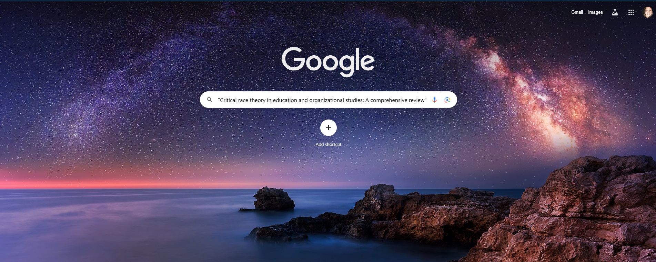

Slide 25
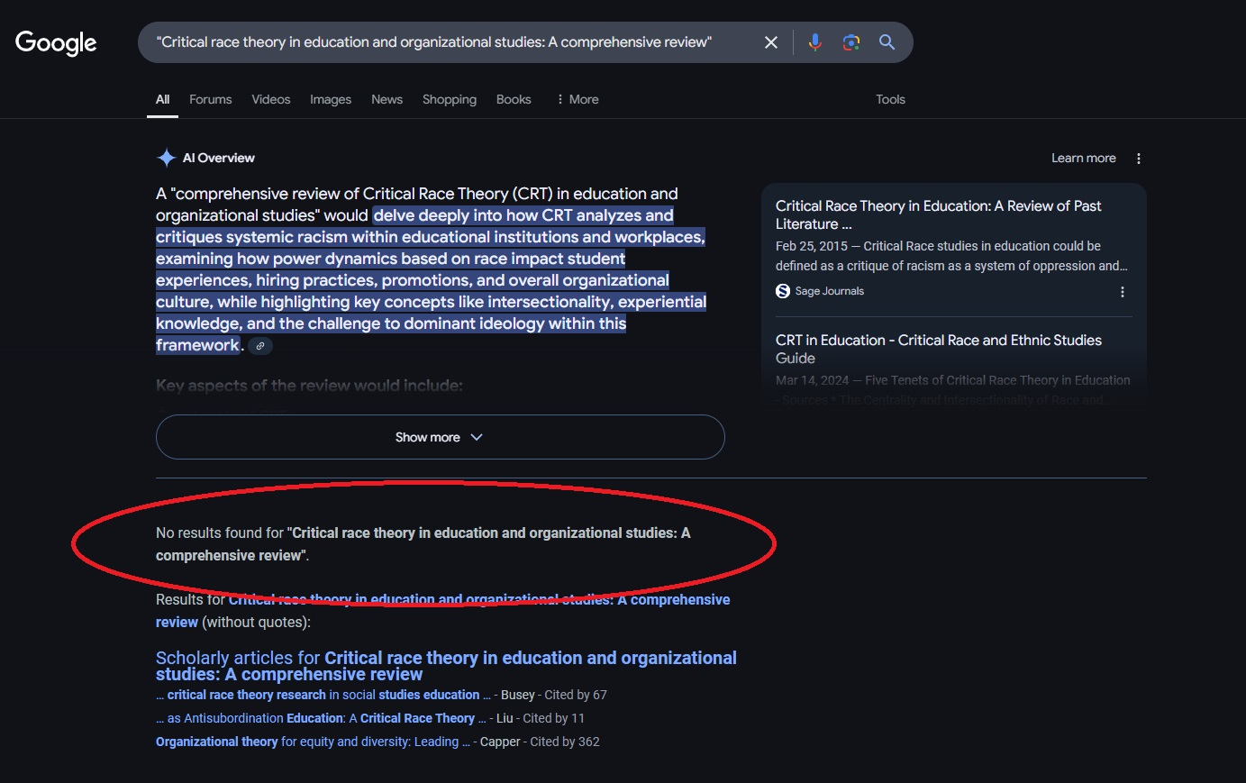

Slide 26
DOI Checker doi.org

Slide 27


Slide 28
Crossref crossref.org

Slide 29
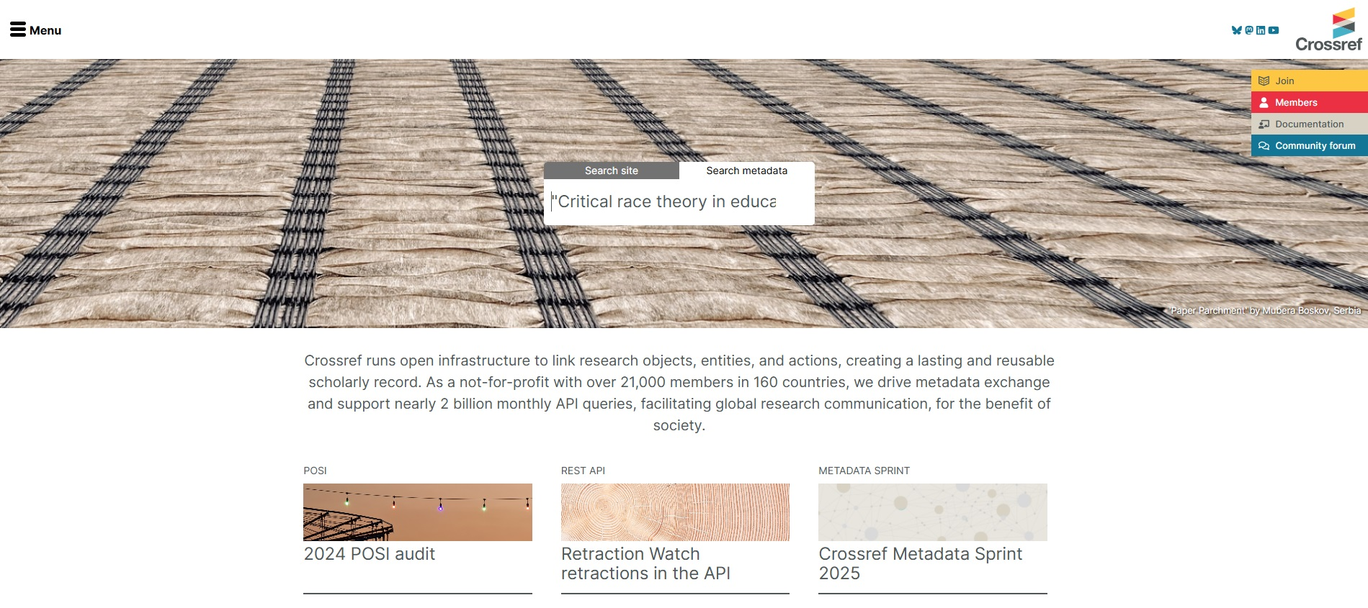

Slide 30
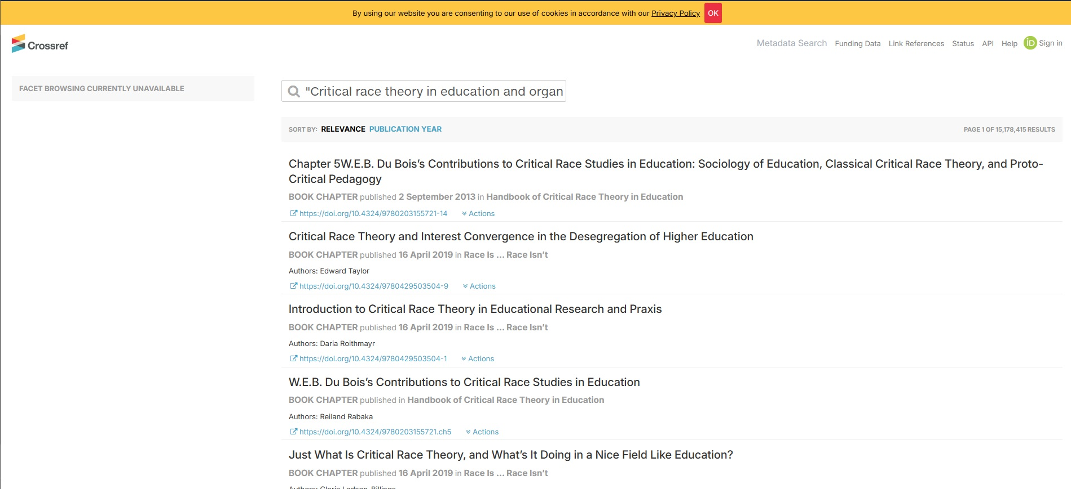

Slide 31
Faculty &/or Student Hallucinations
Liu, X., Zhang, Y., & Wang, P. (2023). Barriers to digital transformation in SMEs: A focus on skill gaps and resource limitations. Journal of Small Business and Technology Management, 30(2), 112-130. https://doi.org/10.1016/j.jsbtm.2023.112130
Nwaiwu, F., Belgrave, L. S., & Kamoun, F. (2020). Understanding digital transformation in small and medium enterprises: A systematic review. Journal of Small Business Management, 58(1), 1-29.
Spencer, M. B. (2021). The psychological costs of racism: Microaggressions, isolation, and the impact on Black men in STEM leadership. Psychology in Leadership, 10(4), 771-783. https://doi.org/10.1037/amp0000789
Teh, W., Chong, S., & Ismail, S. (2023). Digital transformation readiness: A study of SMEs in the ASEAN region. Journal of Innovation and Knowledge, 8(2), 45-57. https://doi.org/10.1016/j.jik.2022.12.005

Slide 32
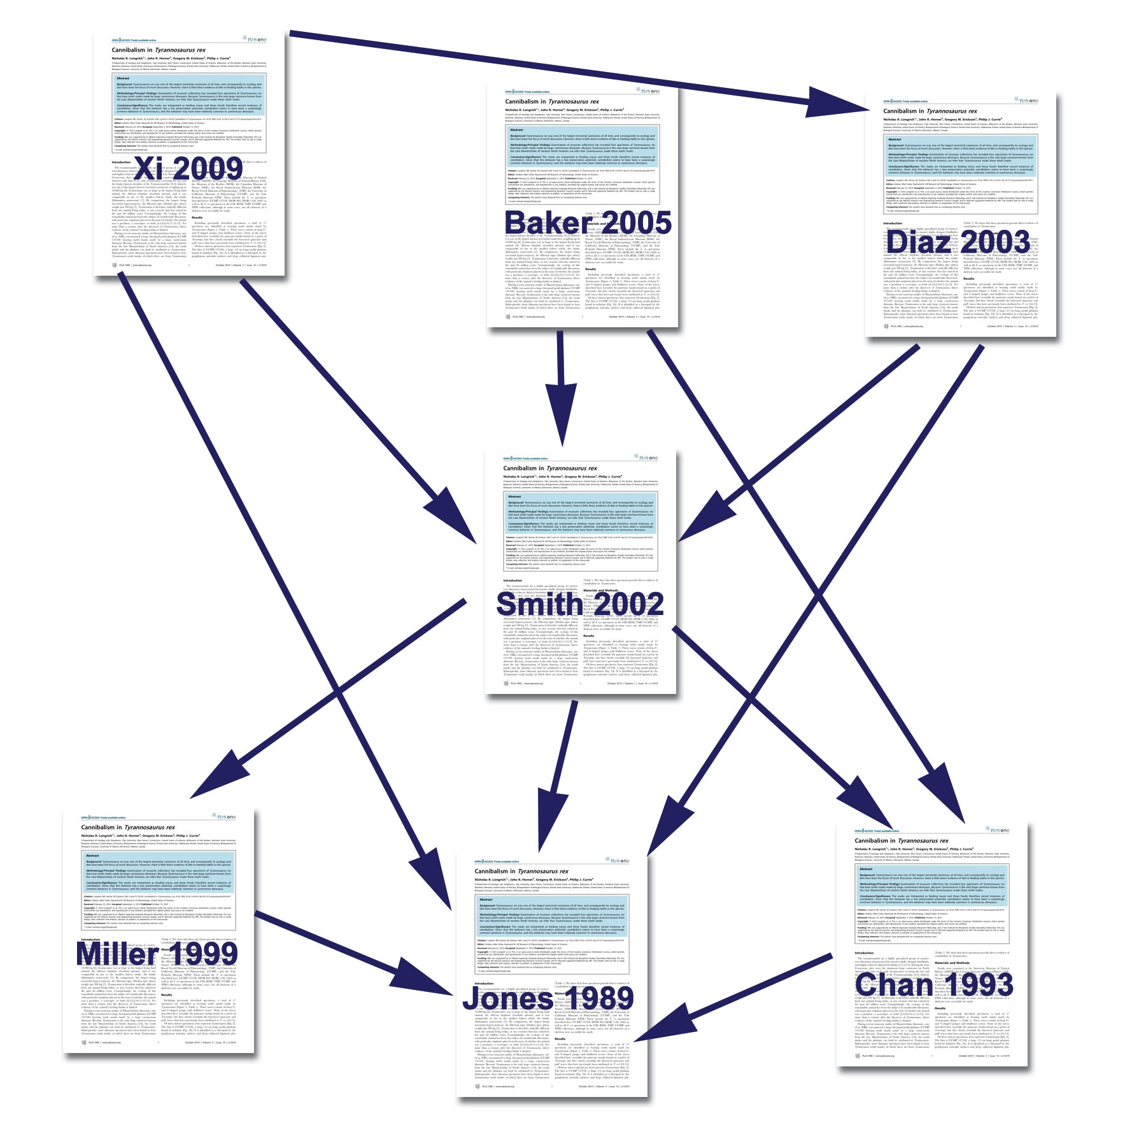
Ways to become an excellent researcher…
Citation Chaining
Look backwards and forwards with your own paper’s citations, as well as others’

Slide 33
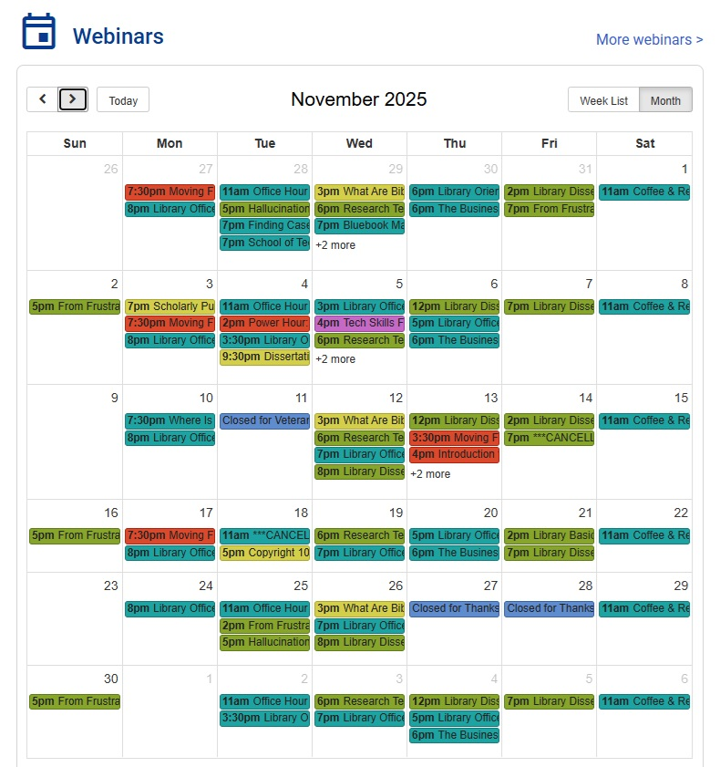
Ways to become an excellent researcher…
Library Webinars
resources.nu.edu/library

Slide 34
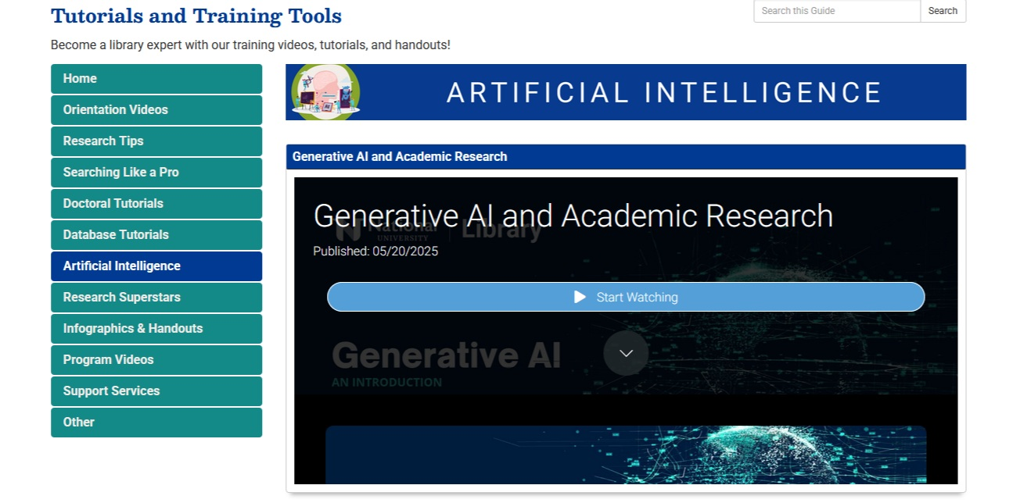
Ways to become an excellent researcher…
Library Tutorials
resources.nu.edu/tutorials

Slide 35
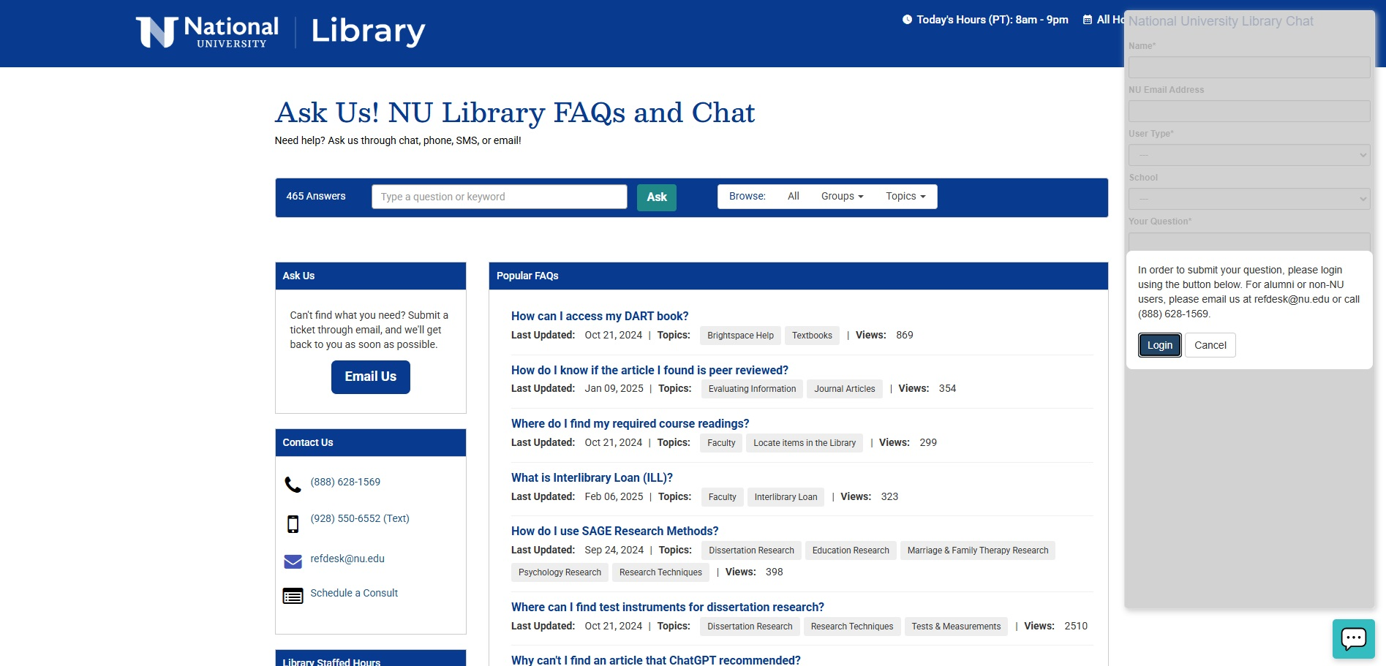
Ways to become an excellent researcher…
Ask for help
Chat 24/7 through the library’s homepage

Slide 36
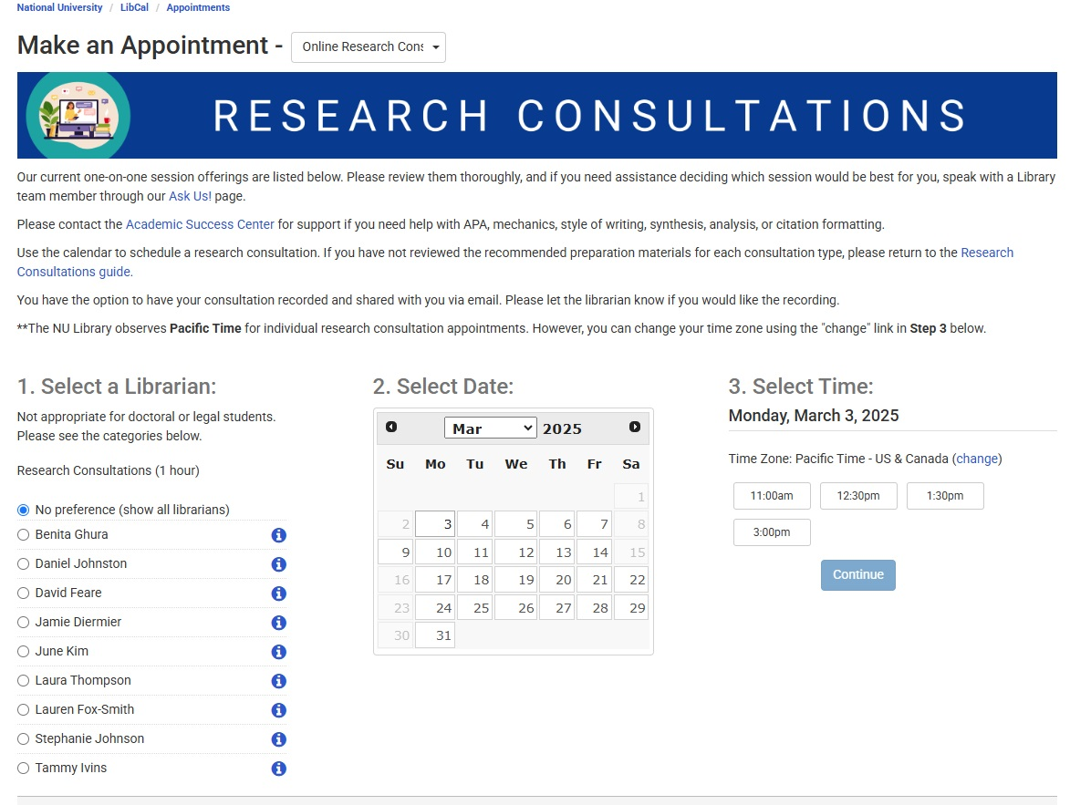
Ways to become an excellent researcher…
Schedule a research consultation
resources.nu.edu/researchconsultations

Slide 37

Ways to become an excellent researcher…PRACTICE

