Slide 1
Black College Students’ Experiences with Microaggressions and Colorblind Racism:
A Qualitative Descriptive Phenomenology
Stacy C. Marrow
National University
Dissertation Chair: Dr. Belle Booker Zorigian
Subject Matter Expert: Dr. Bruce Barnhart
Academic Reader: Dr. Carrie Lloyd

Slide 2

INTRODUCTION
Black students’ college transition involves complex developmental demands (Mushonga, 2020)
Diversity increases while Black students’ graduation rates decrease (Mushonga, 2020; NCES, n. d.-b)
Microaggressions and colorblind racism at HPWIs contribute to race-based stress (Marks et al., 2023)
Sustained microaggressions lead to racial trauma, the need for systemic changes (Marks et al., 2023) Mushonga, 2020)

Slide 3
PROBLEM & PURPOSE STATEMENTS
The Problem
The problem addressed by the study is Black college students experience microaggressions and colorblind racism at Historically and Predominantly White institutions, resulting in declines in academics, ethnic identities, and psychosocial health (Mills, 2020; Mushonga, 2021; Mushonga & Henneberger, 2020).
The Purpose
The purpose of this qualitative descriptive phenomenology study was to understand Black college students’ descriptions of experiences with microaggressions and colorblind racism related to academics, ethnic identities, and psychosocial health at HWPIs (Mills, 2020; Mushonga, 2021; Mushonga & Henneberger, 2020).

Slide 4
RESEARCH QUESTIONS
RQ1
What is microaggression for Black students at HWPIs?
RQ1A
How do Black students at HWPIs describe specific encounters with White classmates?

Slide 5
RESEARCH QUESTIONS
RQ1 B
How do Black students at HWPIs describe specific encounters with White professors and staff members?
RQ1 C
How do Black students at HPWIs describe specific instances of colorblind racism?

Slide 6
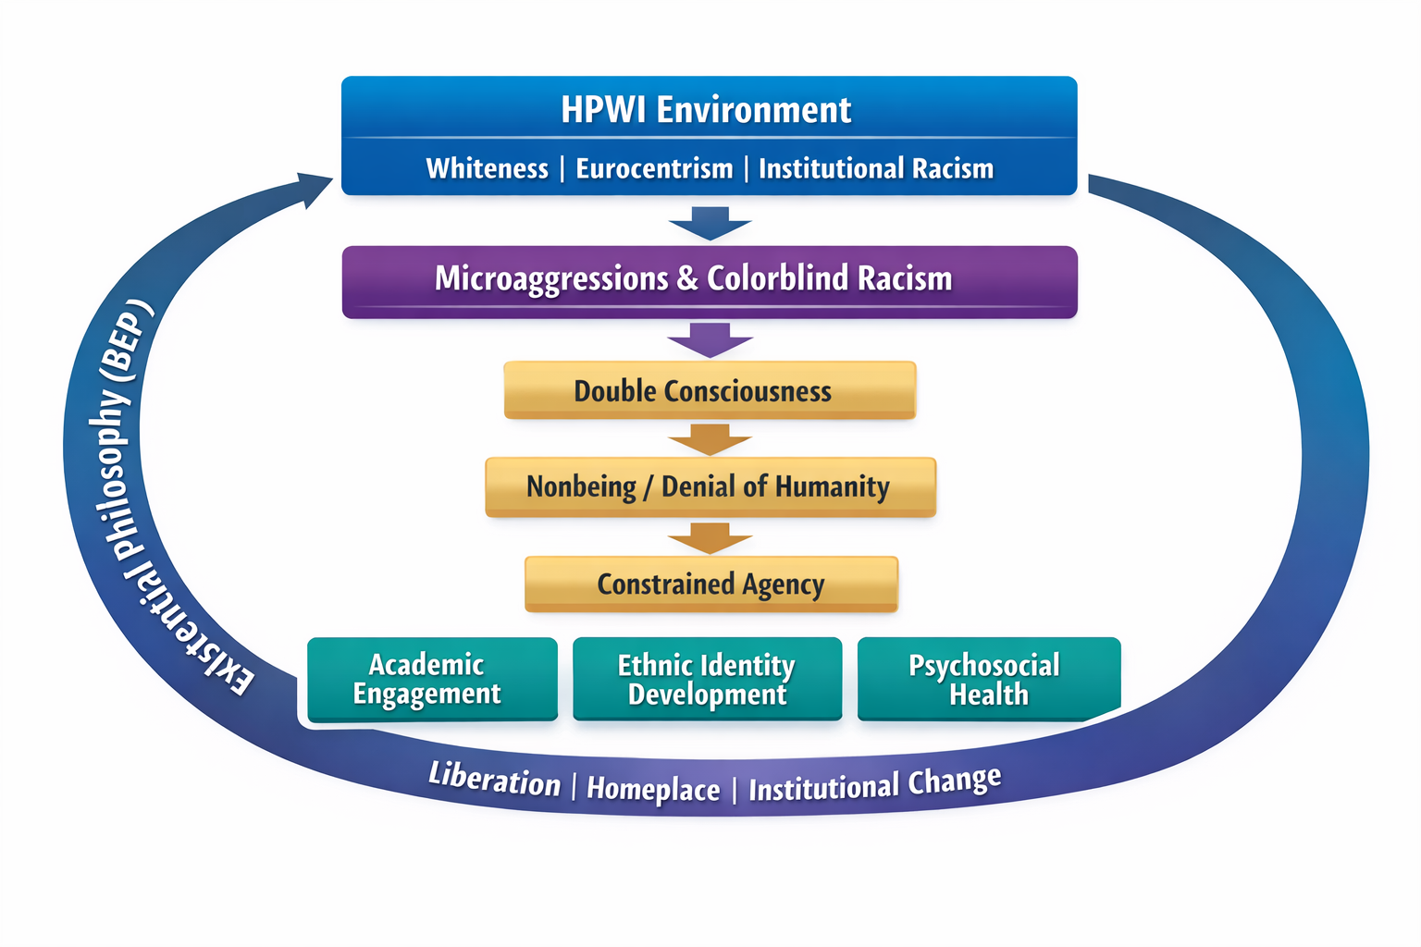
BLACK EXISTENTIAL PHILOSOPHY

Slide 7
REVIEW OF THE LITERATURE
Pierce, Solórzano, Spanierman, and Sue defined and refined the definition of microaggressions (Pierce, 1978; Solórzano, 2000; Spanierman et al., 2021 & Sue, 2007)
Williams’ contributions to microaggression research (Williams, 2020; Williams, 2021; Williams et al., 2020; Williams et al., 2021)
Affirmative Action and colorblind racism
Anti-microaggression research and attitudes
Notes:
SLIDE INSTRUCTIONS:
Briefly discuss 4-5 major studies/ideas
NOTE: Look at the sections of your Literature Review to determine the most important information to convey.
TIP: The start of your Literature Review will be the broader info, so when determining what to use, consider looking at later sections in the Literature Review, which are more specific.

Slide 8
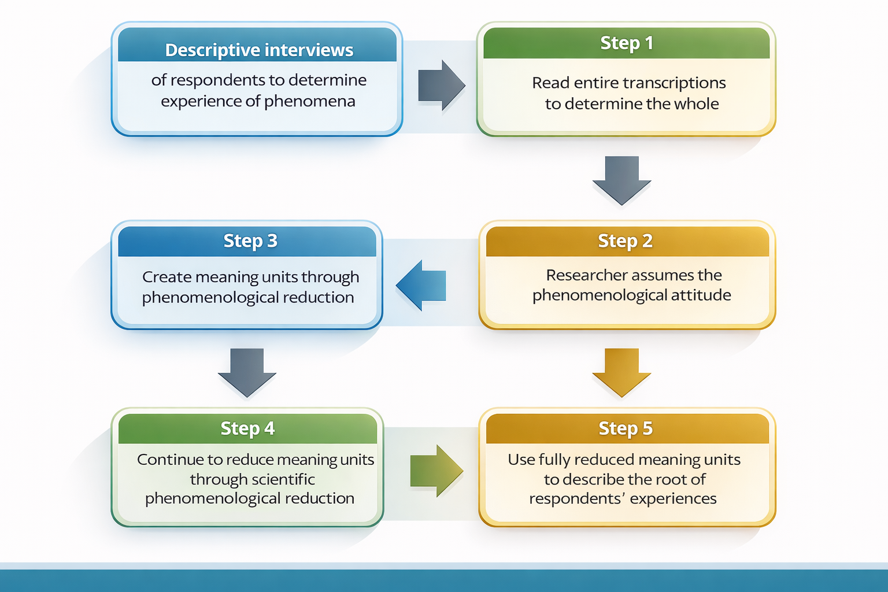
RESEARCH METHODOLOGY & DESIGN
Notes:
Descriptive interviews
This study employed descriptive phenomenology (DP) to examine Black college students’ lived experiences with microaggressions and colorblind racism at four-year public HWPIs. Grounded in Husserl’s (1965) philosophy, DP focuses on understanding how individuals experience phenomena within their lifeworlds. Rather than interpreting experiences through the researcher’s lens, DP prioritizes participants’ own descriptions, allowing the essence of the phenomenon to emerge (Giorgi, 2009).
Reading Entire Transcriptions
In alignment with Giorgi’s (2009) method, the first analytic step involved reading each interview transcript in its entirety to gain a holistic understanding of participants’ experiences. This process ensured immersion in respondents’ narratives before any segmentation or interpretation, allowing the researcher to remain grounded in the full meaning of each lived experience.
Adopting the Phenomenological Attitude
The researcher intentionally assumed a phenomenological attitude, engaging in bracketing to suspend personal assumptions, prior knowledge, and theoretical interpretations. This step was essential to ensure that the analysis remained focused on participants’ subjective realities rather than the researcher’s perceptions of racism or higher education environments (Giorgi, 2009).
Creating Meaning Units
Transcripts were then broken into meaning units using phenomenological reduction. Meaning units represent shifts in meaning within participants’ descriptions of experiences with microaggressions, colorblind racism, academic engagement, ethnic identity, and psychosocial well-being. At this stage, participants’ language was preserved to maintain fidelity to their lived experiences.
Scientific Phenomenological Reduction
Meaning units were further reduced through scientific phenomenological reduction, transforming everyday descriptions into psychologically and educationally relevant expressions. This step allowed the researcher to move from concrete examples (e.g., classroom interactions) to deeper structures of experience, such as belonging, marginalization, identity strain, and cognitive burden, while remaining grounded in participants’ accounts.
Describing the Essence of Experience
Fully reduced meaning units were synthesized to describe the essential structure of Black students’ experiences with microaggressions and colorblind racism at HWPIs. This final step captured the root of the phenomenon, illustrating how these experiences shaped students’ academic performance, ethnic identity development, and psychosocial health across institutional contexts (Giorgi, 2009).
Data Collection Alignment with DP
Data were collected through open-ended Zoom interviews lasting 1–1.5 hours, with each participant completing two interviews two weeks apart. This approach prioritized depth over sample size, a core principle of DP. Interviews were audio-recorded, securely stored, and transcribed verbatim to preserve participants’ voices and protect confidentiality (Khan & MacEachen, 2022). This method aligned with descriptive phenomenology by allowing meanings to emerge naturally from participants’ words rather than being imposed by the researcher.

Slide 9

POPULATION & SAMPLE
Target Population
Black college students at public 4-year HWPIs
Sample Size
3-5 participants (descriptive phenomenology)
Sampling Methods
Purposive and snowball sampling
Notes:
SLIDE INSTRUCTIONS:
Describe the population, including the estimated size and relevant characteristics.
A. Explain the appropriateness of the population for your research.
2. Describe the sample that was obtained.
A. Note the inclusion criteria (they should align with the population).
B. Explain how the sampling procedures aligned with the chosen design and method.
- For qualitative studies, evidence must be presented for data saturation achieved.
C. Note the recruitment efforts, including any obstacles.

Slide 10

POPULATION & SAMPLE
Inclusion Criteria:
Identified as Black
Attended public 4-year HWPIs
Experienced campus microaggressions
Notes:
SLIDE INSTRUCTIONS:
Describe the population, including the estimated size and relevant characteristics.
A. Explain the appropriateness of the population for your research.
2. Describe the sample that was obtained.
A. Note the inclusion criteria (they should align with the population).
B. Explain how the sampling procedures aligned with the chosen design and method.
- For qualitative studies, evidence must be presented for data saturation achieved.
C. Note the recruitment efforts, including any obstacles.

Slide 11

POPULATION & SAMPLE
Data Collection
Two 1–1.5-hour Zoom interviews per participant
Saturation Achieved: Recruitment continued until themes recurred
Notes:
SLIDE INSTRUCTIONS:
Describe the population, including the estimated size and relevant characteristics.
A. Explain the appropriateness of the population for your research.
2. Describe the sample that was obtained.
A. Note the inclusion criteria (they should align with the population).
B. Explain how the sampling procedures aligned with the chosen design and method.
- For qualitative studies, evidence must be presented for data saturation achieved.
C. Note the recruitment efforts, including any obstacles.

Slide 12
INSTRUMENTATION
Open-ended interviews
Five open-ended questions
1-1 ½ hours to complete
provided understanding of students’ lived experiences with microaggressions and colorblind racism at HWPIs.
Field tested by a National University expert educational research panel

Slide 13
National University Institutional Review Board (IRB) approval
recruited respondents through purposive and snowball sampling
Data collection was conducted through open-ended interview questions in 1-1.5-hour Zoom sessions, given respondents’ locations and availability. Each participant completed two interviews, scheduled two weeks apart.
STUDY PROCEDURES
Notes:
SLIDE INSTRUCTIONS:
1. Recap for your committee the exact steps you followed to collect the data.
NOTE: You want to provide enough detail that you can show others how the study can be replicated.

Slide 14
DATA ANALYSIS
Describe the strategies used to analyze the data.
Include any software used.
Use proper terminology in association with each design/analysis.
Notes:
SLIDE INSTRUCTIONS:
Describe the strategies used to analyze the data and any software used.
NOTE: Use proper terminology in association with each design/analysis.

Slide 15
LIMITATIONS
Describe the study limitations.
Remember to indicate what you did to mitigate these limitations.
For qualitative studies, consider the issue of trustworthiness and how the four aspects of trustworthiness were potentially threatened/limited, and how you mitigated these threats/limitations, if you were able.
Notes:
SLIDE INSTRUCTIONS:
1. Describe the study limitations.
NOTE 1: Remember to indicate what you did to mitigate these limitations.
NOTE 2: For qualitative studies, consider the issue of trustworthiness and how the four aspects of trustworthiness were potentially threatened/limited, and how you mitigated these threats/limitations, if you were able.

Slide 16
ETHICAL ASSURANCES
Confirm your study received IRB approval
You might want to just indicate the date you received approval on this bullet point
If your study had more than minimal risk to participants, discuss the relevant ethical issues and how they were addressed.
Explain how you kept participants anonymous (if you did) and information confidential.
Note how you have securely stored your data.
Discuss relevant issues you faced as a researcher, including biases as well as personal and professional experiences with the topic, problem, or context.
Present any strategies you used to prevent these biases and experiences from influencing the analysis or findings.
Notes:
SLIDE INSTRUCTIONS:
1. Confirm your study received IRB approval. You might want to just indicate the date you received approval on this bullet point.
2. If your study had more than minimal risk to participants, discuss the relevant ethical issues and how they were addressed.
3. Explain how you kept participants anonymous (if you did) and information confidential.
4. Note how you have securely stored your data.
5. Discuss relevant issues you faced as a researcher, including biases as well as personal and professional experiences with the topic, problem, or context. Present any strategies you used to prevent these biases and experiences from influencing the analysis or findings.

Slide 17
FINDINGS
NOTE: May have multiple slides listing key findings/results.
Research Question #
Address each research question. It is recommended that you do one research question per slide.
For each qualitative research question:
Note the themes for the research question and the meaning of each theme in the context of the research question.
Summarize the findings under each theme.
Provide a compelling/exemplary quote for each theme.
Notes:
SLIDE INSTRUCTIONS:
1. Address each research question. It is recommended that you only address one research question per slide.
2. For each qualitative research question:
A. Note the themes for the research question and the meaning of each theme in the context of the research question.
B. Summarize the findings under each theme.
C. Provide a compelling/exemplary quote for each theme.

Slide 18
COMPARISON OF RESULTS TO THE LITERATURE
Research Question #
Address each research question. It is recommended that you address one research question per slide.
Compare the results in light of existing research and framework. For a qualitative study, connect to the themes.
Discuss any factors that might have influenced the interpretation of the findings.
Describe the extent to which the findings are consistent with existing literature and your framework and provide potential explanations for unexpected or divergent results.
Notes:
SLIDE INSTRUCTIONS:
Address each research question. It is recommended that you address one research question per slide.
A. Compare the results per research question in light of existing research and framework (as discussed in Chapters 1 and 2). For a qualitative study, connect to the themes.
B. Discuss any factors that might have influenced the interpretation of the findings.
C. Describe the extent to which the findings are consistent with existing literature and your framework and provide potential explanations for unexpected or divergent results.

Slide 19
RECOMMENDATIONS (PRACTICAL APPLICATION)
Discuss recommendations for how your findings can be applied to practice and/or theory.
Support all the recommendations with at least one finding from the study and frame them in the literature you have reviewed.
Do not overstate the applicability of the findings.
Notes:
SLIDE INSTRUCTIONS:
Discuss recommendations for how the findings of the study can be applied to practice and/or theory.
Support all the recommendations with at least one finding from the study and the literature from Chapter 2.
NOTE: Be careful to avoid overstating the applicability of the findings.

Slide 20
RECOMMENDATIONS (FUTURE RESEARCH)
Based on the framework, findings, and implications, explain what future researchers might do to learn from and build upon this study. Justify these explanations.
Discuss how future researchers can improve upon this study, given the limitations as discussed in Chapter 3.
Explain what the next logical step is in this line of research.
Notes:
SLIDE INSTRUCTIONS:
1. Based on the framework, findings, and implications, explain what future researchers might do to learn from and build upon this study. Justify these explanations.
2. Discuss how future researchers can improve upon this study, given its limitations as discussed in Chapter 3.
3. Explain what the next logical step is in this line of research.

Slide 21
CONCLUSIONS
Provide strong, concise overarching conclusions as a summary focusing on the problem, purpose, and research questions.
From the discussion of the study findings, emphasize specifically how the findings of the study connect to your framework, practice, and to the literature, considering specifically the gap in the literature.
Present the main message of the entire study and concisely summarize the recommendations for future research.
Notes:
SLIDE INSTRUCTIONS:
Provide strong, concise overarching conclusions as a summary focusing on the problem, purpose, and research questions.
From the discussion of the study findings, emphasize specifically how the findings/results of the study connect to your framework, practice, and to the literature, considering specifically the gap in the literature.
Present the main message of the entire study and concisely summarize the recommendations for future research.

Slide 22

THANK YOU

Slide 23
REFERENCES
Marks, L. R., Schimmel-Bristow, A., Harrell-Williams, L. M., & Hargons, C. (2023). Racial discrimination and risky sex: Examining cognitive-emotional factors in Black college students. The Counseling Psychologist, 50(5), 594–621. https://doi.org/10.1177/00110000221092662
Mushonga, D. R. (2021). The glass is half full: The need to promote positive mental health in Black college students. Journal of College Student Psychotherapy, 35(4), 313-326
National Center for Education Statistics. (2024b). IPEDS Data Explorer. Retrieved June 13, 2024, from https://nces.ed.gov/ipeds/search/viewtable?tableId=36023&returnUrl=%2Fsearch
Williams M. T. (2020). Microaggressions: Clarification, evidence, and impact. Perspectives on psychological science: Journal of the Association for Psychological Science, 15(1), 3–26. https://doi.org/10.1177/1745691619827499
Williams M. T. (2021). Microaggressions Are a Form of Aggression. Behavior Therapy, 52(3), 709–719. https://doi.org/10.1016/j.beth.2020.09.001
Williams, M. T., Skinta, M. D., Kanter, J. W., Martin-Willett, R., Mier-Chairez, J., Debreaux, M., & Rosen, D. C. (2020). A qualitative study of microaggressions against African Americans on predominantly White campuses. BMC psychology, 8(1), 111. https://doi.org/10.1186/s40359-020-00472-8
Williams, M. T., Skinta, M. D., & Martin-Willett, R. (2021). After Pierce and Sue: Evidence for a revised racial microaggressions taxonomy. Perspectives on Psychological Science, 16(5), 991-1007. https://doi.org/10.1177/1745691621994247
Notes:
SLIDE INSTRUCTIONS:
Put your references in alphabetical order on the slides. Will require more than one slide.
NOTE: Include only the references that apply to your slides. For a full list of references, readers should consult your Dissertation Manuscript.

