Slide 1

NEWGATHE: A NEW NURSING THEORY OPEN EDUCATIONAL RESOURCE (OER)
Helda Pinzón-Pérez, Ph.D., RN, FNP
CC BY-NC-ND 4.0

Slide 2
No title
This presentation discusses a proposed new nursing theory “NEWGATHE-Nursing Empowerment for Wellness Global Advocacy Theory”
How this theory responds to gaps in addressing global issues by incorporating concepts such as advocacy, empowerment, equity in health, and wellness as core elements in nursing practice

Slide 3
No title 2
This presentation also includes an analysis of the role of Nurse Practitioners (NPs) and Doctor of Nursing Practice (DNP) professionals in the NEWGATHE theory
Inter-professional and Inter/Cross-disciplinary approach

Slide 4
ROLE OF NURSE PRACTITIONERS
*International Council of Nurses-- International Council of Nurses (ICN) | ICN - International Council of Nurses
* The American Association of Nurse Practitioners-- AANP | The American Association of Nurse Practitioners
* American Nurses Credentialing Center-- American Nurses Credentialing Center (ANCC) | ANA
* American Nurses Association- Join the American Nurses Association | ANA
National League for Nursing-- NLN Home

Slide 5
U.S. NP Practice Authority
Growing independence
Growing demand
Specialty and sub-specialty practice
American Association of Colleges of Nursing-- AACN: American Association of Colleges of Nursing

Slide 6
NURSE PRACTITIONERS AT THE INTERNATIONAL LEVEL
International Council of Nurses’ (ICN) International Nurse Practitioner/Advanced Practice Nursing Network (INP/APNN) -- NP/APN Network | ICN - International Council of Nurses
Education, practice, research, health policy, communications, and fundraising
Research initiatives
Global Education

Slide 7
DNP Doctor of Nursing Practice

Slide 8
No title 3
American Association of Colleges of Nursing (AACN)–
What is the Doctor of Nursing Practice (DNP) and Fact Sheet-DNP- AACN Fact Sheet - DNP
Report on Doctor of Nursing Practice Education-- AACN Issues New Report on Doctor of Nursing Practice Education

Slide 9
The "Nursing Empowerment for Wellness Global Advocacy Theory-NEWGATHE”
Is a new theoretical model for the integration of the health promotion and nursing in zones affected by conflict and war.
Nursing theories & Health Promotion theories have guided our professional practice.
Their seminal work has served as the basis for our understanding of our profession.

Slide 10
No title 4
NEWGATHE is embedded in a paradigm of evidence-based practice with international and global perspectives.
The methodology used involved the development of a logic model and consultation with academic faculty with expertise on nursing and health promotion theory.
This graduate NP project was developed based upon cultural considerations proposed by professional organizations in nursing and health promotion.

Slide 11
Concepts
Globalization
Internet
Advocacy
Health policy
Nursing and Health Promotion/Health Education
Expanding role
Emerging Technologies- Artificial Intelligence

Slide 12
Nursing Empowerment for Wellness Global Advocacy Theory (NEWGATHE)

Slide 13
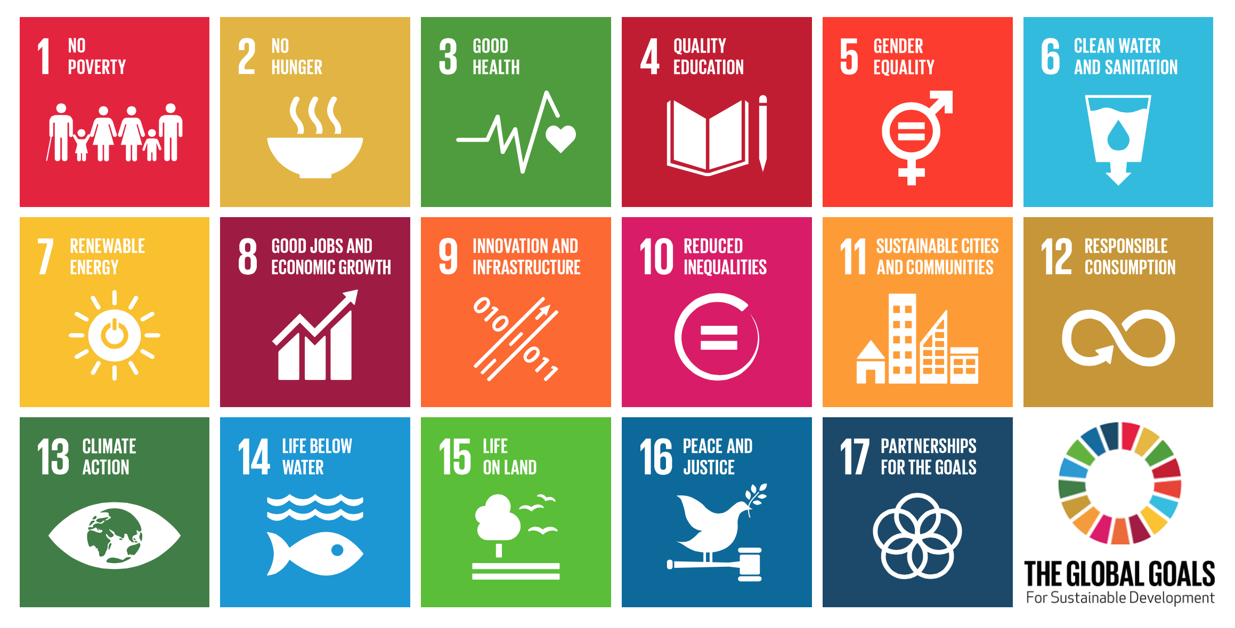
EQUITY IN HEALTH--U.N. SUSTAINABLE DEVELOPMENT GOALS Source: https://sdgs.un.org/goals

Slide 14
Public Health and The NP/DNP Role
Closely related
Public health duties in NP and DNP practice
Education
Wellness
Prevention
Health Promotion

Slide 15
PREVENTION
U.S. Preventive Task Force
https://www.uspreventiveservicestaskforce.org/
Recommendations for Primary Care Practice
https://www.uspreventiveservicestaskforce.org/Page/Name/recommendations

Slide 16
Social Determinants of Health
Social Determinants of Health - Healthy People 2030 | odphp.health.gov
Very relevant to the NP and DNP roles
Integrating Social Determinants of Health into Nurse Practitioner Education Through a Faculty Enrichment Initiative - PubMed

Slide 17
Examples of Applications
Vulnerable Communities in The US
International/Global Communities
Communities affected by conflict and war
Need for more RNs, NPs/APRNs/DNPs

Slide 18
Case Studies- Applications
A Nurse Practitioner (NP) is asked to provide professional services in a zone affected by war. Resources are very scarce and considerations such as safety for the NP and the clients are a priority.
Discussion Questions:
How does the role of NPs vary in zones affected by war?
How can NEWGATHE be used as a framework for practice in this case?
What local and international resources can be used by NPs providing services in regions affected by war?

Slide 19
Case Studies- Applications Continued
A Doctor of Nursing Practice (DNP) working with a global health care organization is asked to design a health promotion program for a vulnerable community in a zone affected by war.
Discussion Questions:
How can NEWGATHE be used as a framework for the design of a health promotion program in this case?
What policy considerations need to be taken into account by the DNP professional in this case?
How can the DNP maximize the effectiveness of the limited resources in this case?

Slide 20
Case Studies- Applications Continued…
A Nurse Practitioner is working with a vulnerable population in a rural area of The US.
Discussion Questions:
How can NEWGATHE be used as a framework for the services provided by the NP in this case?
What Social Determinants of Health should be taken into consideration in this case?
How can the concepts of advocacy, cultural humility, and interdisciplinary/cross-disciplinary work be applied in this case?

Slide 21
Acknowledgements
Special gratitude to
National University- OER Grant
Dr. Keitha Mountcastle- Project Chair
California State University, Fresno- My graduate NP Training

